Slide 1
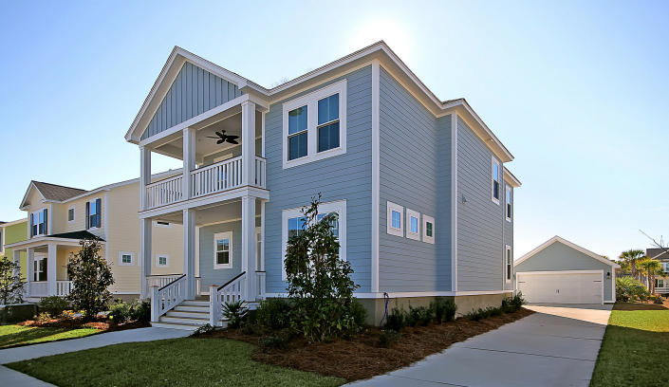

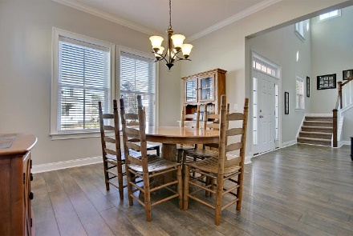
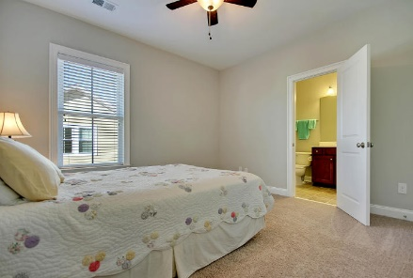
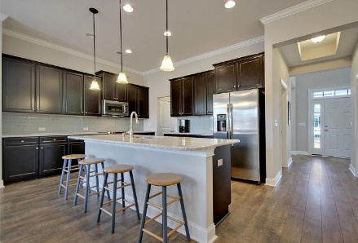
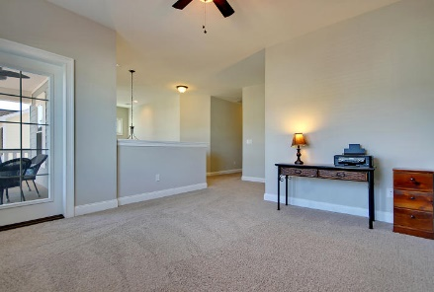
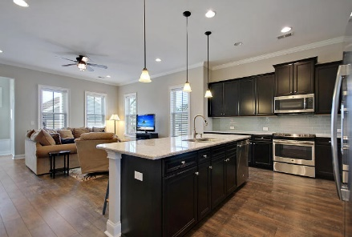
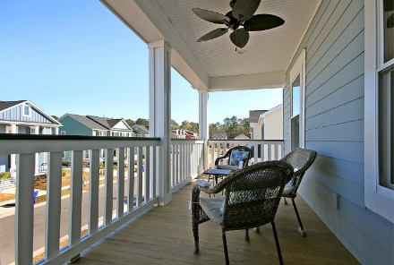
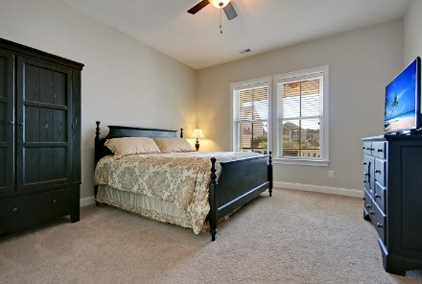
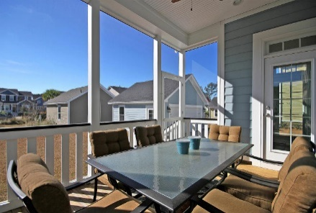
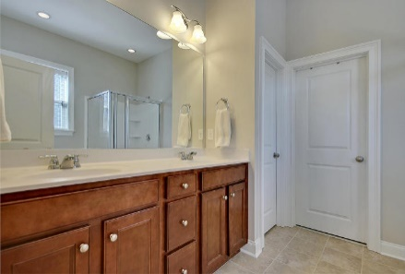
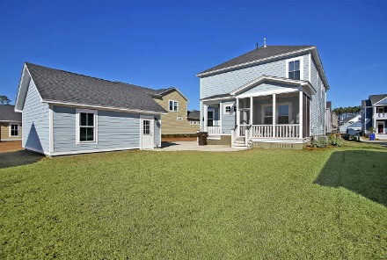

Parkshore Marshfront
Like New in
Carolina Park
1487 Hollenberg Ln ~ Mt Pleasant ~ MLS# 16002569 ~ $475,000
Better than new!
Less than one year old, this unbelievable 4BR, 3.5BA, 2CG Charleston Single shows like a model! The front porch leads into the dramatic two story foyer w/lots of windows to let the light pour into this open floor plan. The kitchen features Silestone counters, a center island with breakfast bar, SS appliances and subway tile backsplash. The first floor owners retreat boasts an en-suite with a walk-in closet, dual vanity, walk-in shower and relaxing garden tub. On the 2nd floor are 3 bedrooms, 2 baths and a media room and a loft with access to the balcony. Yet another space to enjoy the outdoors is the screened-in porch. Walking trails, a sparkling swimming pool and tennis courts are among some of the great amenities found in this community. Why wait 8 months for a new build
Additional features include:
High ceilings
Recessed lighting
Transom windows in the dining room
Crown molding and baseboard molding
Book your showing today!
Call or email for details: (843) 654-7777 or Ben@MattOneillTeam.com

