Slide 1
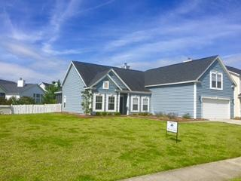
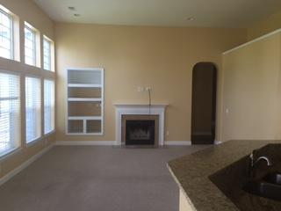
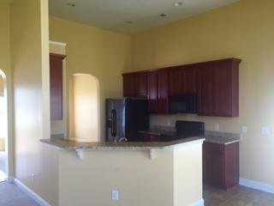
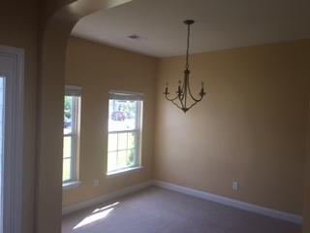


Selling Agent Bonus!!
148 Back Tee Circle
Legend Oaks Plantation
Summerville, SC 29485
MLS# 15013671
$217,900
$1,000 Bonus to Agent
with Closing by July 31, 2015
Beautiful home in the sought after Legend Oaks !! Bonus almost a double lot, Great floor plan Three bedrooms with a 4th/office above the double garage. Fenced yard with screened patio and view of the pond at your back door. Golf course community! Eat in kitchen with gas fireplace opens to the great room. Garden tub in the master bath with huge walk-in closets. Hurry!!
Stephen Woodard
Mobile - (843) 327-1600
CharlestonYacht@gmail.com
www.charlestonhome4you.com
Brand Name Real Estate
4 Carriage Lane Suite 106
Charleston, SC 29407

