Slide 1
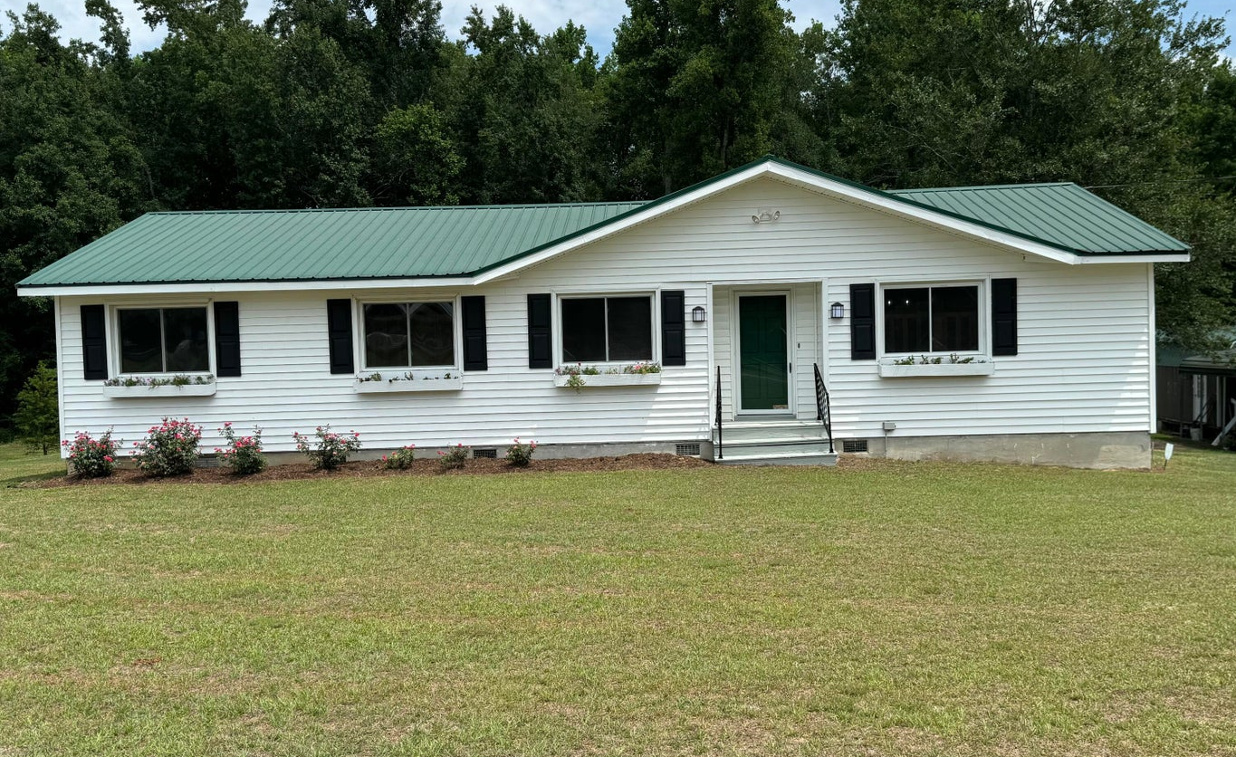
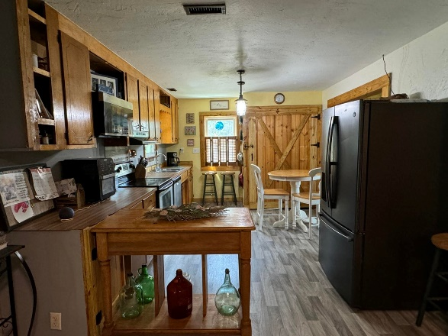
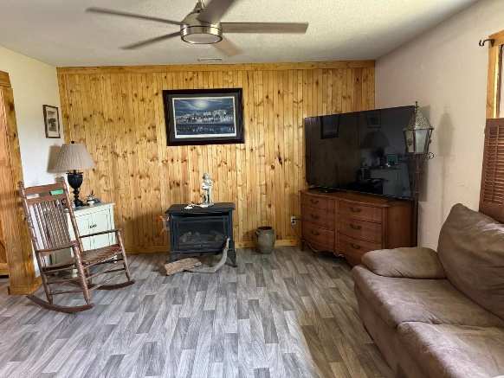
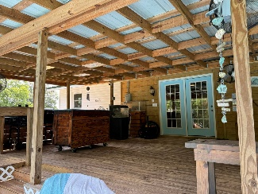
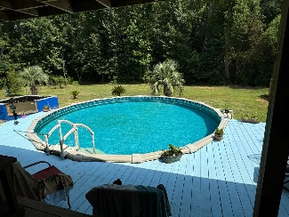
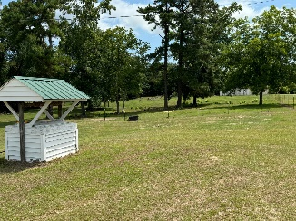
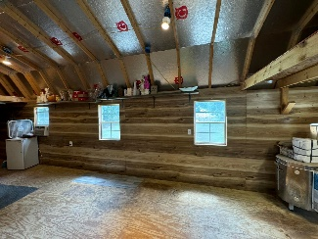


PLENTY OF SPACE INSIDE & OUT
148 Cascade Drive
Bowman, SC 29018
MLS# 24017942
NEW PRICE! $335,000
CHARLESTON SINGLE STYLE HOME
4 BEDS/2.5 BATHS/LOFT
MASTER BEDROOM DOWN
YARD W/PRIVACY FENCE
HARDIPLANK SIDING
HOME ONLY 2 YEARS OLD
QUARTZ COUNTERTOPS
STAINLESS APPLIANCES
REFRIGERATOR INCLUDED
COVERED PORCH
PERFECT JOHNS ISLAND LOCATION
1 MILE FROM SEVERAL RESTAURANTS/SHOPS
BLINDS AND WASHER/DRYER INCLUDED
LESS THAN 10 MILES TO DOWNTOWN CHARLESTON
12 MILES TO KIAWAH OR FOLLY BEACH
THIS WONDERFUL 4 BEDROOM AND 2 BATH HOME ON 2 PEACEFUL ACRES HAS CARPORTS FOR 6 CARS AND AS WELL AS GREENHOUSE, POOL HOUSE AND WORKSHOP/SHED. INSIDE THE HOME, PLEASE VIEW THE AMAZING WOODWORK ON THE LAUNDRY AND THE KITCHEN CLOSET/STORAGE ETC. ENJOY THE LARGE BACK DECK WITH ELECTRIC, WATER AND 5 CEILINGS FANS OVER-LOOKING ABOVE GROUND POOL AND MATURE LANDSCAPING. THE PRIMARY SUITE HAS OUTISDE ACCESS TO LARGE BACK DECK FOR MIDNIGHT SWIMS OR TO ENJOY THE MORNING COFFEE RIGHT OUTSIDE THE MASTER BEDROOM. THIS PROPERTY HAS A GENERATOR IF ELECTRICITY IS INTERRUPTED. RECENTLY THIS PROPERTY HAS SOME NEW PAINT, SOME NEW FLOORING, WOODWORK AND PRESSURE WASHING. THIS PROPERTY WILL NOT LAST LONG. MAKE YOUR APPOINTMENT TODAY. BUYERS AND BUYERS AGENTS PLEASE VERIFY ALL INFORMATION OF IMPORTANCE.
Carla Davis
843-437-4873
gaweber@tds.net
Adler Realty
518 Parrot Point Dr
Charleston, SC 29412
www.adlerrealtychs.com

