Slide 1
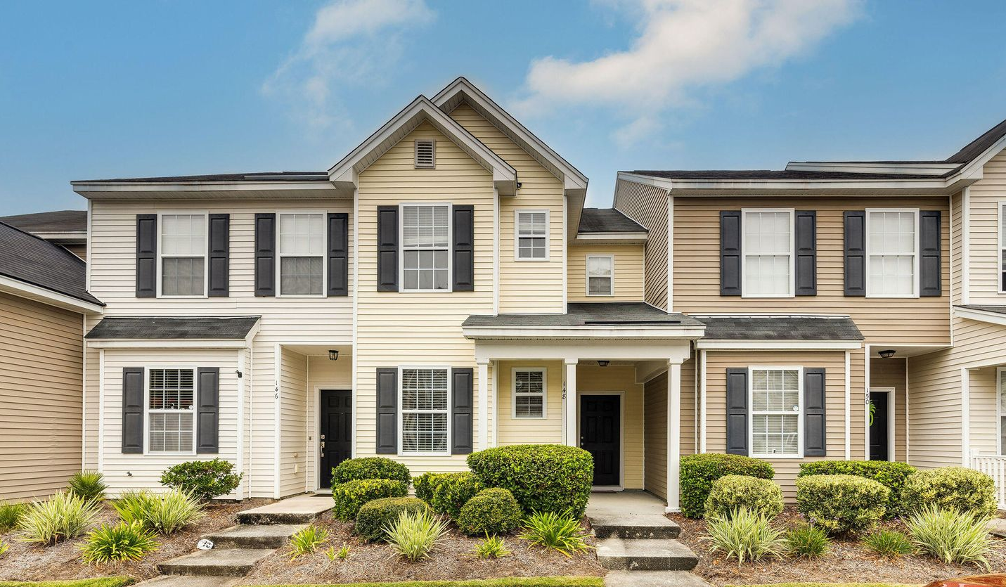
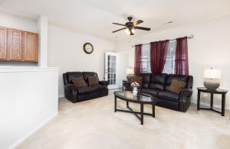
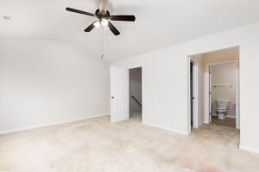
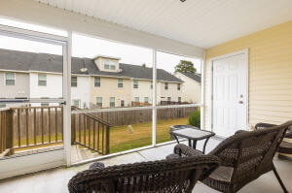

Back on Market!
148 Woodward Road
Liberty Hall Plantation
Goose Creek, SC 29445
MLS# 22027857
$245,000
Welcome to Liberty Hall Plantation! This beautiful townhome is centrally located in Goose Creek, with neighborhood walking trails and pool. On the first floor of the home, you will find kitchen that opens into the living room, pantry, full bathroom, and a front bedroom that could also be a great office. Up the stairs, the owner suite features a vaulted ceiling, walk-in closet, extended vanity, and large windows offering plenty of natural light. The second floor also has an additional bedroom, a full bathroom, and the laundry room. This home also features wall-to-wall carpet and ceramic tile throughout. You'll love spending evenings relaxing in your new screened-in porch after an enjoyable day at the neighborhood pool!
Buyer’s financing fell through due to employment changes, no fault of seller.
Kelly Snyder
843-457-5951
kelly.snyder@agentownedrealty.com
Greg Gelber
843-494-2354
greg.gelber@agentownedrealty.com
AgentOwned Charleston Group | 902 Savannah Hwy | Charleston, SC 29407-7802

