Slide 1
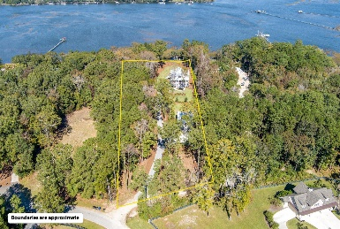
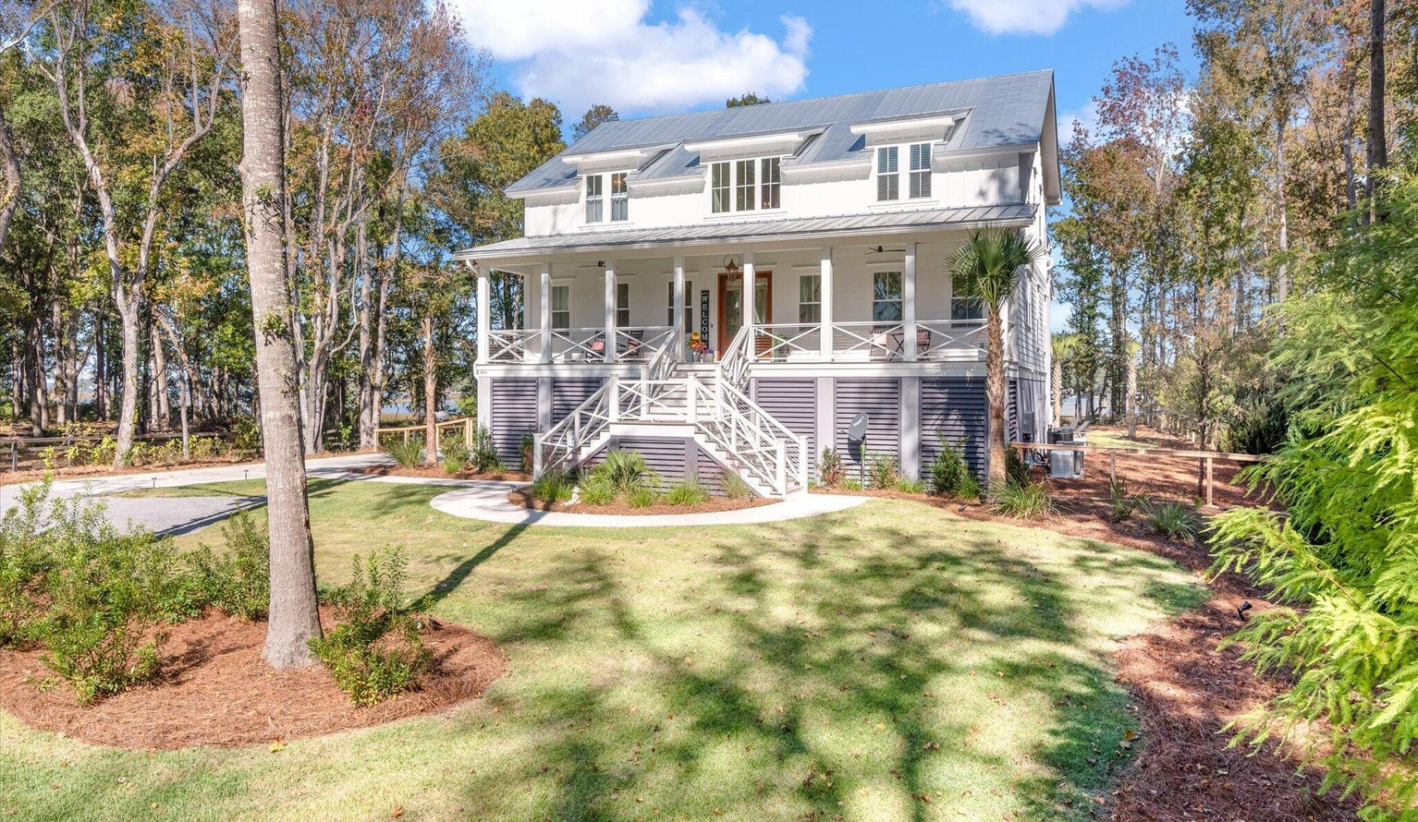
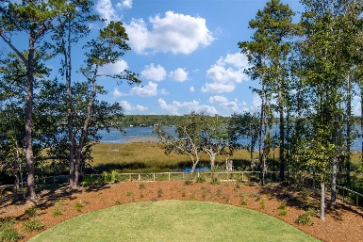
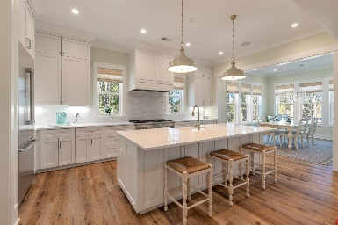
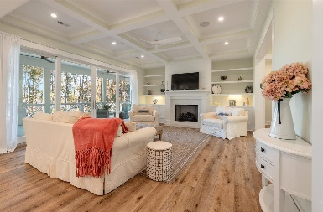
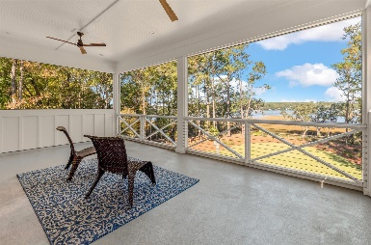
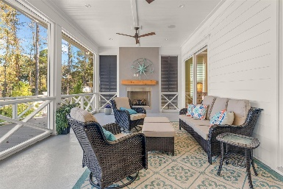
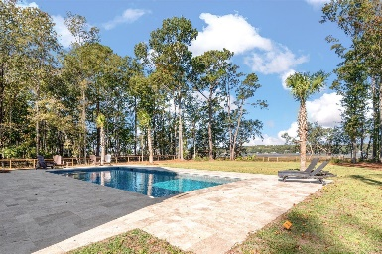


1490 Old Rosebud Trail
Pepper Plantation · Mount Pleasant, SC 29429
MLS# 23025127 · $3,700,000
Significant Price Reduction
Luxury Property in Mount Pleasant
This gorgeous riverfront home is next to new! This luxury estate includes a main house and a guest cottage that sits on 2.5 acres of land with amazing views of the Wando River. As you enter the main house you walk into a beautiful foyer space. To the left is an office with built in shelves and cabinetry that could be a second main floor bedroom or even a den or playroom, man cave, etc. Then back into the foyer head straight back and you enter into a spacious family room where you will immediately notice the views of the Wando River. The family room is spacious with a coffered ceiling and it has a lovely gas fireplace. To the left is the open kitchen with a huge island that boasts fresh and modern pedant lights, custom cabinetry, and Thermador 6 burner gas range with a griddle and double ovens. There is a beautiful tile backsplash, under cabinet lighting and a built in Thermador refrigerator. Off of the kitchen is a huge pantry with custom wood shelving. Also off of the kitchen towards the back of the home is a huge breakfast area with a gorgeous chandelier. As you sit in the space eating your meals you can enjoy gorgeous views of the river. To the left of the breakfast area is a large screened in porch which is the perfect spot to enjoy the amazing Lowcountry weather. It is also perfect for chilly nights because it has a gas fireplace! Back inside the home just beyond the family room is one of the 2 master bedrooms in the main house. The master also includes views of the Wando River and has a large en suite bathroom with a dual sink vanity, a walk in tiled shower and a luxury soaking tub. Upstairs there are 3 large bedrooms. One is another master bedroom complete with a walk in closet, walk in tiled shower, dual vanities and a soaking tub. The middle bedroom could also be used as a media room, man cave or a bedroom. Off of the middle bedroom is a third floor porch that is a great spot to sit and enjoy the riverfront views. The bedroom to the right has a door that leads to the secondary bathroom that is also connected to both the bedroom and the hallway so that both the middle and the right bedroom have access to it. The laundry room is just off of the hall and it is huge! It includes a utility sink, tons of cabinetry and counter space and it has a closet for extra storage. Down at the floor level is a beautiful mother-in-law suite complete with its own living area, full kitchen and laundry room. Also on the floor level is another living area that could be a recreation room just off of the patio that leads to the pool area. The pool is both heated and cooled and it also has a spa and a retractable pool cover to protect the pool when not in use. The back portion of the lot is fully fenced in with a living fence as to not obstruct the river views. And the home has a built in speaker system that plays in the kitchen, family room, back second floor screened-in porch and the pool area. The existing elevator services all three floors in the home as well. The main house has a 3 car garage that is epoxied and offers ample storage as well. There is a whole house generac generator, a security camera and the yard comes complete with lawn irrigation with a separate water meter. There is also solar lighting in the yard as well. The guest cottage boasts 850 square feet of heated and cooled living space. It has one bedroom with a shower, tub and a nice sized walk in closet. It also boasts a gourmet kitchen, a family room and a half bath. There is a 2 car garage under the cottage and a full front porch, a screened in porch off of the back and a covered patio underneath. It has its own address and therefore its own electric and water meters and mailbox. This home also has an option to build a barn or storage building if the buyer so desires. Eastech Property Development was the builder for this luxury property and is known as one of the top builders for quality construction in the area. This home is just minutes away from the heart of Mount Pleasant and is a short drive to the area beaches, Towne Center, downtown Charleston and to the area schools.
Enjoy the virtual tour!
Carey Nikonchuk
(843) 276-1701 M
cnikonchuk@gmail.com
www.brennamangroup.com

