Slide 1
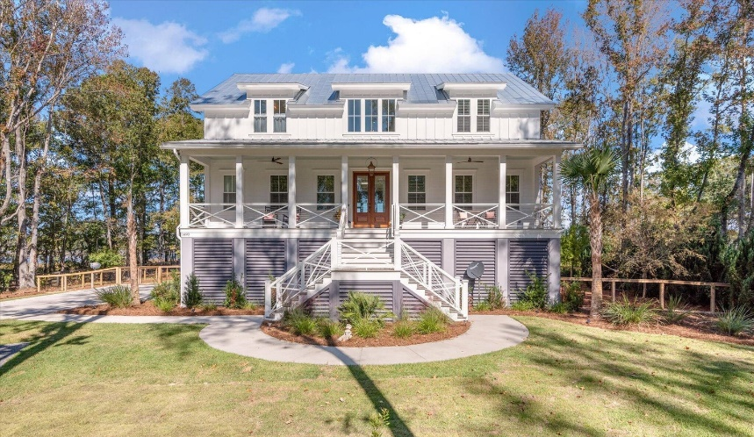
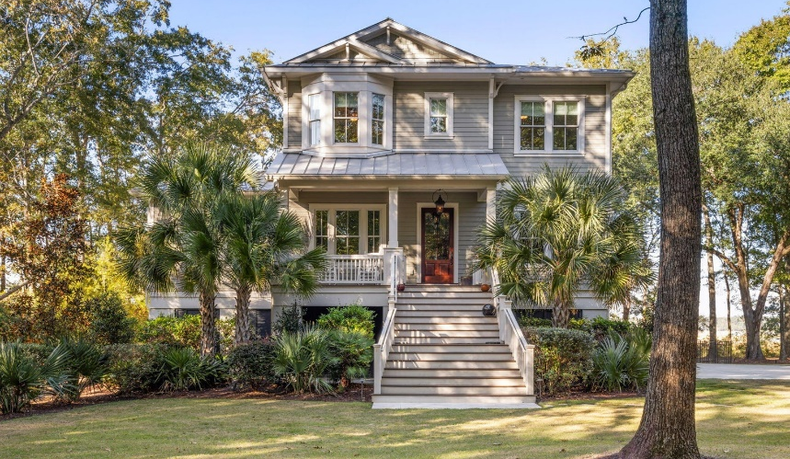
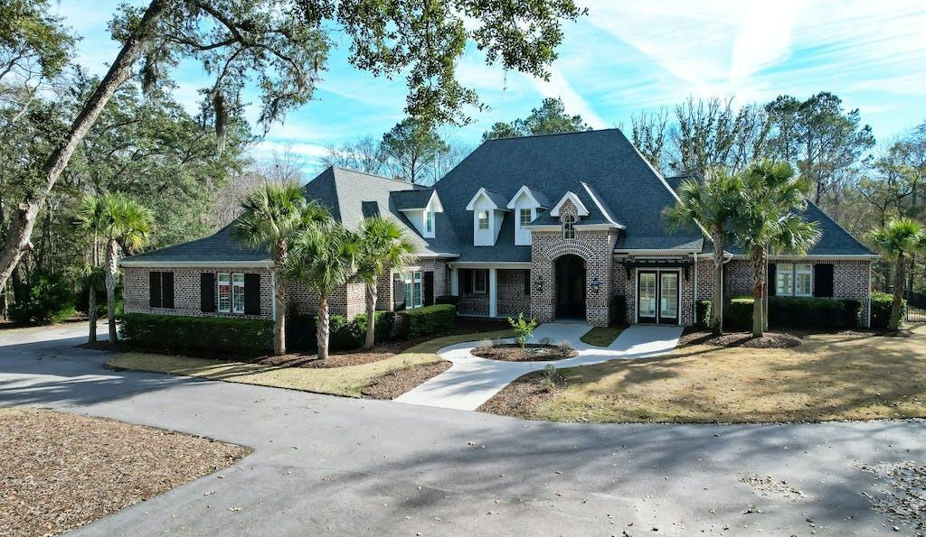


1490 Old Rosebud Trail
Listed at $3,850,000
Carey Nikonchuck | The Brennanman Group 843.276.1701 | cnikonchuk@gmail.com
Pepper Plantation Multi-Listing Open House
Thursday February 15th from 11-1
Agents here's your chance to bring your buyers to 3 incredible homes in the ultra-private, gated community of Pepper Plantation.
1490 Old Rosebud Trail this luxury estate includes a 7 bedroom, 7 bath main house and a guest cottage, plus private pool and sits on 2.5 acres of land with amazing views of the Wando River.
1510 Old Rosebud Trail offers panoramic views of the Wando River. This 3 acre, private retreat with 5 bedroom, 5 bath is nestled in a cul-de-sac with expansive views of the Wando River,
3595 Thunder Gulch Trail this breathtaking and meticulously maintained, 6-bedroom, 4.5-bath residence includes a backyard oasis with expansive patio with gas fireplace, grill, sink, and an additional beverage fridge. Step further to discover a pool with a beach walk-in.
This highly sought after community of approximately 41 lots of custom built homes, many with pastures and barns. The neighborhood offers a training track w/grass infield for grazing, a riding trail within the neighborhood and a Pavilion overlooking a 10+acre freshwater lake.
1510 Old Rosebud Trail
Listed at $3,400,000
Patty Scott | Luxury Simplified Real Estate
843.814.2400 | pattys@luxurysimplified.com
3595 Thunder Gulch Trail
Listed at $3,895,000
Clay Cunningham | Carolina One Real Estate
843.345.4647 | clay@carolinaone.com
Carey Nikonchuk
(843) 276-1701 M
cnikonchuk@gmail.com
www.palmettoproperty.net

