Slide 1
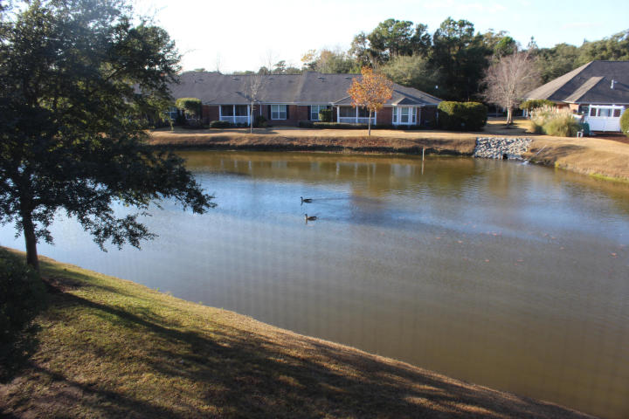
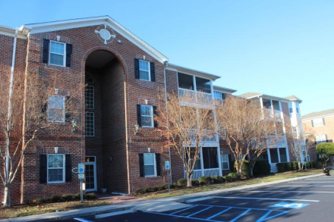
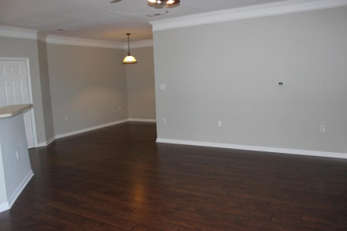
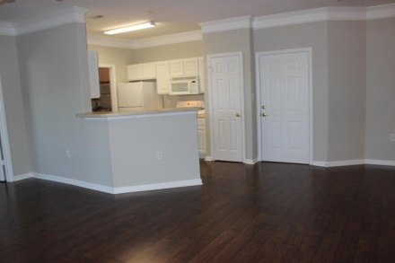
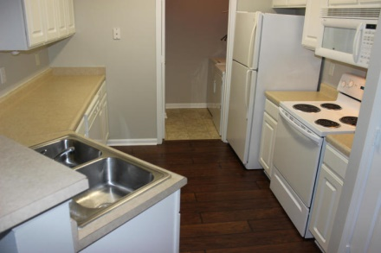
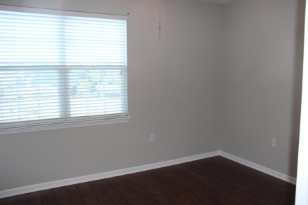
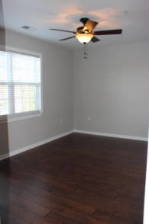
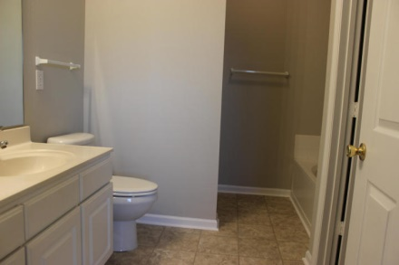
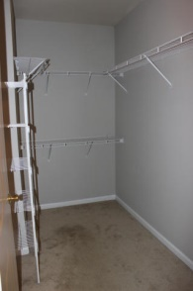
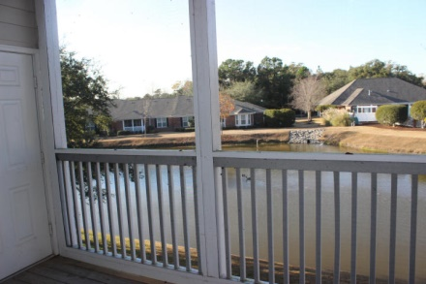


1493 Cambridge Lakes Drive Cambridge Lakes ~ Mount Pleasant MLS# 14030851 ~ $182,500
Beautifully updated with dark wood 4'' laminate in the living/dining room combo as well as in all the bedrooms. New vinyl in the bathrooms. Fresh paint in the stylish grey family throughout the condo. The washer, dryer and refrigerator are working and convey in ''as is'' condition at the time of closing. Window blinds are already in place. All this condo needs is YOU to complete it. There is a screened porch to enjoy the wonderful Charleston weather. As you know, Cambridge Lakes is in Midtown Mount Pleasant offering you access to almost every corner of Mount Pleasant in just minutes. With I-526 quick access, you can be anywhere in the Metro Charleston area easily. Remember the safety at Cambridge Lakes with its locked entrance to the building and the luxury of an elevator.
Kay Kennerty MBA, ABR, CRS, GRI
843-345-5011
Kay@agentownedrealty.com
www.KayKennertyHomes.com
The AgentOwned Realty Company
824 Johnnie Dodds Blvd
Mt. Pleasant, SC 29464

