Slide 1
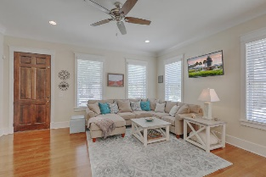
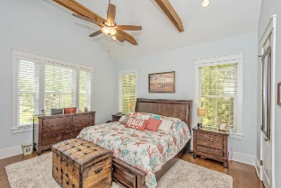
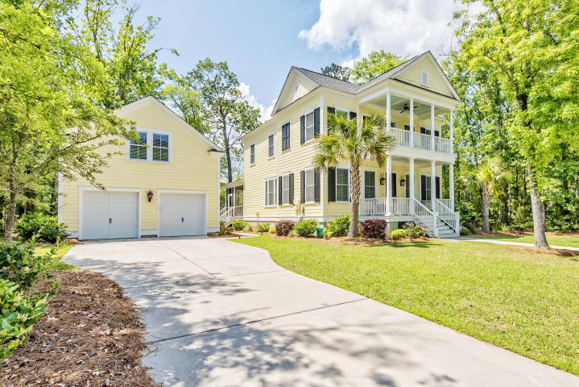
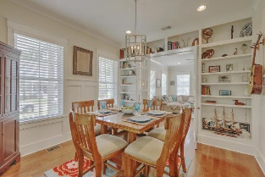
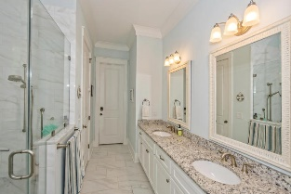
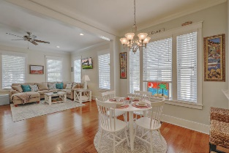
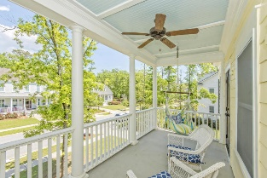
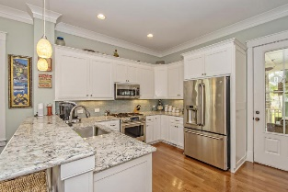
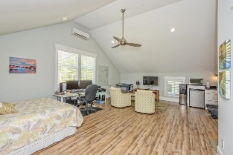
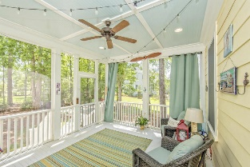
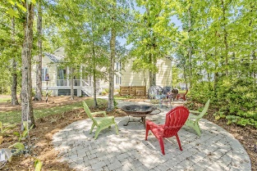


The Best Deal in the Riverside of Carolina Park
1493 Gunnison Street
Carolina Park | Mount Pleasant
MLS# 17010629 | $675,000
Welcome To 1493 Gunnison Street, Located In The Highly Desired Riverside Section Of Carolina Park. This Charming Lowcountry Home is Extremely Clean And Sure To Please. This House Has An Open Floor Plan With 5 Bedrooms, 3.5 Bathrooms, Beautiful Oak Floors, 8' Solid Doors, and 10' Ceilings With Extensive Trim Work. The Kitchen Has Beautiful Quartz Countertops and Stainless GE Cafe Appliances. The First Floor Master Bedroom Has A Vaulted Beamed Ceiling, Access To The Backyard Screened In Porch, En-Suite Bathroom With Custom Shower, Dual Sinks And A Huge Walk-In Closet. There Is An Additional 530sqft of Heated/Cooled Living space above the Garage That Has a kitchenette with Granite Countertops And A Full Marble Tiled Bathroom That Could Be Used As a Guest House, Office, Mother-in-Law-Suite or Studio. This house is a must see!
Located about 10 minutes from Isle of Palms and Towne Centre, and only 20 minutes from Downtown Charleston. Carolina Park offers a truly remarkable living experience. Residents enjoy the comforts of thoughtfully designed neighborhoods along with abundant recreation space, an array of amenities & a convenient coastal location. Carolina Park provides residents with a true sense of community, with its convenient Mt. Pleasant location, abundant natural beauty, friendly neighbors and endless array of amenities and conveniences, Schools are within walking or bike riding distance, neighbors share conversations on wide front porches, and opportunities for relaxation and recreation are around every corner. Drive your golf cart to the Jr. Olympic Size swimming pool or to the new soon to be built Charleston County 40,000 sq.ft. library! Carolina Park was designed with a network of miles of pedestrian walkways along attractive streetscapes so that residents can enjoy spending time outdoors. This house is a must see!!
Todd McKenna
(843) 870-8110
todd@toddmckennarealestate.com www.SoldWithTodd.com
Brand Name Real Estate
4 Carriage Lane Suite 106
Charleston, SC 29407

