Slide 1
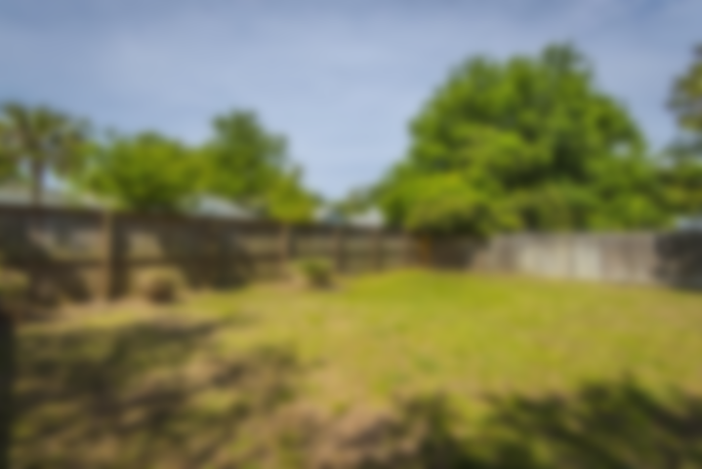
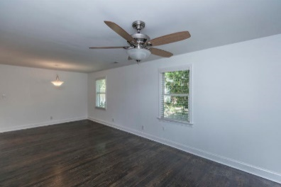
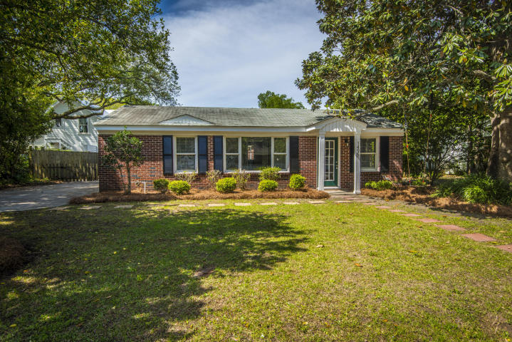
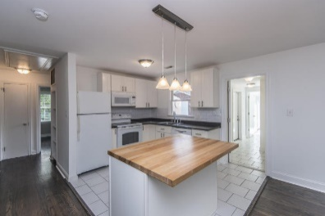
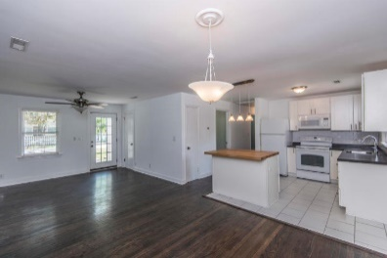
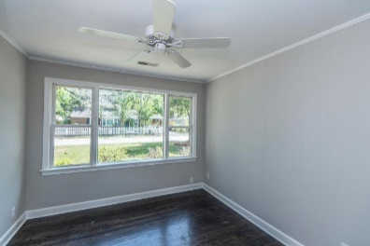
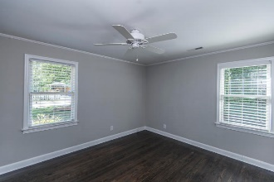
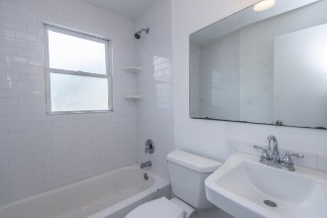
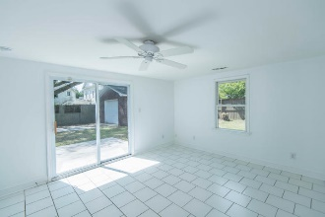
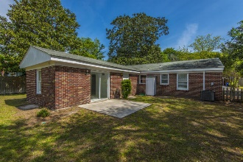
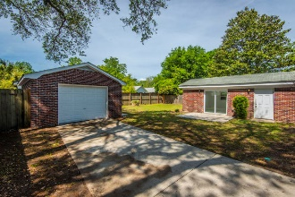



1495 Indian Street
Old Mt Pleasant ~ Mount Pleasant, SC 29464
Great Value – Old Mt. Pleasant – Just Reduced!
Unbeatable location in the prime of Mount Pleasant's Old Village! This low maintenance, all brick, single story ranch style home has been completely renovated and updated with modern finishes and conveniences! You'll love the bright and cheery feel as soon as you step into this little gem. Dark hardwood floors contrast beautifully with the crisp walls and natural light in the generously sized living area which is open to the updated kitchen.
Hop in a golf cart or on your bikes and head to one of the many popular restaurants on Shem Creek. The location of this home simply can't be beat! In the heart of the Old Mount Pleasant, you are mere minutes to the beaches of Sullivan's Island, the shops, entertainment and restaurants of the Coleman Blvd corridor as well as the world-class offerings of historic downtown Charleston.
Asking $560,000
MLS# 18011920
1,420 SqFt
4 Bed/2 Baths
Short Drive to Historic Downtown Charleston & Beaches
Don Dawson
843-514-0452
ddawson@carolinaone.com
Carolina One Real Estate • 2713 Highway 17 North • Mount Pleasant, SC 29466
www.TeamDawsonSC.com

