Slide 1
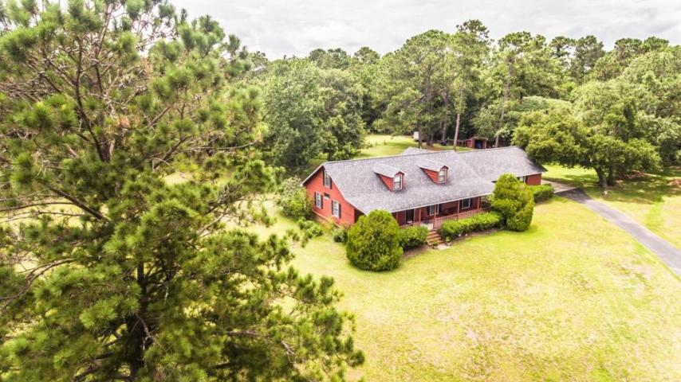
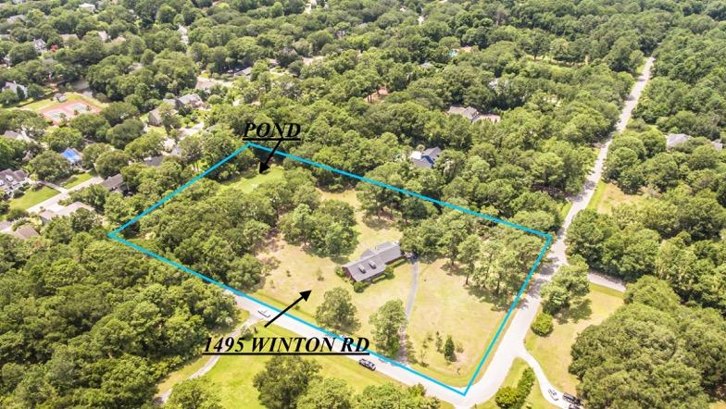
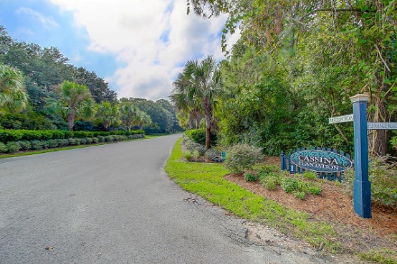
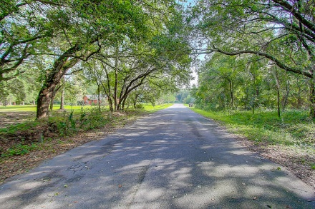

1495 Winton Road Mount Pleasant ~ MLS# 17017991 ~ $1,362,500
3.67 Acres Cassina Plantation Open House This Weekend!
Saturday & Sunday From 2-5pm
3.68 ACRES, of Prime property in the heart of Mt Pleasants, Cassina Plantation where all the home sites are at least 2 acres or more ! This best kept secret is nestled just off Rifle Range Rd, and convenient to both Isle of Palms and Sullivans Island beaches, downtown Charleston and central to everything in Mount Pleasant! This charming 2500 sq ft home is located on an expansive 3.68 acres land which includes a pond as well holds all the opportunity for expansion as well an additional dwelling to be built on the property should you choose to bring the entire family! Neighborhood horse trails throughout!
Chip Streeter
(843) 300-8797
chip.streeter@cbcarolinas.com
Coldwell Banker Residential Brokerage 1127 Queensborough Blvd Mount Pleasant, SC 29464

