Slide 1
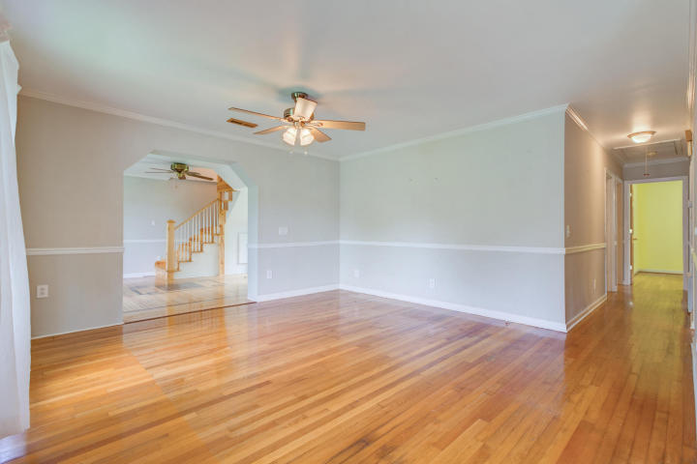
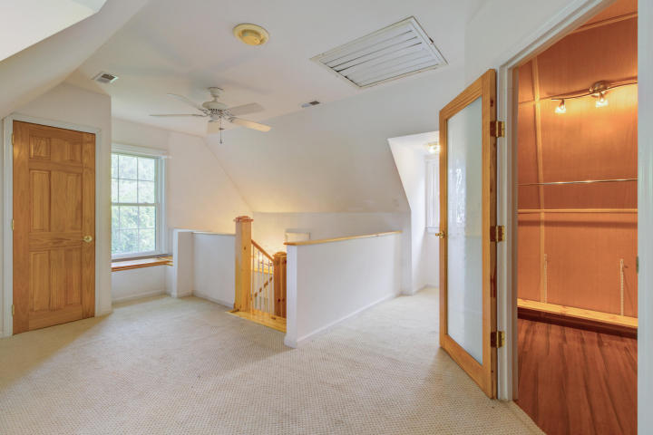
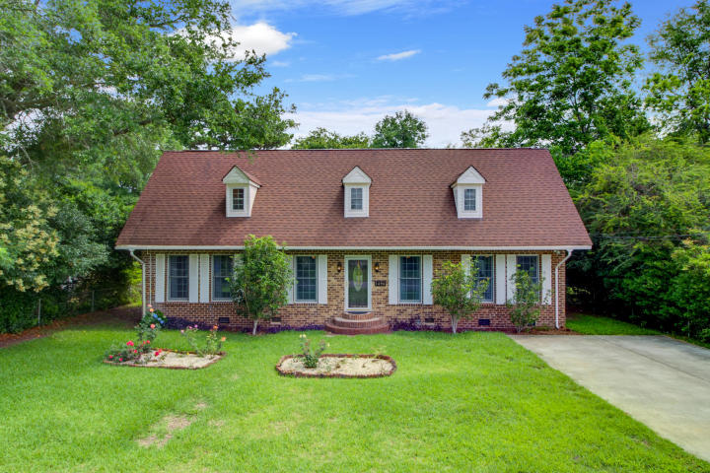
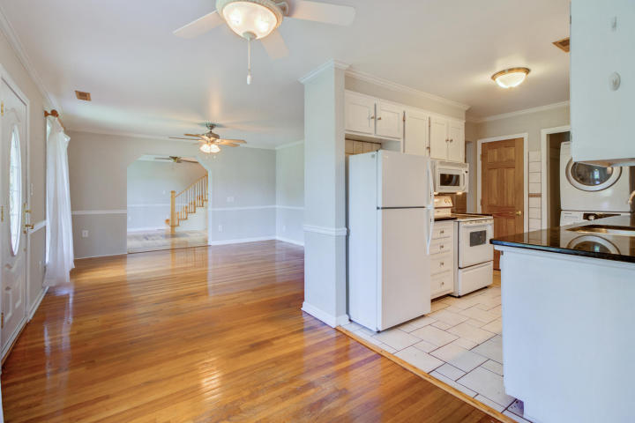
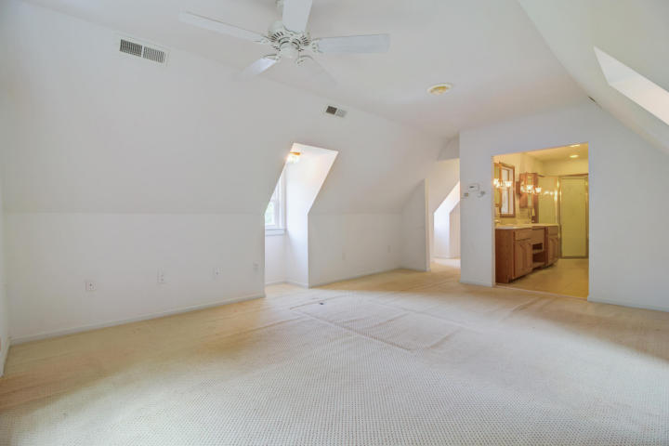
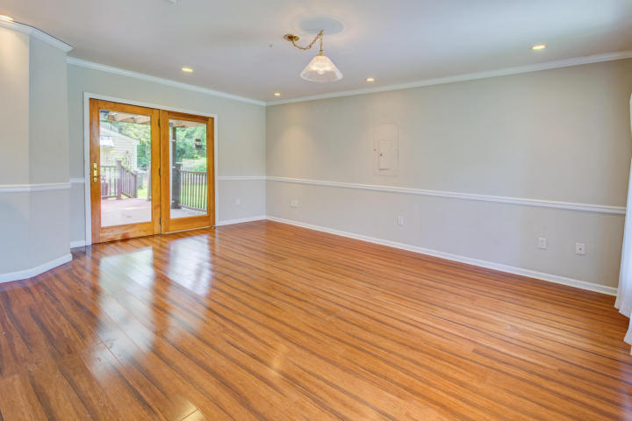
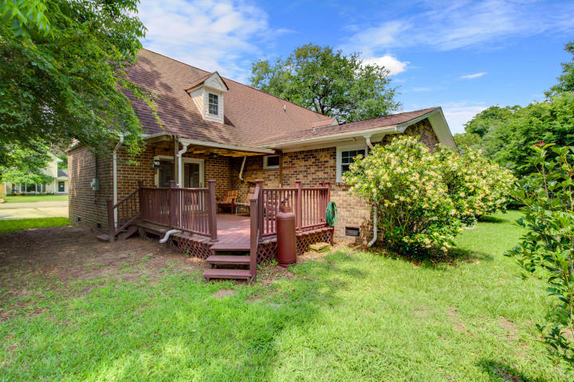
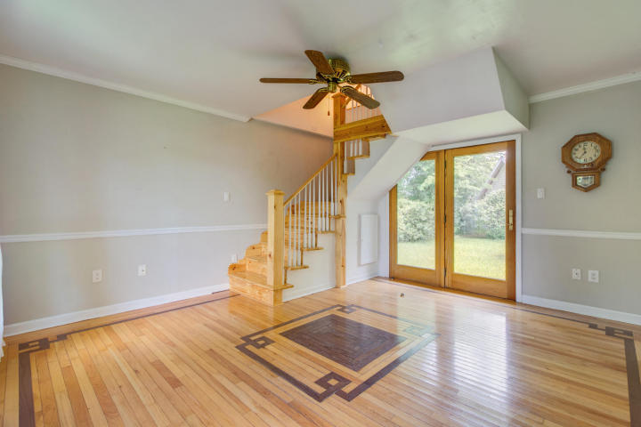
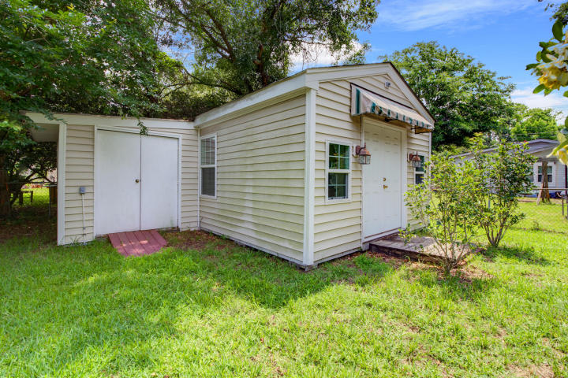


Back on the Market! Great Opportunity in Old Mt. Pleasant!
1496 Goblet Avenue
Jasper Terrace
Mount Pleasant, SC 29464
MLS# 18020157 ~ $525,000
BACK ON THE MARKET- Buyer's Financing fell through. Now is YOUR chance to make this home your own! Located in one of Mt. Pleasant's most sought after communities, children can walk or ride bikes to award winning schools. The gorgeous beaches of Sullivan's Island are within biking distance as well! If that is not enough, take a golf cart ride to the restaurants on Shem Creek or take a walk to Pitt Street Bridge and Alhambra Hall! Historic Downtown Charleston is a mere ten minute ride from 1495 Goblet. This all brick four bedroom home has a versatile floor plan and is ready for new owners to make it their own! Once a small ranch, the current owners did a massive renovation in 2008 adding to the left and right sides of the home.
3D Walk thru tour on MLS or go to
https://my.matterport.com/show/?m=VDCQBL4jkeW
Ellen O'Neil
Broker/Owner, ABR, e-PRO, CNE
Charleston Realtor of Distinction
(843) 300-8530
www.EllenONeilProperties.com

