Slide 1
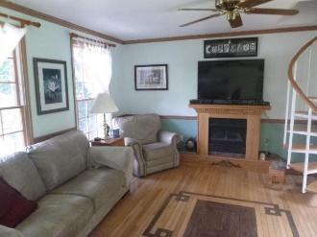
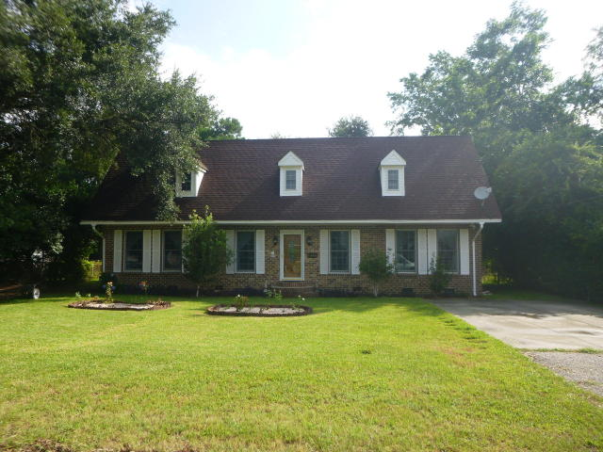
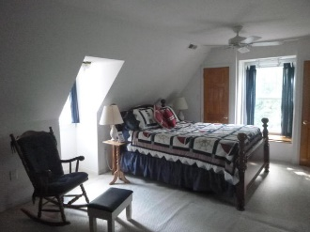
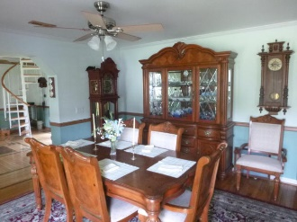
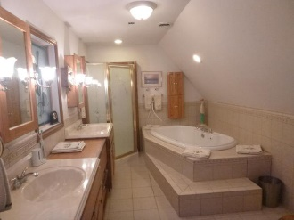
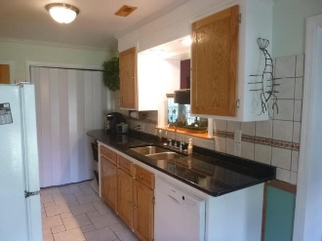
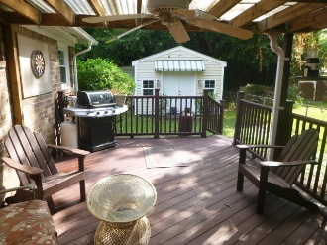
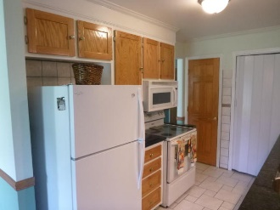
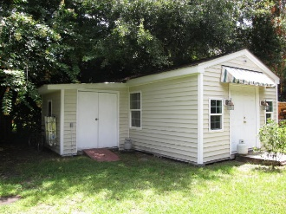
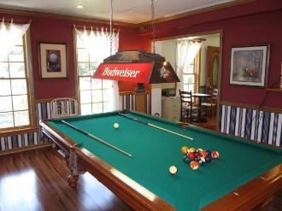
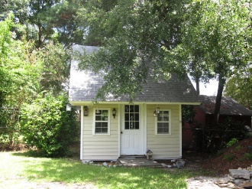
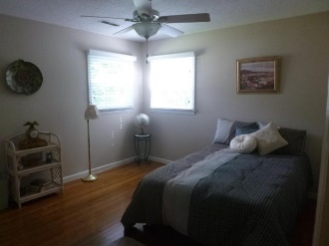
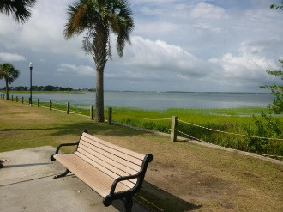
1496 Goblet
Old Mt Pleasant ~ Mount Pleasant ~ MLS# 16020779 ~ $599,000
Wow!!!
Reduced $26,000!
OPEN HOUSE
CANCELED FOR 10/6
Agent Open House with Lunch, Thursday, Oct. 13th from 11:00-2:00
Well cared for home, improved over the many years the current owners have lived there. Gas fireplace in the living room with hardwoods extending to much of the downstairs. The kitchen has granite countertops and new kitchen faucet/sink. It is within easy walking/biking distance to Mt. Pleasant Academy, Farmer's Market, Pitt St. Bridge, Sullivans Island, and the Old Village. 5 bd/2ba with lots of storage. There are 2 outbuildings on the property, one with heating and air. The larger of those outbuildings has great insulation and lighting and could be an office, music or art studio, woodworker shop, or bonus room. An extensive list of improvements to roof, HVAC, and other items is detailed on the disclosure.
Susan Lee
(843) 557-6120
susanlee@hbrtwn.com
Deborah Hulett
(843) 814-0255
debby@hbrtwn.com
Harbourtowne Real Estate | 672 Marina Drive, Ste 110 | Daniel Island, SC 29492

