Slide 1
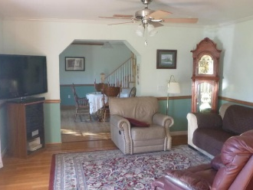
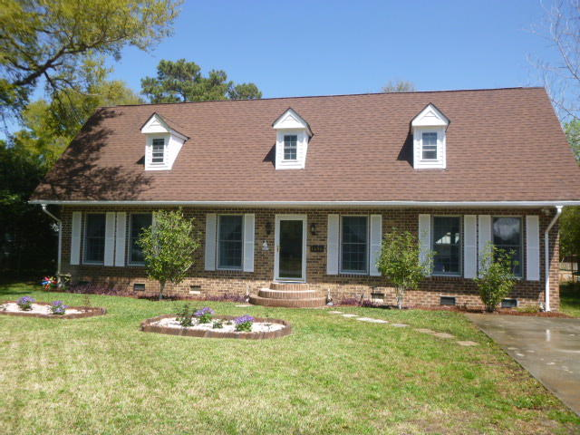
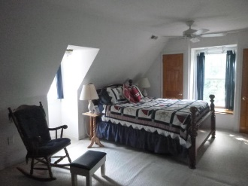
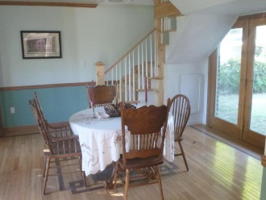
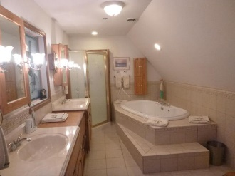
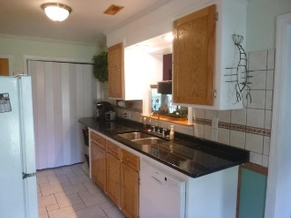
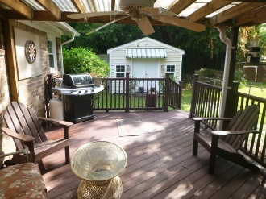
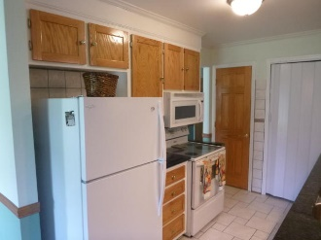
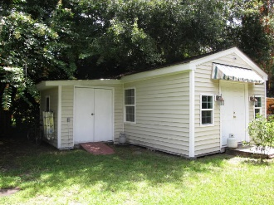
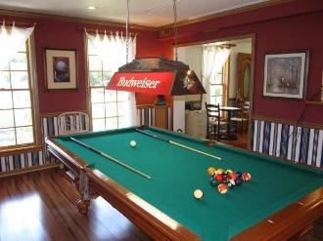
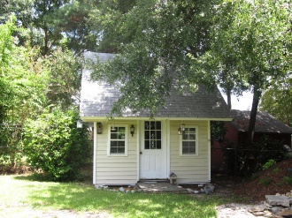
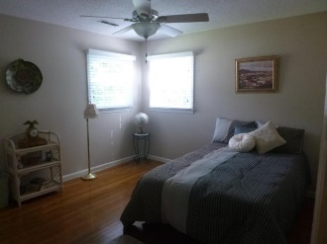
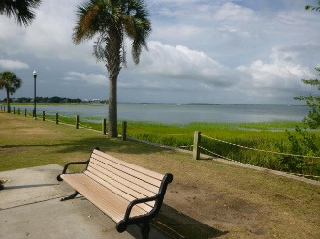
1496 Goblet
Old Mt Pleasant ~ Mount Pleasant ~ MLS# 17008709 ~ $595,000
OPEN HOUSE
Thursday 10-1
If you've seen this home before, please come see it again with real stairs to the second floor!
BRING ALL OFFERS!
These homeowners have done substantial work to the home, adding a staircase, lighting, and paint. Home has been well cared for by the owners and has 3 downstairs bedrooms with a hall bathroom, and an additional office and master suite upstairs. Home is close to all Old Mt. Pleasant has to offer, including restaurants, Sullivan's Island beach, Farmer's Market, and schools. Hardwoods in much of the downstairs with granite countertops and new kitchen faucet/sink in the kitchen. Three outbuildings on the property have power, and 2 have heating and air. The larger of those outbuildings would be perfect for a studio office, music room, or workshop. Details of all the improvements are listed in the seller disclosure.
Susan Lee
(843) 557-6120
susanlee@hbrtwn.com
Deborah Hulett
(843) 814-0255
debby@hbrtwn.com
Harbourtowne Real Estate | 672 Marina Drive, Ste 110 | Daniel Island, SC 29492

