Slide 1
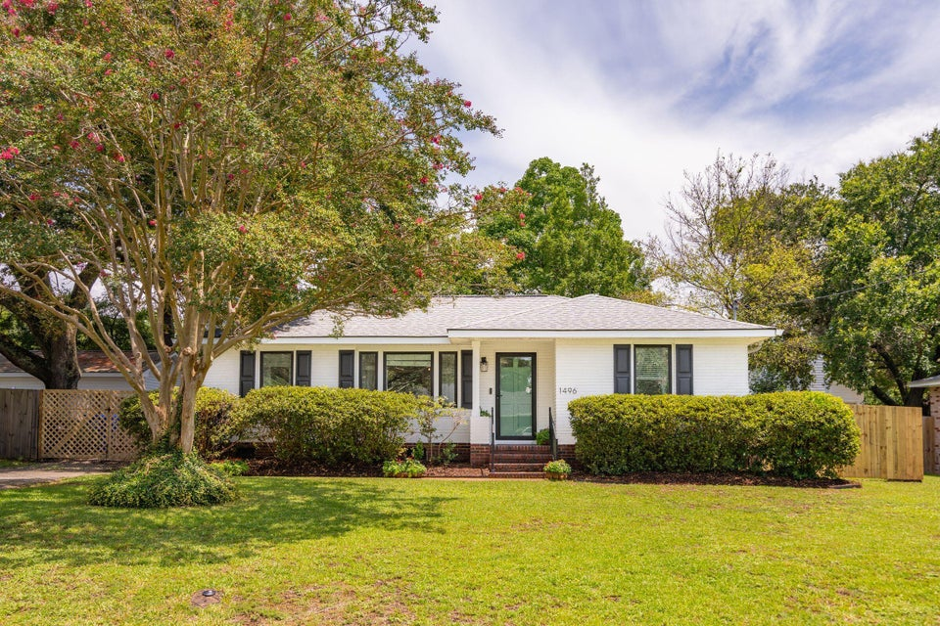
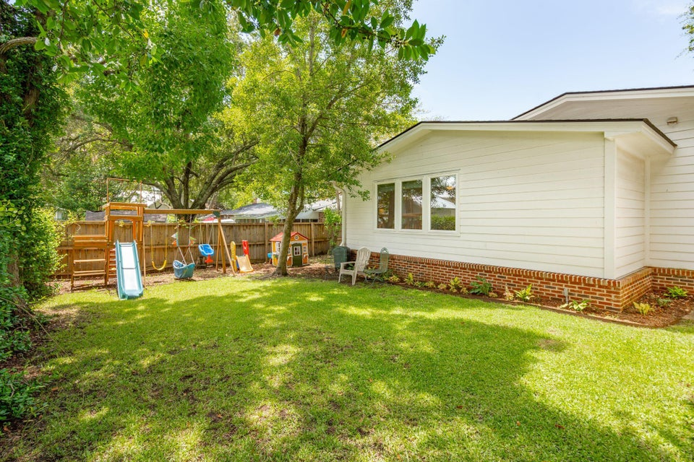
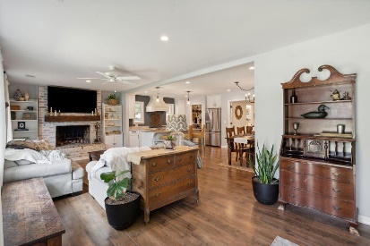
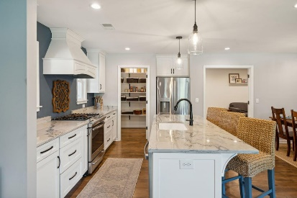
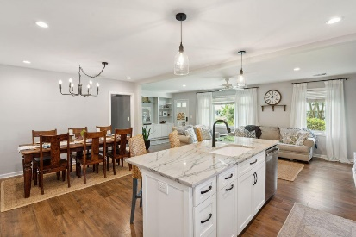
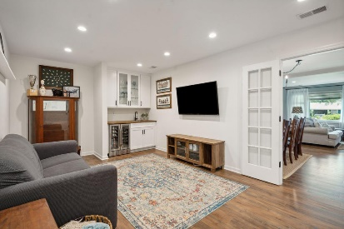
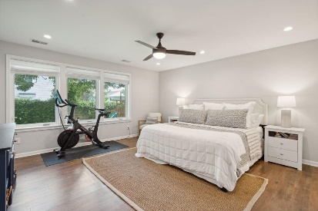
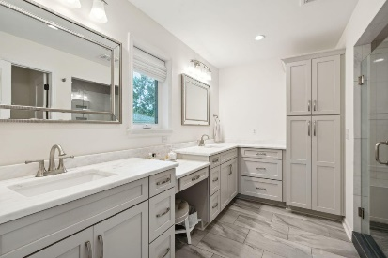
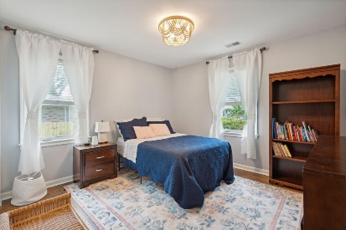
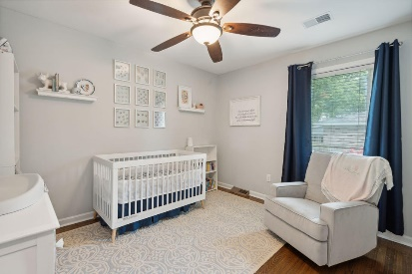


Potential Short Sale!
Open House This Weekend - 11-3 Sat/Sun
1496 Hindman Avenue
Jasper Terrace ~ Mount Pleasant, SC 29464 ~ MLS# 24018760 ~ $1,895,000
Amazing opportunity to own this classic, single-story home in one of the most sought-after neighborhoods in Mt Pleasant. This 3 bedroom, 3 bath home was completely renovated with a new addition in 2019. Updates include an open floor plan, a new kitchen, den, a master suite and 2 additional bathrooms. The electrical, plumbing and AC (including new duct work ) were all updated. New tankless water heater was added in 2023. This ranch style home is move in ready. There is an additional 500 sq ft 2 car garage on property ready to be converted with endless options. Walk or ride your bike to Sullivans Island, Shem Creek and some of the best schools in Mt Pleasant.
Chuck & Edy Mimms
Edy 843-224-9509
Chuck 843-224-9507
myhomeincharleston.com
Mimms Group LP | 64 Salty Tide CV | Mt. Pleasant, SC 29464

