Slide 1
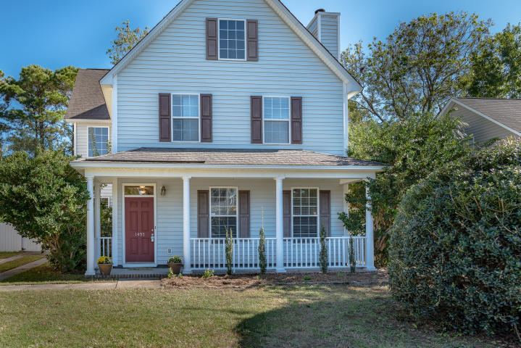
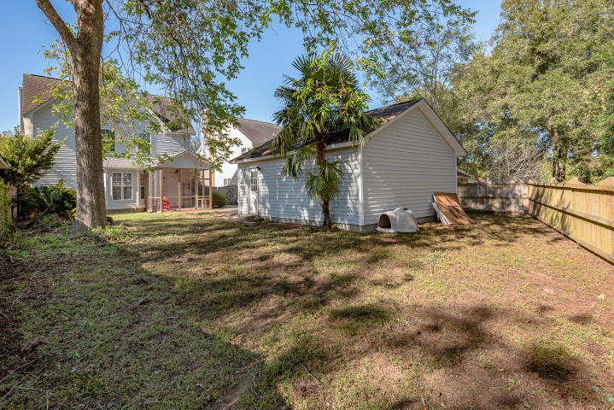
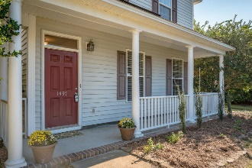
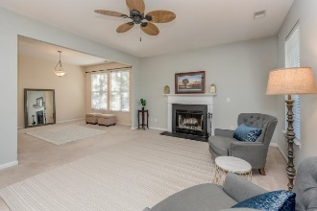
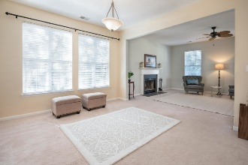
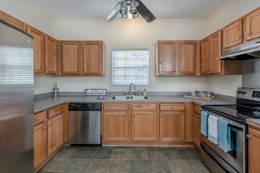
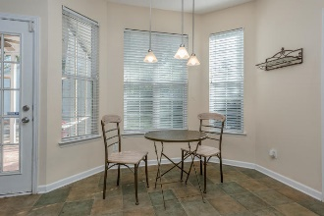
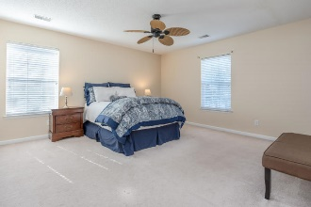
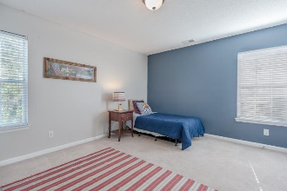
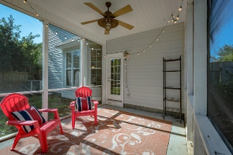
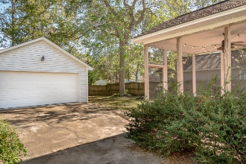
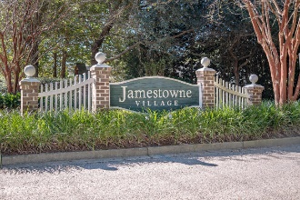


Just Listed
Lowest Price Per Square Foot in Jamestowne Village
1497 Swamp Fox Ln
Jamestowne Village | Charleston | MLS# 18031132 | $347,500
Lowest price per square foot home currently available in Jamestowne Village! This wonderful home has 9' ceilings, an open floor plan, spacious backyard that is fully fenced in and a two car garage. Centrally located only minutes to downtown Charleston or Folly Beach. This home is a great value and in a wonderful neighborhood. Seller offering a $2000 credit towards flooring at closing with acceptable offer. Easy to show! Motivated sellers!
Whitley Boyd
(843) 324-4761
w.boyd@agentowned.com
www.PropertiesofCHS.com
AgentOwned Preferred Group | 824 Johnnie Dodds Blvd | Mt Pleasant, SC 29464

