Slide 1
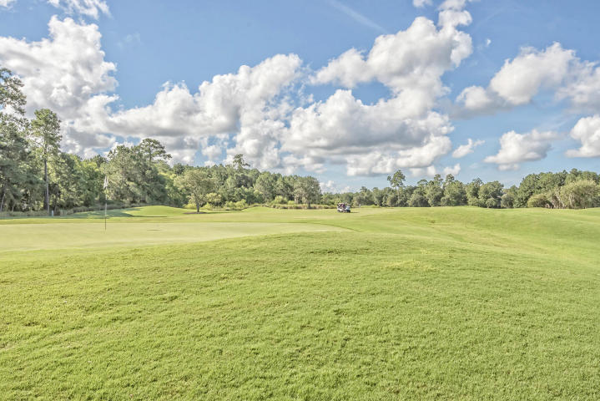
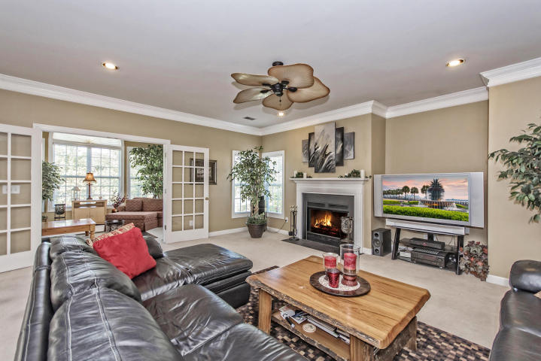
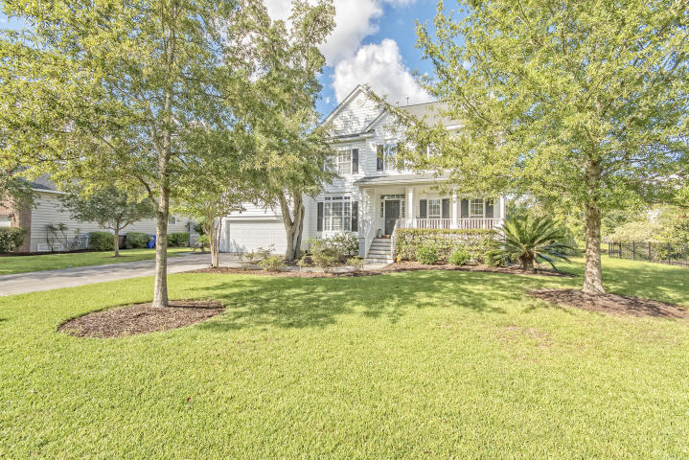
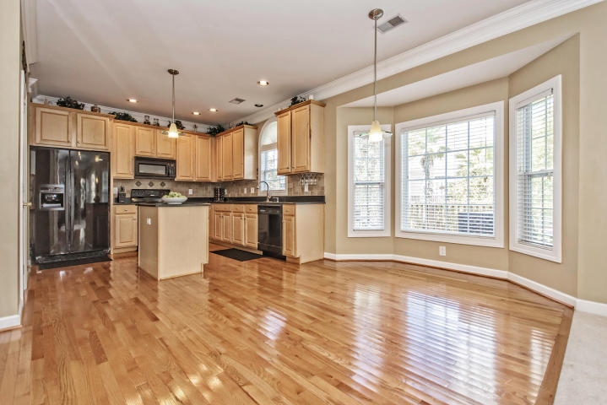
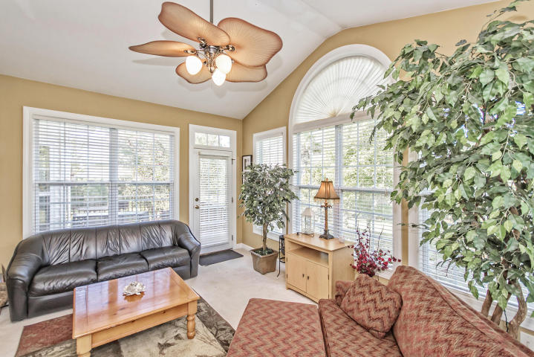
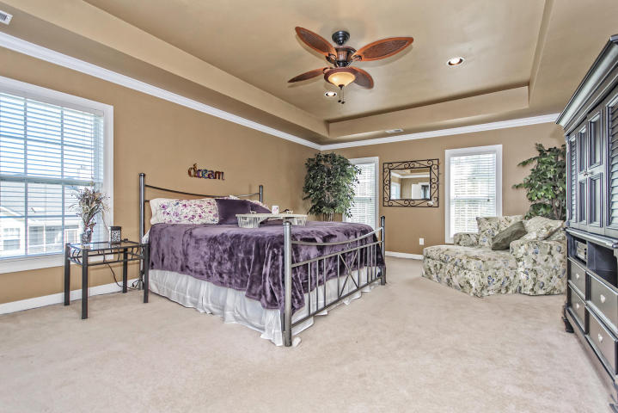
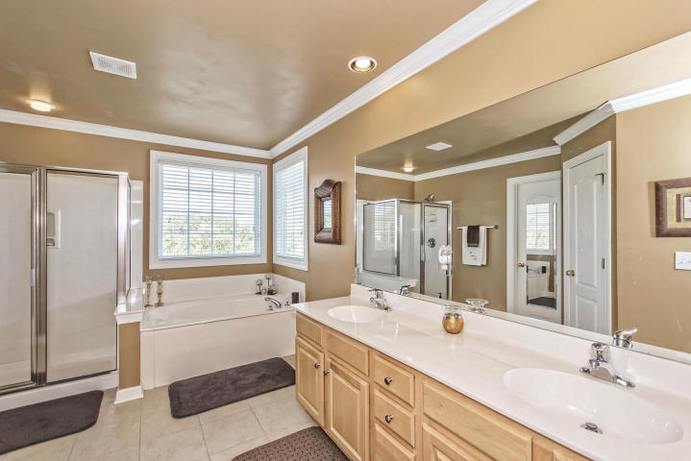
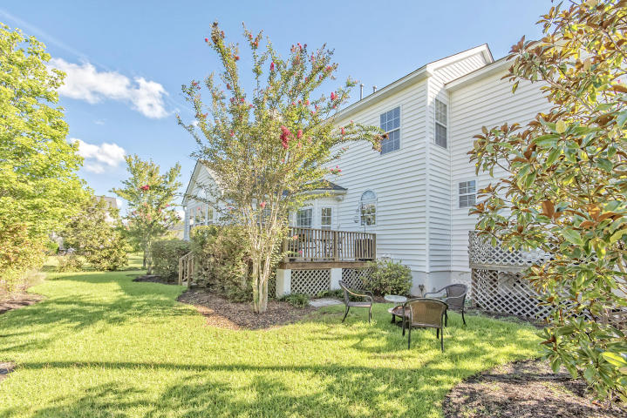

OPEN HOUSE
Saturday Oct 1st From 1-3pm!
1498 Oakhurst Drive
MLS# 16022364 ~ $499,900
5 Bedrooms ~ 3½ Bathrooms
A “SECOND-TO-NONE” HOME HAS BEEN FOUND IN RIVERTOWNE! Pristine, turn-key, 5 bedroom, 3.5 bath home with numerous features that are truly “second to none”…. These second-to-none features, that virtually can’t be found anywhere else, include: 1) A first-floor laundry room with huge counter space, 42-inch maple cabinets, gorgeous ceramic tile floors and a full bath. Come straight from the beach, shower the sand off and leave your wet clothes right in the washer. 2) Double massive kitchen pantries: a very large kitchen pantry is accompanied by a Butler’s Pantry which possesses tumbled Italian marble backsplash, 42-inch maple cabinets and natural black quartz countertops. This Butler’s pantry connects the spacious gourmet kitchen to a stately dining room with double crown molding. 3) Double Electrical Breaker Boxes so that it is virtually impossible to overload the electrical capacity of the downstairs office. In addition, this spacious downstairs office could double as a bedroom and is accented with double crown molding and elegant French doors. 4) Dual first floor staircases that result in a uniquely exquisite and utilitarian floor plan for both the 1st and the 2nd stories of the home 5) A sun room with double French Doors that give complete separation and sound isolation between the light and bright sun room and the formal living room with its roaring fireplace. 6) An elevated platform in the garage that provides absolutely mammoth storage space. 7) A custom China hutch in the kitchen with a large work station, maple cabinets and drawers underneath that creates a great display case for beautiful China simultaneously with a terrific work station. Other features that are not exactly "second to none" but "really freaking good" include a wide-open floor plan with a large chef's eat-in kitchen complete with Silestone counter tops, massive counter space, tumbled Italian marble backsplash, 42-inch maple cabinets and stunning artistic details above the stove; a super-sized Master Bedroom with crown molding, trey ceiling and a spa-like master bath with dual sinks, large Jacuzzi garden tub, separate shower, separate toilet area and large walk-in closet; gleaming hardwoods; large live oak tree with hanging Spanish moss and ever-blooming azalea bushes; and an intimate back deck with a back-yard courtyard reminiscent of a setting for High Tea in an enchanted English Garden. In addition, Rivertowne Country Club has MACK DADDY amenities that include world-class golf; a stunning clubhouse; a new play park; a Jr. Olympic-sized pool; new spray fountains for the children; a covered pavilion with grills, ceiling fans and tables; and 2 clay tennis courts. YES, this unique home really does exist and it can be yours for the #1 VERY BEST VALUE in Mount Pleasant!
Chip Walsh
843-822-4663
chipwalsh@gmail.com
Andi Walsh
843-822-4663
myandigirl@gmail.com
Century 21 Properties Plus | 3301 Salterbeck Ct Suite 100 | Mt. Pleasant, SC 29466

