Slide 1
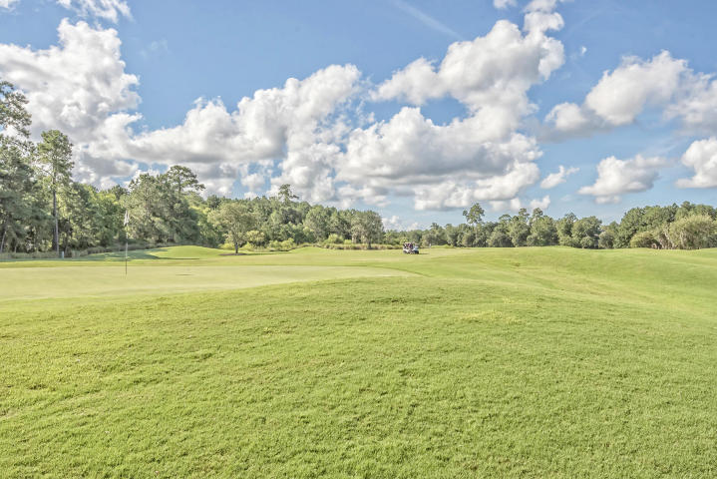
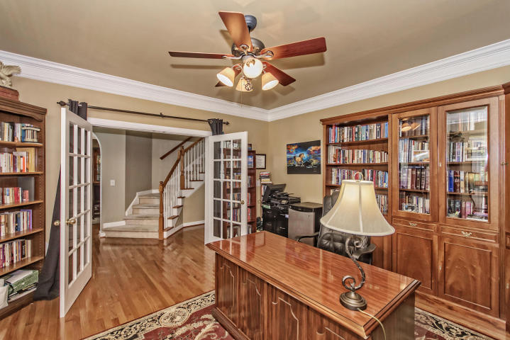
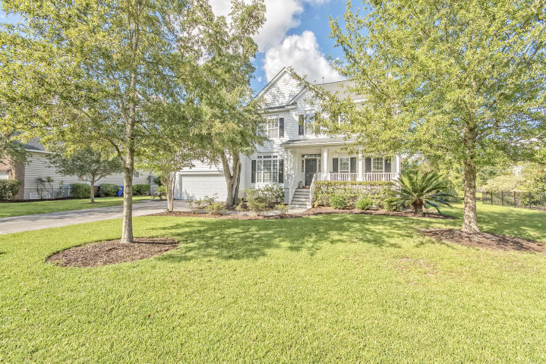
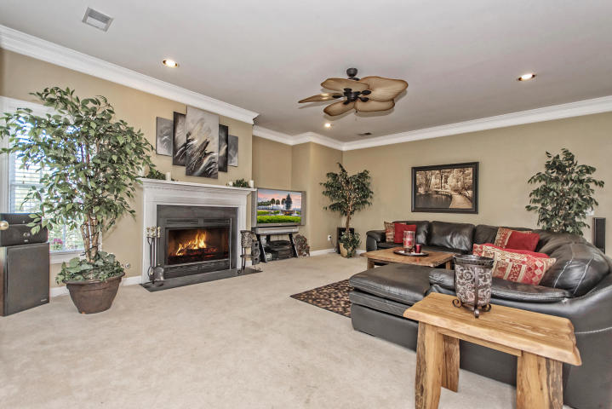
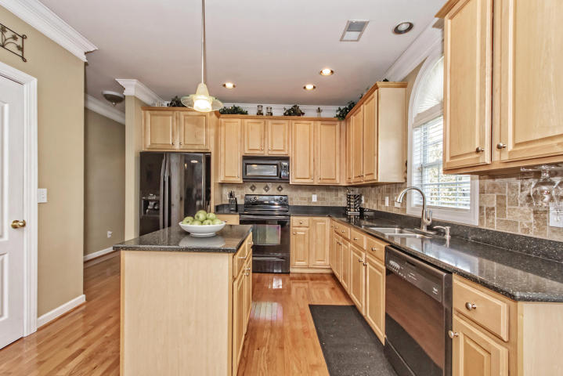
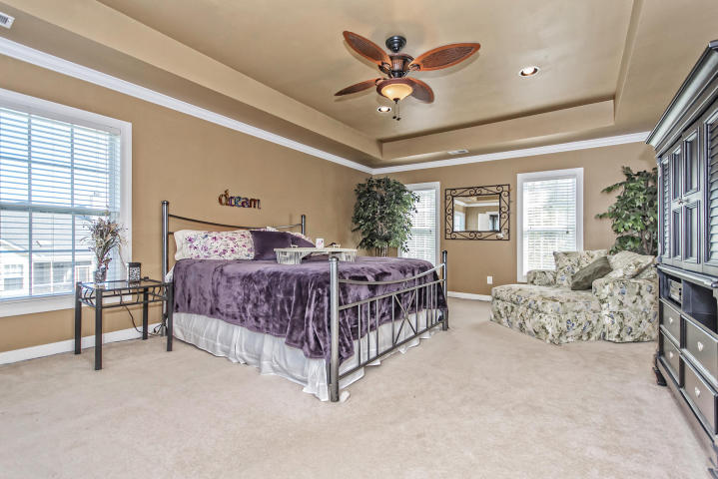
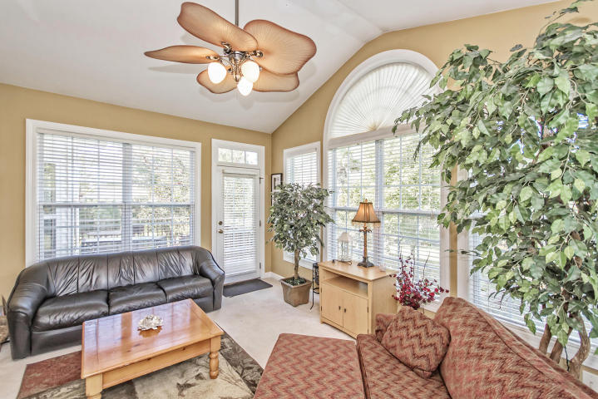
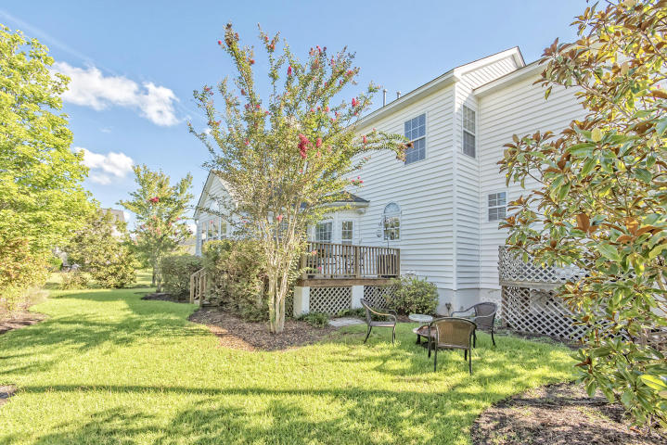

#1 BEST VALUE IN
RIVERTOWNE COUNTRY CLUB!
1498 Oakhurst Drive MLS# 16029278 ~ $479,900
5 Bedrooms ~ 3½ Bathrooms
Unbelievable Price Reduction ~ Won’t go lower and won’t last long!
This price has been reduced thousands below comparable sales in Rivertowne Country Club and this local author is already half moved out, making it easy and quick for you to move in. If you prefer less yard work, cheaper water bills, and a more intimate setting for your back yard, look no further! While this back yard is smaller than most in RiverTowne, it is a serene safe haven that boasts blazing red and orange Maple trees, blooming Crepe Myrtle trees, a gorgeous Magnolia, colored fountain grass, stunning sunsets and more. The neighbors surrounding this property are amazing and look forward to meeting you! The neighborhood amenities will also add quality to your family’s life, including a Jr. Olympic pool, which includes spray fountains for younger children; clay tennis courts, golf, a new play park for kids of all ages, a covered pavilion - free for your own events, and so much more.
This is a modern and very open floor plan with dual staircases, a convenient first floor laundry room with full bath so you can wash off from the beach as you enter the house, gleaming hardwoods on most of first floor, double crown molding, and too many other upgrades to mention.
This truly is an amazing deal that won't last long. Serious inquiries only.
Chip Walsh
843-822-4663
chipwalsh@gmail.com
The Boulevard Company, LLC 35 Broad Street Charleston, SC 29401
www.TeamWalshRealEstate.com

