Slide 1
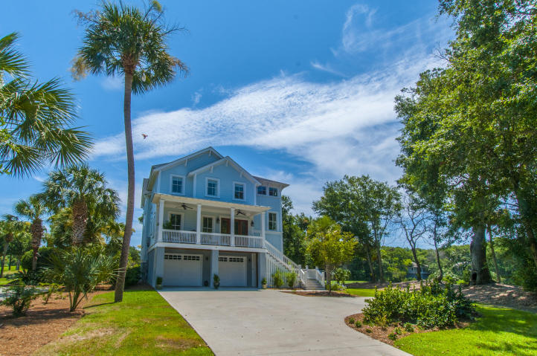
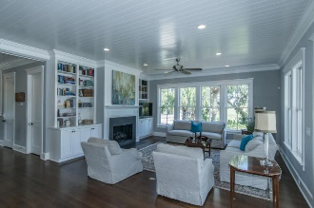
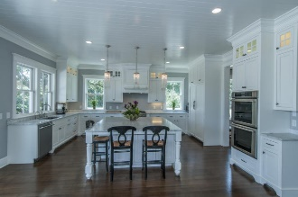
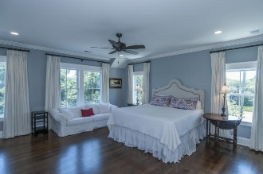
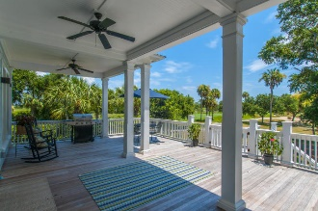
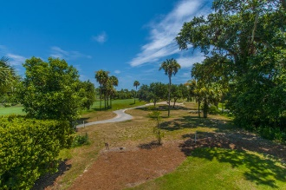


14 Fairway Village Lane
Isle of Palms :: MLS# 16019332 :: $1,450,000
Like New Lowcountry Home in Wild Dunes
This home was built with all the bells and whistles for todays living. Open floor plan with large bright family room with wall of windows overlooking eighteenth hole of Harbor Course and marsh.
Kitchen is chef's dream, marble counters, custom cabinets, large island, Thermador appliances and walk in pantry. There is a separate dining room, guest suite, laundry room and half bath also on main floor. Upstairs you will find beautiful master suite with sitting area and fabulous bath . Two additional bedrooms with private baths, a home office and second laundry room.
White Oak dark stained floors throughout, 10 ft ceilings, Anderson impact windows, elevator shaft. Parking for multiple cars in garage with plenty of other storage and 2 outdoor showers.
Clay Cunningham
O (843) 886-8110
M (843) 345-4647
clay@carolinaone.com
www.claysre.com
Carolina One Real Estate
1503 Palm Blvd Ste
Isle of Palms, SC 29451

