Slide 1
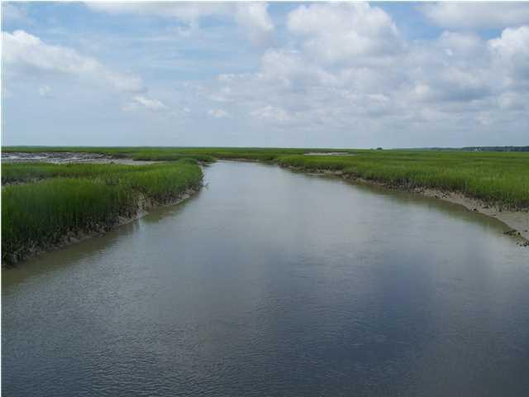
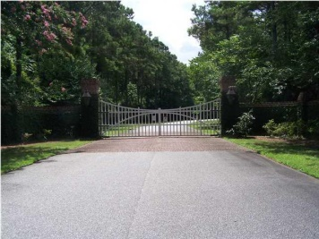
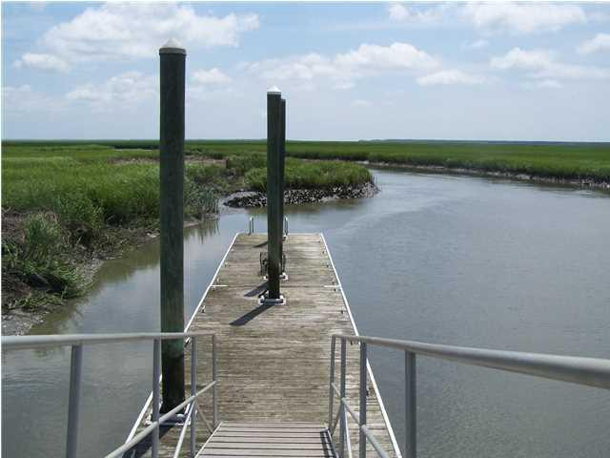
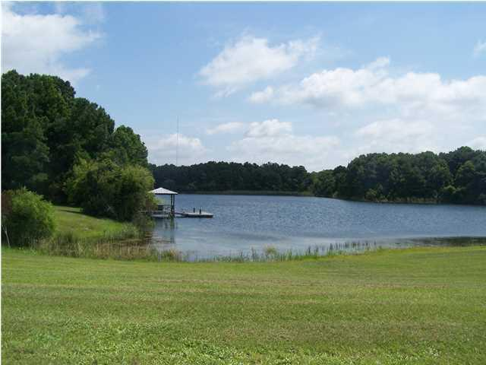
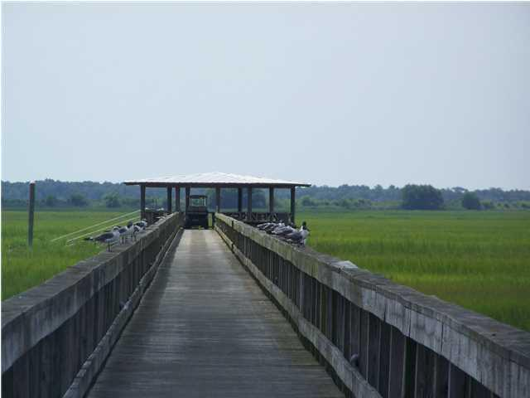
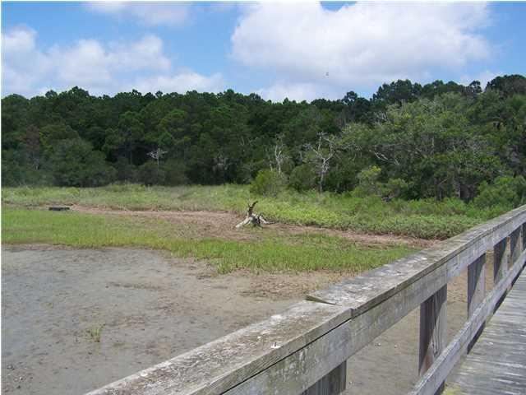
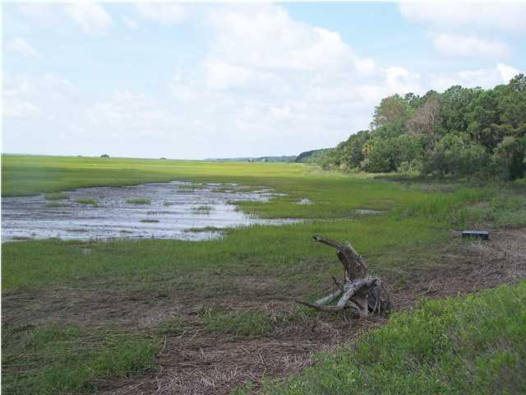
Lowest priced lot in Sewee Preserve
Sewee Preserve is a residential community with an outdoor feel. Located along the marshes of Clawson Creek in the Awendaw area of Charleston County, Sewee Preserve is a conservation centered community that offers a variety of outdoor amenities. Sewee Preserve has one of the largest fresh water lakes in the area. The lake has several docks and a launching area as well as a community club house overlooking the lake. There is also a larger dock with floater and covered peirhead for community use. This lot is located next to the community dock. Equestrian facilities and a community garden are also located within Sewee Preserve. This area is teeming with wildlife and offers some excellent fishing opportunities. Forget the head aches with the banks. Owner financing is available. Terms and rates will need to be discussed with the seller.
14 Longmarsh Road
Sewee Preserve
Awendaw, SC 29429
$412,000
MLS# 1314778
Thomas Hartnett, Jr
Hartnett Realty Co., Inc.
134 Meeting St, Chas, SC 29401
tom@hartnettrealty.com
(843) 723-7222 Office | (843) 270-2915 Mobile

