Slide 1
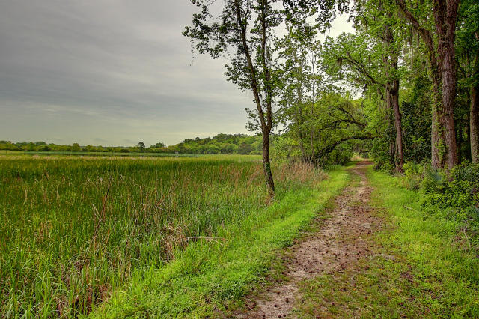
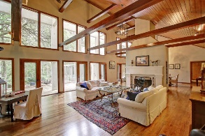
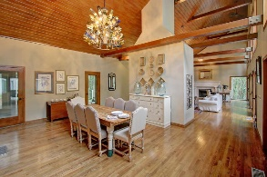
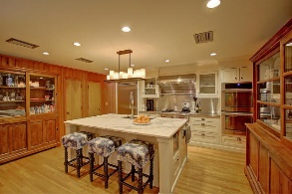
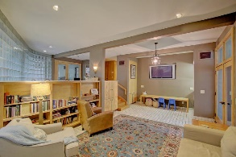
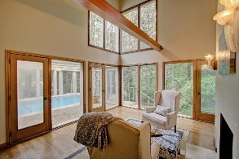
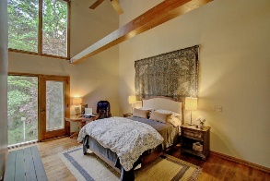
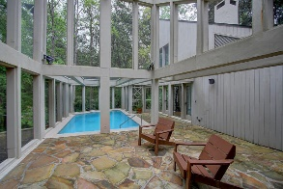
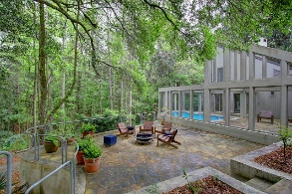
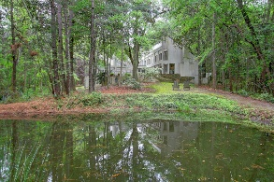
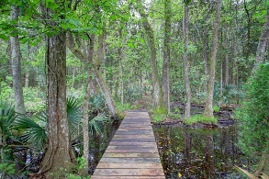


14 Middleton Oaks Road Middleton Place :: Charleston :: MLS# 16009953 :: $1,100,000
Must See!
Outstanding Architecture and Views...
Welcome Home to this 3.3 acre home next door to historic Middleton Plantation and Inn. Take a short walk or golf cart ride to the plantation and let the kids pet the animals or enjoy a romantic walk after having dinner at the plantation's restaurant. Looking for solitude, you can walk, bike or ride horse back on the quiet path behind the home nestled on the Ashley River. With stunning contemporary architecture, this home features beautiful outdoor spaces with a large flagstone patio under the grand oaks. Many windows bring the outdoors in. From the large, welcoming foyer with a mural of Middleton Place to the vaulted and beamed living/dining rooms this home offers unique entertaining spaces. The open kitchen makes a large marble island the stage for gatherings. The gourmet kitchen includes wolf gas range with heat lamps, warming drawer, 2 ovens , and large refrigerator. Full size freezer is located in laundry space directly by the kitchen. Sunken bar area compliments the kitchen with ice maker and mini fridge. The master suite boasts soaring beamed ceilings, wood burning fireplace, and separate sitting area overlooking the home's saltwater pool enclosed in the screen porch.
Off the foyer, is a spa-like powder room with two changing areas convenient to the pool area. Both masters are located downstairs with the second master featuring its own entrance and full bath. Perfect suite offers privacy for guests or a mother-in-law suite. Upstairs features two large bedrooms with two additional full bathrooms. Bedroom with white painted wood floors has a large heated/cooled attic space. The family space offers a wet bar, wine fridge and built-in bookcases with additional sitting area. The massive detached garage has two car parking spaces and a wood working shop. There is also a bonus room, heated and cooled, perfect for a playroom or private office space. This home is unique and one of a kind to Charleston. Come enjoy the best of the Lowcountry and call it Home.
Tracy Meredith
M (843) 270-4800 :: O (843) 886-8110
tmeredith@carolinaone.com
Carolina One Real Estate :: 1503 Palm Blvd :: Isle of Palms, SC 29451

