Slide 1
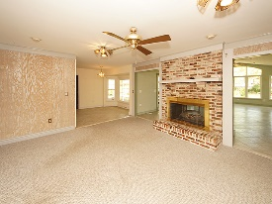
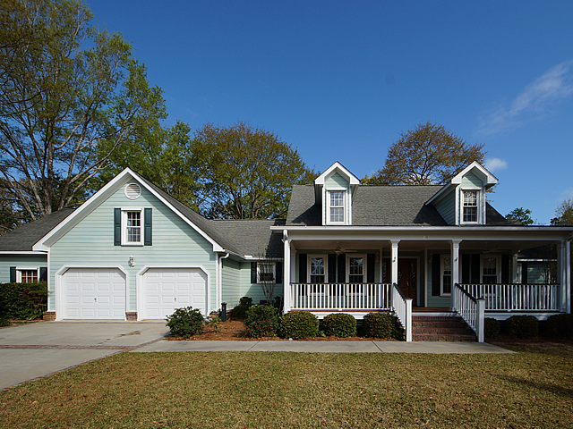
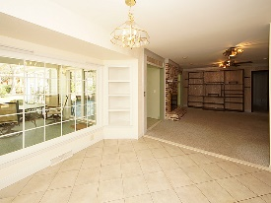
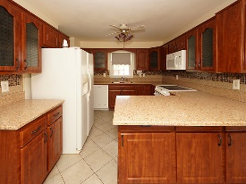
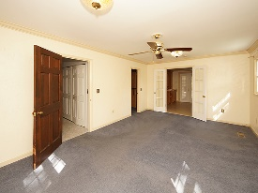
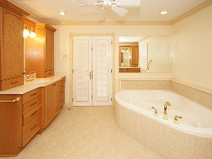
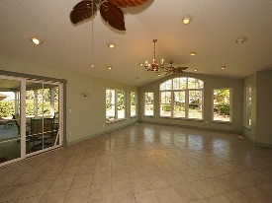
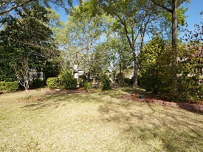


Price Reduction In Otranto!
14 Ravenna Avenue
Otranto
Hanahan, SC 29410
Open House Canceled!
Under Contract In 3 Days!
MLS# 17008699 | $350,000
5 Bed / 2½ Bath
Unique in design, this picturesque home in Otranto offers full front porch, back porch, screen porch and deck. Inside is a well designed kitchen with granite counter tops and the perfect window viewing a professionally landscaped yard. Dual sided fire place creates a sophisticated opening between the den and sizeable sunroom/entertaining area with wet bar. Master bedroom is down stairs and the master bathroom is fit for a queen with a jetted soaking tub, tiled shower and two separated vanities. Over the garage is a separate living area perfect for an office or kids get away. This home is equally captivating on the inside and out! Pictures are worth a thousand words!
***Lot behind house on 5 Sorento is for sale. Same seller owns house and vacant lot if your client is interested in both.**
Connie White, Broker
C: 843-532-3356
conniesyouragent@gmail.com
Charleston Homes
597 Old Mt. Holly Road
Suite 301
Goose Creek, SC 29445

