Slide 1
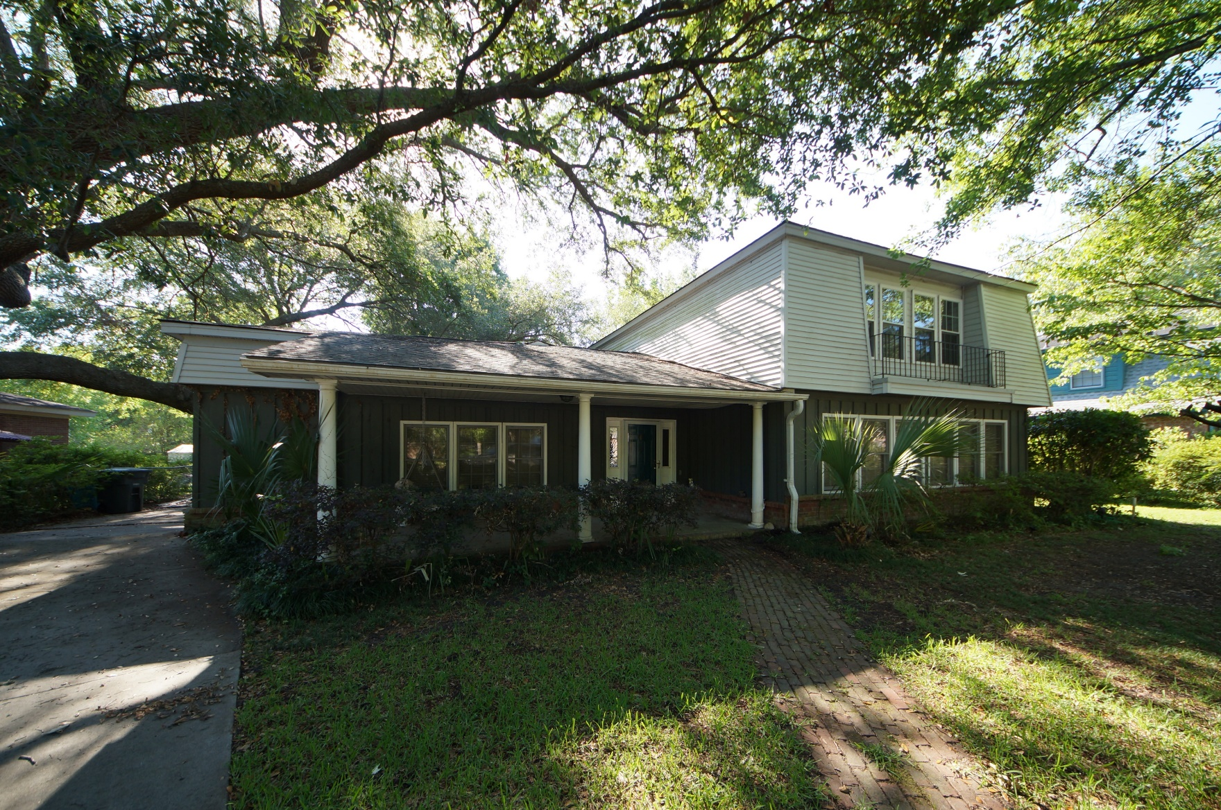
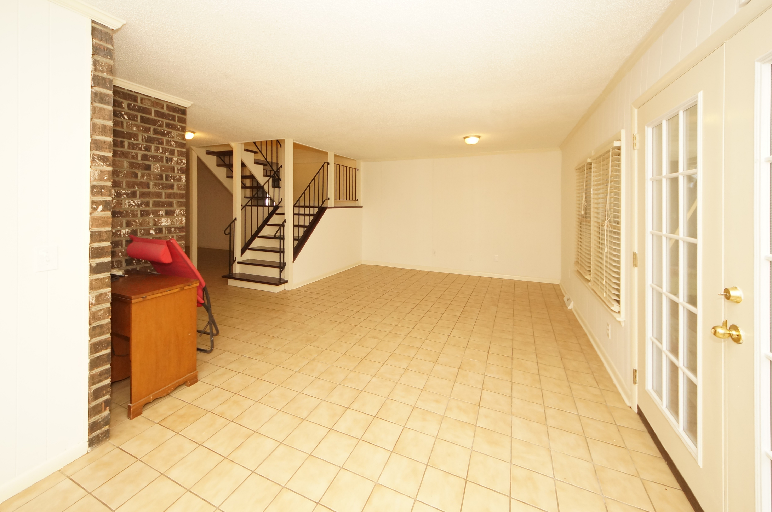
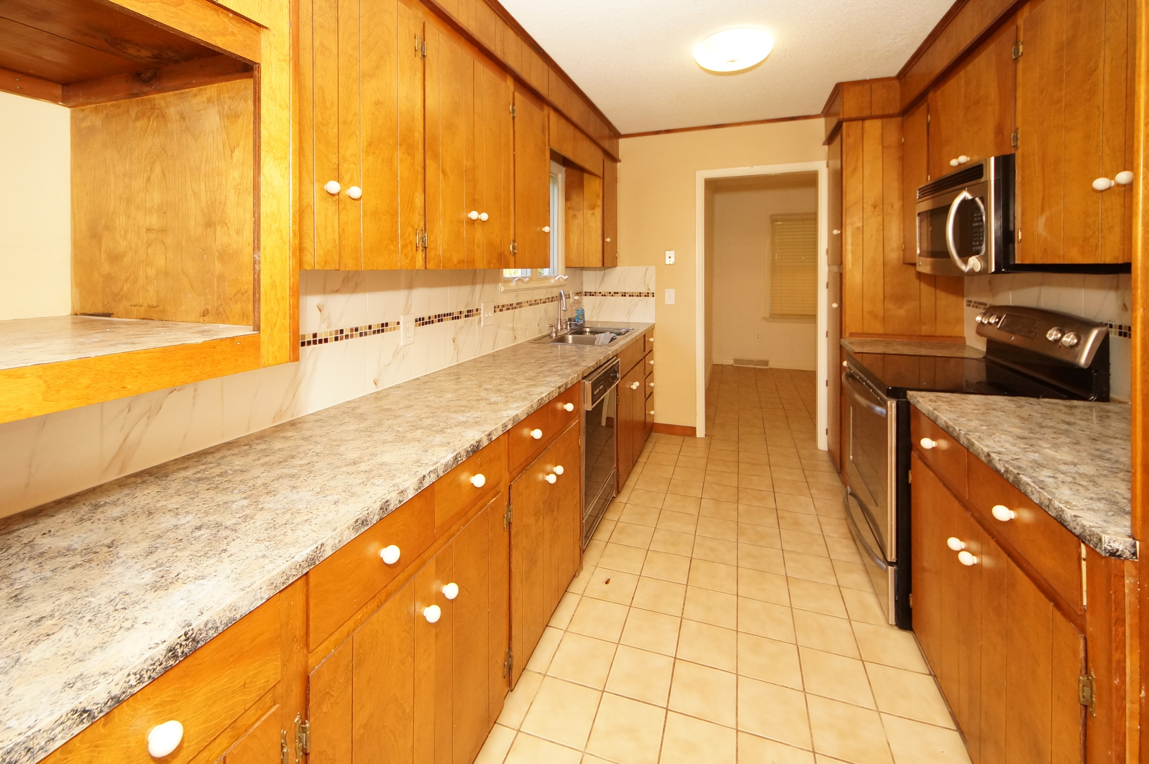
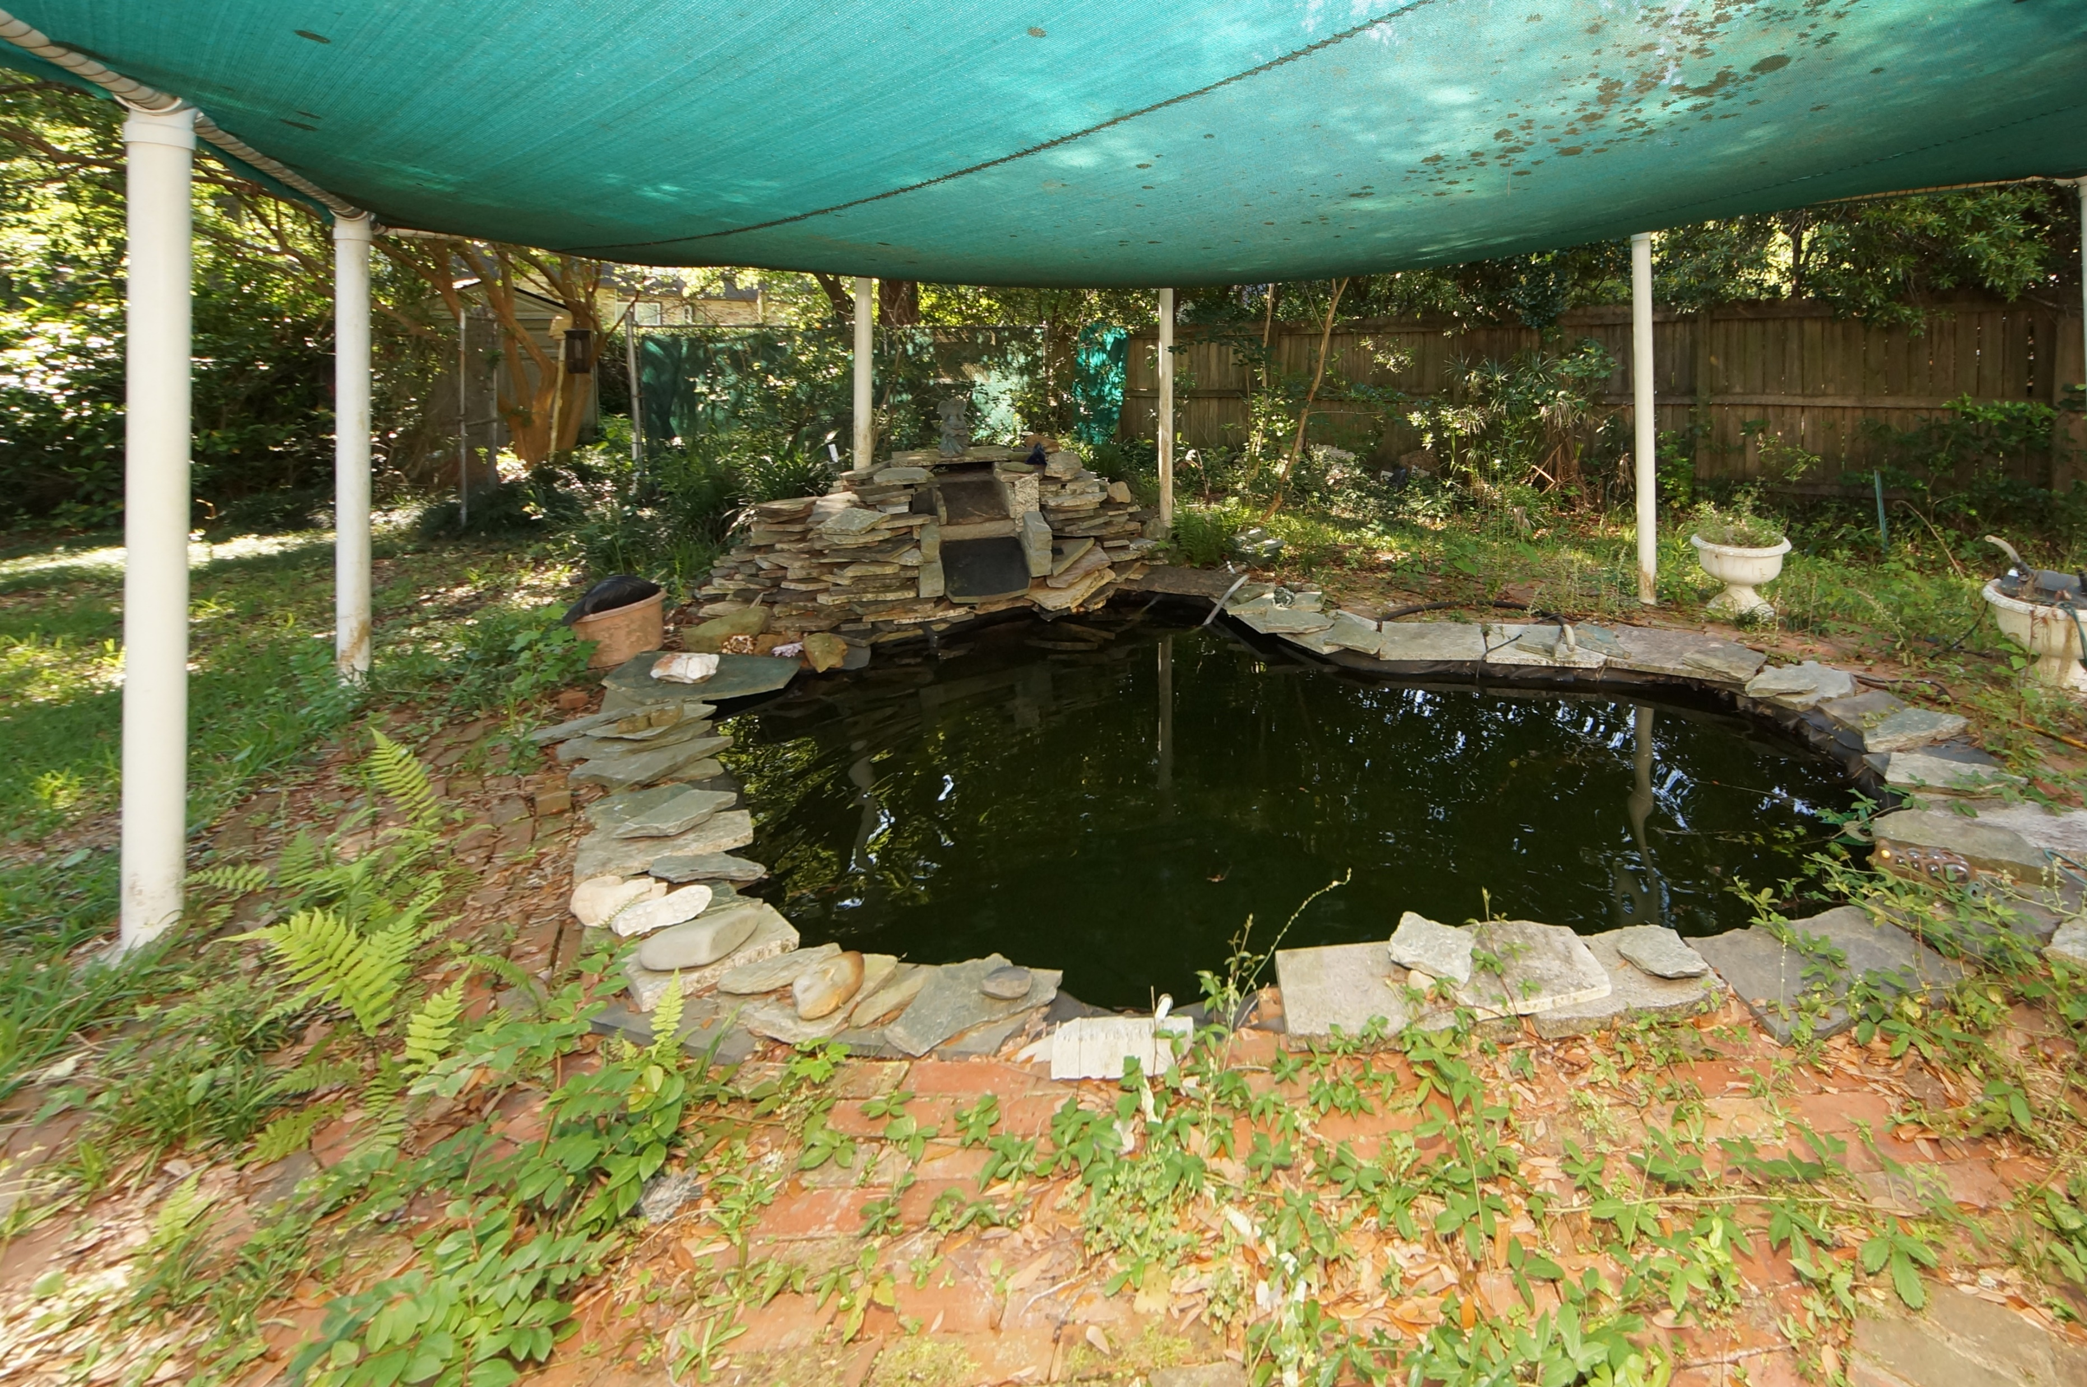


14 S Basilica Avenue Otranto :: Hanahan, SC 29410 MLS# 17014274 :: $225,000 3 Bed / 2½ Bath
Unique In Design! Koi Pond & Waterfall!
Just Reduced
Unique in design, this Otranto home offers full front porch, 3 spacious bedrooms upstairs, separate den to the right of the foyer, living, dining and galley kitchen.
Covered porch gives view to what was a koi pond with a relaxing waterfall. We realize this home needs a few upgrades but painted neutral it is an open palette for the next owners imagination.
Connie White, Broker
843-532-3356
conniesyouragent@gmail.com
Charleston Homes · 597 Old Mt. Holly Road · Suite 301 · Goose Creek, SC 29445

