Slide 1
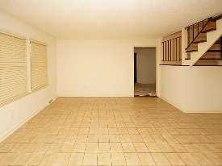
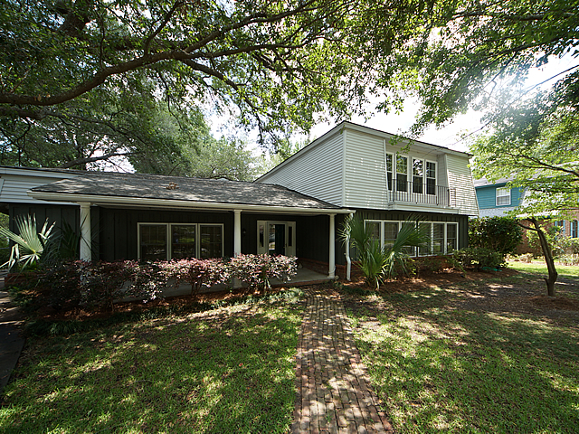
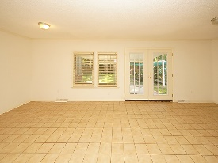
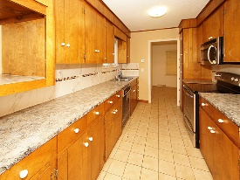
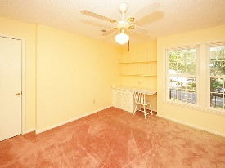
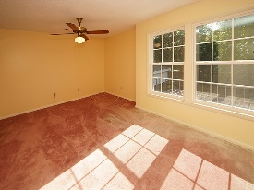
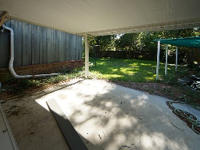
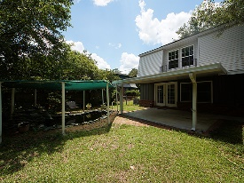

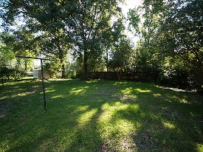

Price Reduction in Otranto! Koi Pond & Waterfall!
14 S Basilica Ave
Otranto
Hanahan, SC 29410
Open House Canceled!
Under Contract In 3 Days!
MLS# 17014274
$230,000
3 Bed / 2½ Bath
Unique in design, this Otranto home offers full front porch, 3 spacious bedrooms upstairs, separate den to the right of the foyer, living, dining and galley kitchen.
Covered porch gives view to what was a koi pond with a relaxing waterfall. We realize this home needs a few upgrades but painted neutral it is an open palette for the next owners imagination.
Connie White, Broker
843-532-3356 · conniesyouragent@gmail.com
Charleston Homes · 597 Old Mt. Holly Road · Suite 301 · Goose Creek, SC 29445

