Slide 1
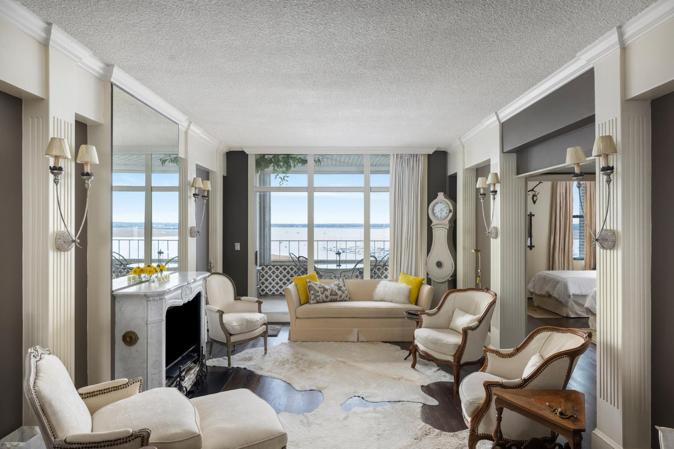

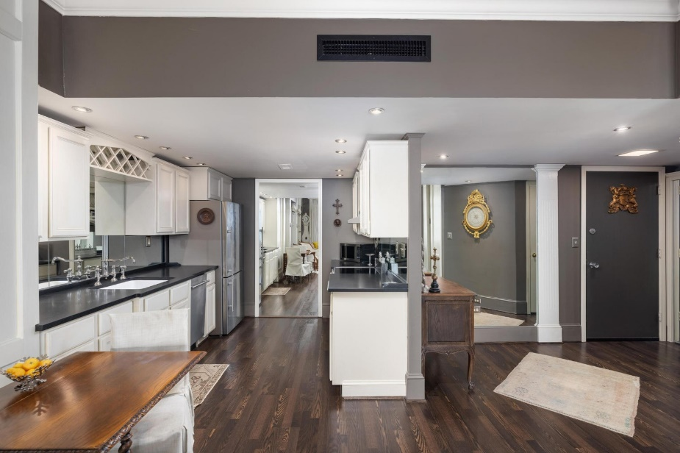
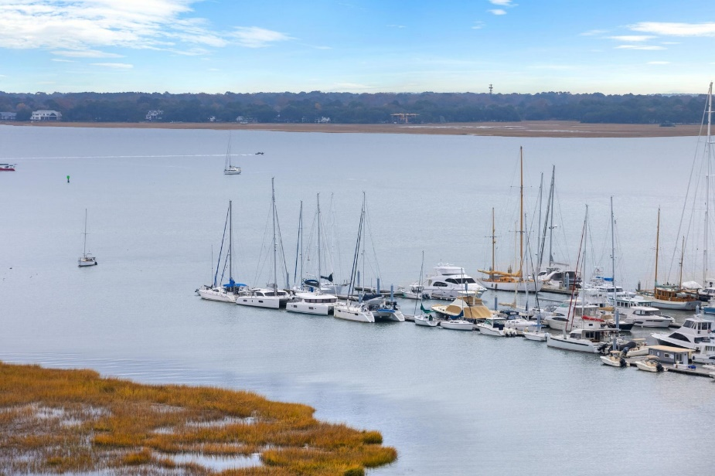


Be sure to watch the YouTube video to see more!
UNIQUE Jewel Box in the
OLD WALLED CITY
Designer's Penthouse with Ashley River Views
14 Lockwood Drive 12 E
Ashley House | Charleston, SC 29401 | MLS# 23018872 | $629,000
2 Bedrooms | 2 Baths | 1,061 sf
This is a rare TURNKEY HOME in the middle of everything great about Charleston!
Handsome Properties, Inc 53 Broad St Charleston, SC 29401
Ellen Leigh Murray
843-813-2006
chaspremierprop@bellsouth.net

