Slide 1
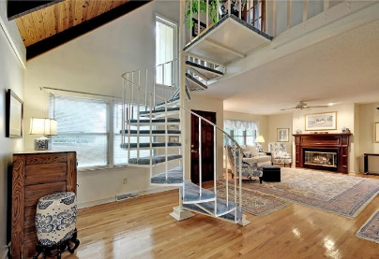
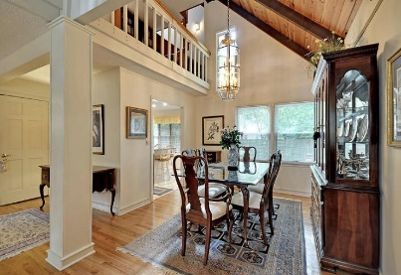
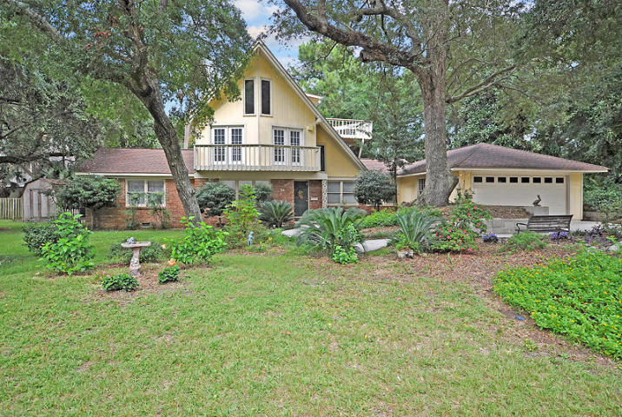
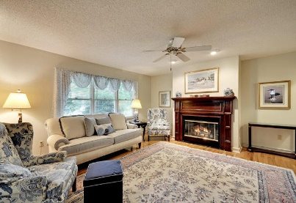
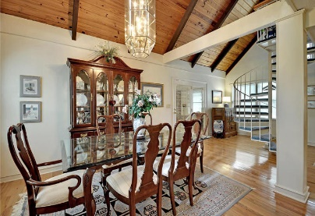
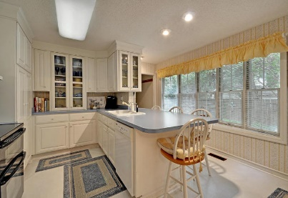
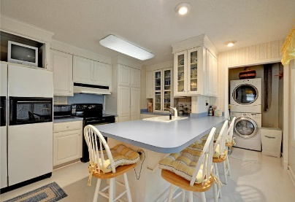
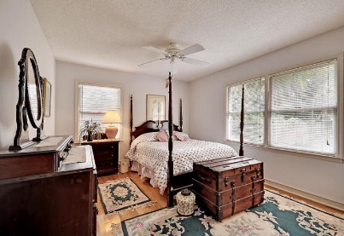
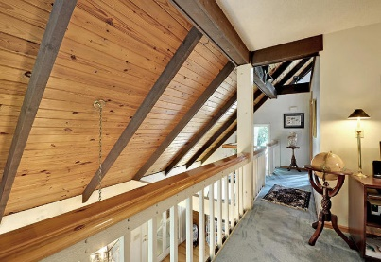
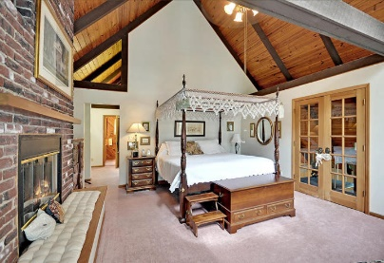
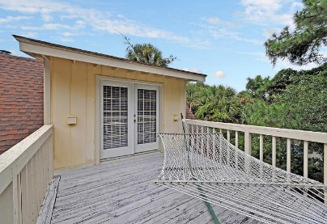
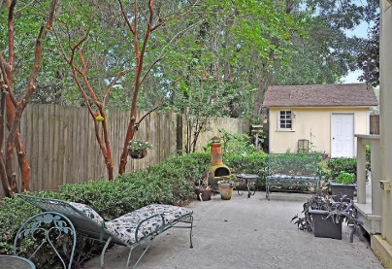
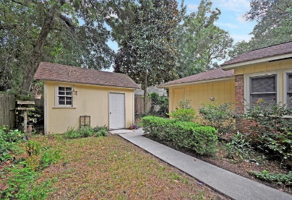


14 20th Avenue
Isle of Palms, SC 29451
MLS# 15024734 | $699,999
IOP under $700,000
Loaded with Updates
A GEM of a home tucked away on 20th Avenue on the Isle of Palms. This 4 bedroom, 2.5 bath 2532 sqft. home is wonderful. The first floor has sky high rich wood planked ceilings-just gorgeous! Also, on the first floor is the bright and airy kitchen, formal dining room, family room with custom built wood mantle, 2 large bedrooms, 1.5 baths, and a serine sunroom perfect for unwinding or reading a good book. The second floor has French doors leading to the grand master bedroom with a fireplace, balcony, walk-in closet and private bath. Also, on the second floor is a fantastic library overlooking the first floor. The railings can be removed to make moving items to the second and third floor easy. The third floor has an area for an indoor garden, a spacious bedroom, and large deck overlooking the IOP. The deck is ideal for enjoying an early morning cup of coffee while listening to the surf, and later gazing at the moon, or watching the 4th of July fireworks! The fenced backyard has mature trees and plantings and the gorgeous front yard boast glorious mature Live Oak trees. This home is much, much more than it is appears. Come look, because you will not find another home like this! Isle of Palms is a short drive to downtown Charleston with 5-star restaurants, world class shopping and iconic history as well as a SHORT WALK to the BEACH, the airport, Boeing, Mount Pleasant and Daniel Island.
Stan Huff
843-670-2835
stan.huff@agentowned.com
Jill Marcacci
843-297-5590
jill@agentowned.com
www.agentownedrealty.com
AgentOwned Realty Co. Preferred Group, Inc. | 824 Johnnie Dodds Blvd | Mt Pleasant, SC 29464

