Slide 1
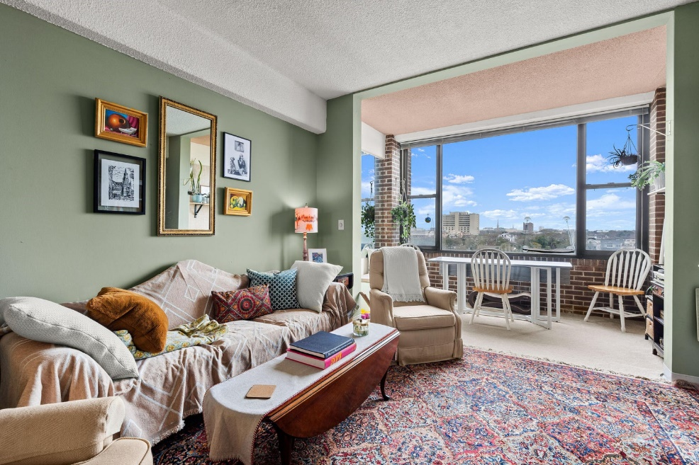
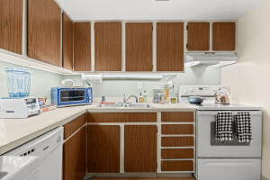
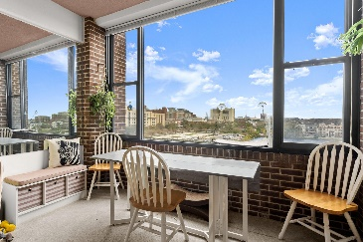
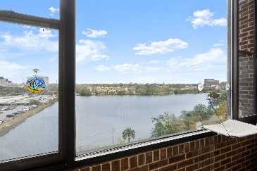
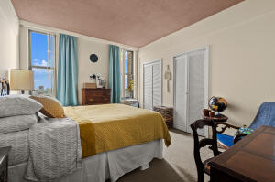
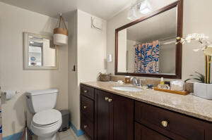
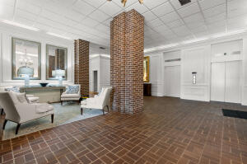
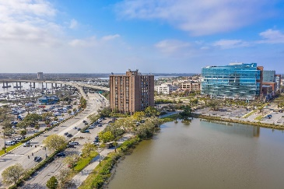
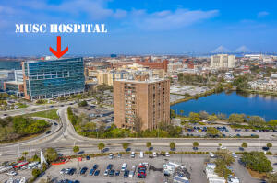
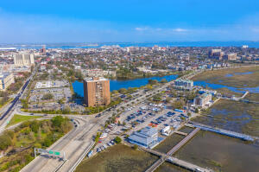
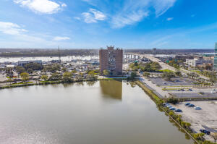



Stunning Views of Downtown Charleston
14 Lockwood Drive 5B
Ashley House
Charleston, SC 29401
MLS# 23004173
$330,000
1 Bed | 1 Bath | 735 sf
Wow! This condo is in PRIME location of Downtown Charleston, within minutes everything Charleston has to offer. WALKING DISTANCE TO MUSC/ROPER ST FRANCIS. This unit is a spacious 1 bedroom and 1 bathroom condo offering a kitchen with plenty of room, extra storage/closet space (which is not in many of the units!) and also has a spacious 1 bedroom, separate from the living area which overlooks downtown Charleston and Colonial Lake. The Regime/HOA covers garbage pick-up, common area maintenance, utilities (water and sewer), pest control, building and flood insurance PLUS Air Conditioning! Short (under 30 days) or Medium term rentals (under 90 days) are NOT permitted.
Nick Mazzilli
(843) 640-5575
nick@nickmcharleston.com
nickmavencharleston.com
Maven Realty
2180 McMillan Ave
#71672
Charleston, SC 29405

