Slide 1
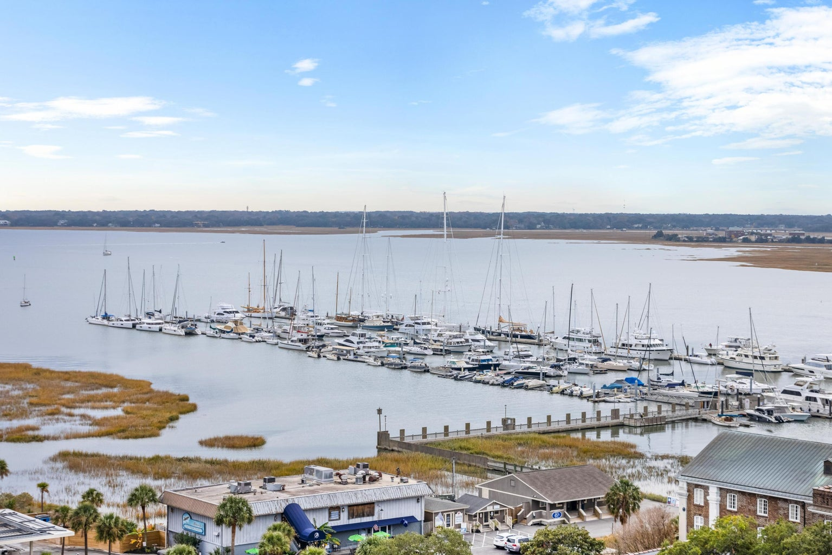

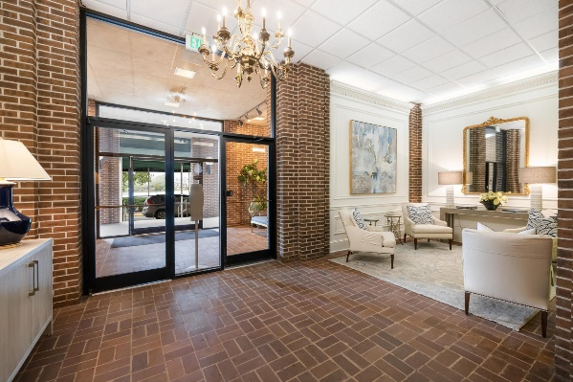
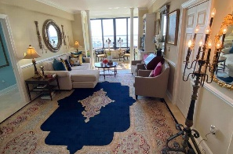


Be sure to watch the YouTube video to see more!
UNIQUE Jewel Box in the
OLD WALLED CITY
Downtown Condo with Amazing Water Views
14 Lockwood Drive 6D
Ashley House | Charleston, SC 29401 | MLS# 24005023 | $549,000
2 Bedrooms | 2 Baths | 1,149 sf
Beautiful completed renovated condo with dead-on views of the Ashley River and Marina. A great floor plan for sharing as each bedroom has its own private bath. New kitchen appliances and cabinets. This condo has a great rental history but would be a wondaful residence too! Furniture is available for purchase.
Plenty of parking and high security. Walk everywhere!
Handsome Properties, Inc
53 Broad St
Charleston, SC 29401
Ellen Leigh Murray
843-813-2006
chaspremierprop@bellsouth.net

