Slide 1

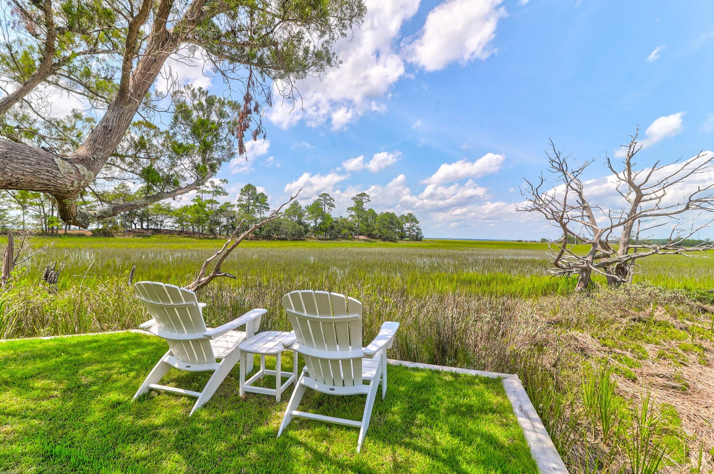
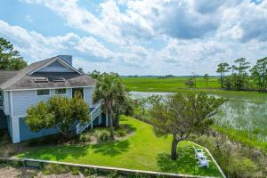
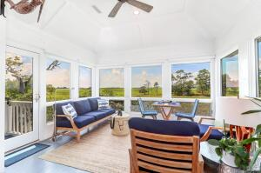
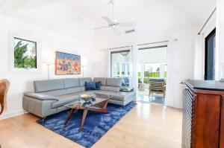
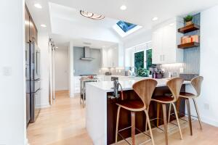
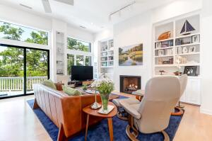
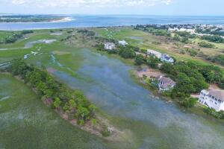


14 Seagrass Lane
Wild Dunes | Isle of Palms | MLS# 23018124 | $2,195,000
Stunning Marsh &
Ocean Views!
This marshfront home provides 180 degree views of the Intracoastal Waterway and Atlantic Ocean and is steps away from the private Seagrass walkway leading directly to the most private beach on the Island. To live on the Out Islands of Seagrass is to commune intimately with nature while being less than five miles from the center of town and steps away from the walkway leading to the beach. Osprey, heron and pelicans soar overhead eyeing the feeding redfish washed in by tidal current steps from the house. This home has been extensively renovated into a retreat like no other. Smooth maple hardwoods, quartzite counters, high-end appliances, spa-like bathrooms, and beautifully filtered light throughout.
In addition to the private beach access, Seagrass offers its own resident-only crab dock for fishing, kayaking and marsh exploration. There is a large four car garage, plenty of storage in the attic and garage, and a small, manicured lawn for outdoor play. The community offers tennis golf, pickle ball, and miles of bike paths. Come kayak, fish and explore this delightful property--you will not be disappointed!
Fantastic Rental Property
Ann Cortes
Office - (843) 886-8110
Mobile - (843) 324-6808
ann.cortes@carolinaone.com
Carolina One Real Estate | 1503 Palm Blvd | Isle of Palms, SC 29451-2280

