Slide 1
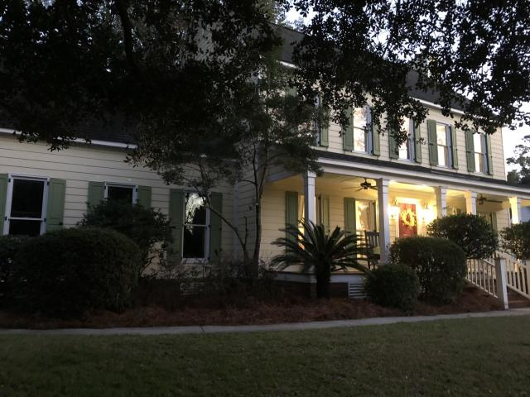
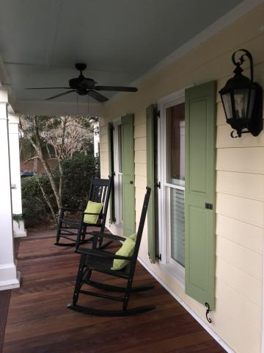
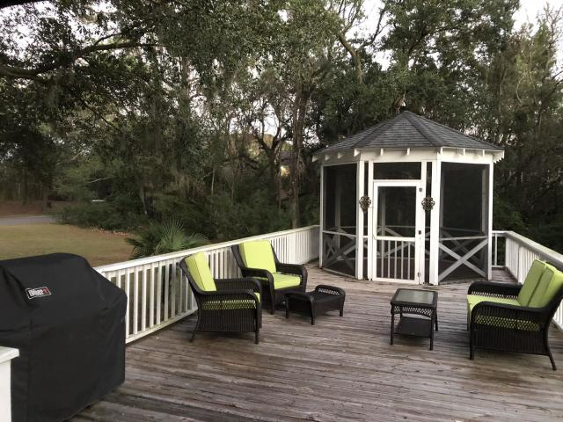
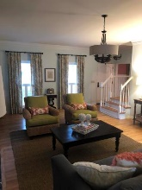
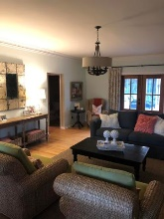
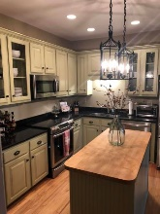
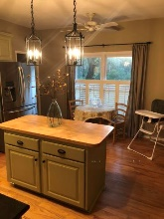
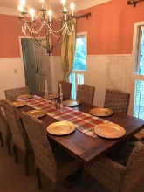
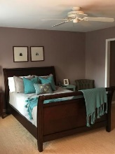
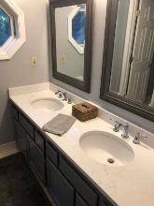
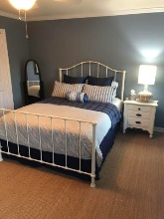
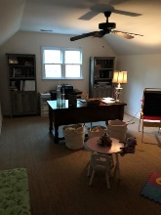
Renovated Lowcountry Beauty 1500 Whitsun Court Hobcaw Creek Plantation ~ Mount Pleasant ~ MLS# 19000486 ~ $545,000
This gorgeous renovated low country home sits on one of the largest lots in the desirable Hobcaw Creek Plantation. The large lot is adorned with a beautiful oak tree and contains plenty of room for further expansion. The first floor features a wonderful kitchen with new appliances that include a double oven and island. The well-lit family living room has gorgeous crown molding, as well as new mahogany doors that open up to the large deck and gazebo making it optimal for entertaining. The first floor also has a formal dining room, as well as a half bath for guests. The second floor offers a master bedroom with large walk in closets and master bathroom with new quartz counter tops. The second floor has two guest bedrooms and another full bath with new counter tops and fixtures.
The home also has a large frog which can serve as an office or a playroom.
The covered front porch made for relaxing is renovated with Ipe decking. Ipe is an exotic hardwood that is naturally resistant to rot and decay, is 8 times harder than California Redwood.
Kenneth Nix
kenneth@landsouthofcharleston.com
M (843) 222-2582 | O (843) 577-5263
Land South of Charleston, LLC | 180 E Bay St Ste 300 | Charleston, SC 29401

