Slide 1
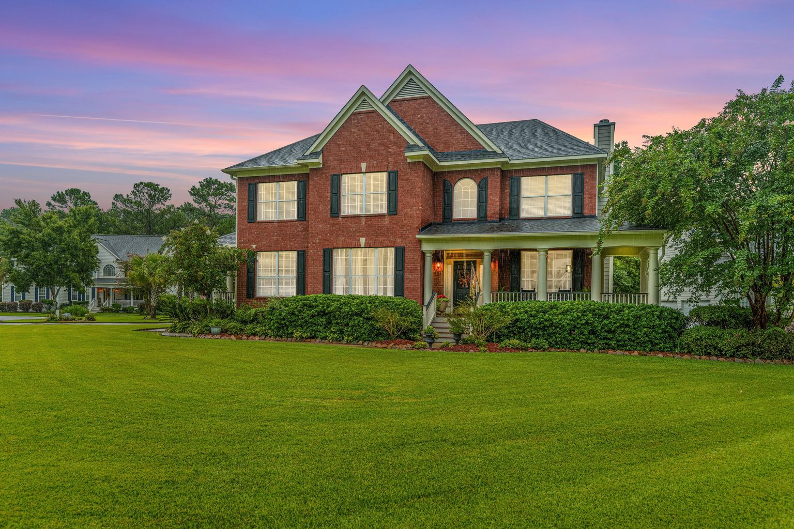
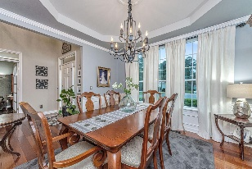
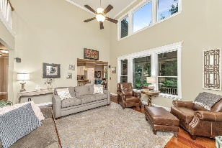
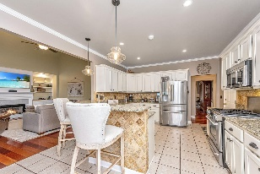
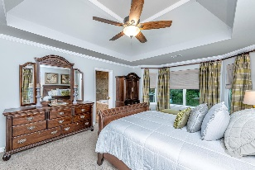
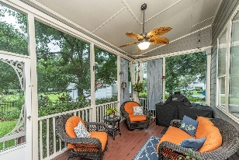


Desirable Legend Oaks Plantation!!
1500 Pondside Court
Legend Oaks Plantation | Summerville, SC 29485
MLS# 22023266 | $599,000
Award wining Beech Hill Elementary! New middle school-East Edisto. Ashley Ridge High school! One of most sought after sections in Legend Oaks! Quality Weiland built home. Welcome to this one owner brick front home on a corner cul de sac lot! With 5 bedrooms, 3 full baths, formal dining, separate office, there is more than enough space for all! As you arrive you will be Wowed by the meticulous care the owners have taken of the yard and the house. Walk up the Southern front porch and enter the 2 story foyer to this beautiful home! Office with glass doors is to the right, large formal dining room is on the left. Ahead continue into the main living area of the home. Many hours will be spent here with family and friends. Brazilian hardwood flooring flows throughout the downstairs living area. This home is great for entertaining as the kitchen is open to the family room. Guests and family can sit at the bar and converse while the cook prepares the meal. Dining can be done formally in the oversized formal dining room, or in the eat-in area for casual time, or better yet, on the back screened porch. Kitchen is ideal for the gourmet chef with amble granite counter space and gas stove. Kitchen is complete with quiet close upgraded cabinets and pantry. Exit the kitchen to the right, at end of the hall you will find the 5th bedroom with its private entrance to the side porch. The full bath is also located here. Would make a great mother-in-law room. Upstairs find the owners suite and additional 3 secondary bedrooms, laundry room, linen closet, loft and upgraded full bath. Owners suite is extremely spacious, bath has dual vanities, upgraded tile shower, soaking jacuzzi tub, separate water closet, walk-in closet where you will find a smaller door to extra storage over garage. Pull down attic access also allows for moderate storage. So many upgrades on this home! Outside you will find professional landscape lighting throughout the entire property, fence is aluminum for easy care and yard has full irrigation. Tankless water heater, insulated garage doors, upgraded bathrooms... ask for the list of special features! Legend Oaks is a golf course community with restaurant at the clubhouse. You can join the pool, tennis, golf or all three. There is an option to join the salt water pool located in other side of neighborhood. None are included in the hoa, but are optional.
Call today for your private showing.
Laurie Loparo
(843) 442-1290 | laurieloparo@gmail.com
www.lauriesellscharleston.com
Carolina One Real Estate | 873 Orleans Road, Ste 102 | Charleston, SC 29407-5753

