Slide 1
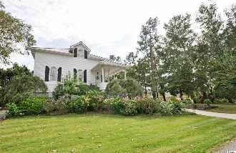
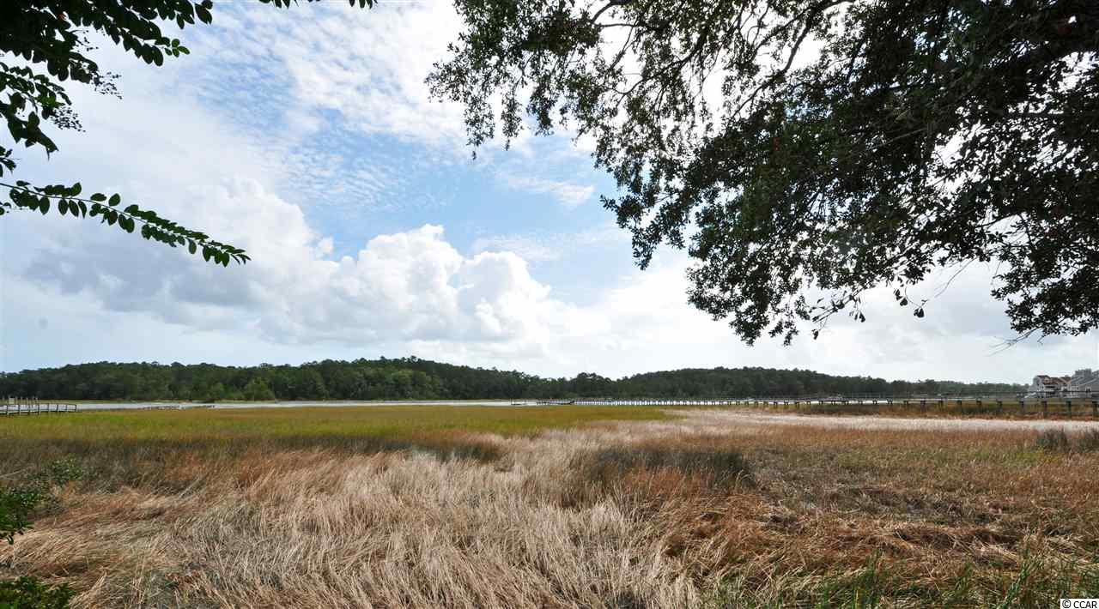
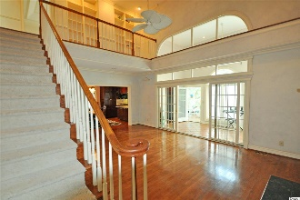
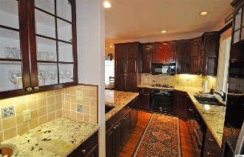
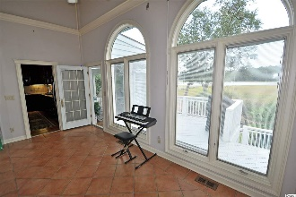
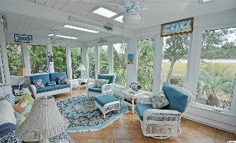
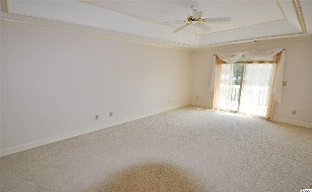
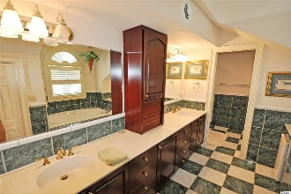
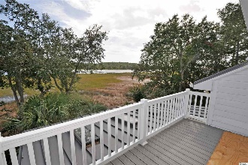
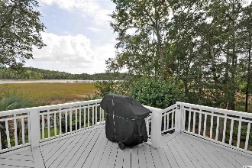
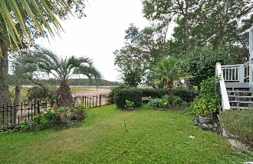


1510 Salt Marsh Trail
Salt March Cove ~ Little River, SC 29566
MLS# 1922486 ~ $575,000
Breathtaking views!
This remarkable, Charleston-inspired low-country raised beach home is on the marsh with DIRECT ACCESS along and unobstructed views of some of the best natural scenery surrounding the iconic Intracoastal Waterway (ICW) anywhere. And the price is right to make it your own! As it is truly a one-of-a-kind 4-bedroom/3 1/2-bath treasure, with 3-car garage and 2 driveways, inviting floor plan and screened Carolina four-season and additional outdoor porches and informal patios, of course designed to overlook the marsh and ICW. It would not be possible to duplicate this unique property and incomparable lot at today's market values. The location is easy to access and close to all that the North Strand has to offer, also, yet peacefully secluded on a very private, uncrowded cul-de-sac set apart from close neighbors and developments. This 3,900 square-foot charmer welcomes you with a southern-style front porch with swing, cozy propane fireplace in the living room which is accented by vaulted cathedral ceilings and bull nose trim and moldings on the walls. The upgraded kitchen has granite counter tops, propane chef's stove, wet bar, wine rack, pantry and island. The loft has custom built-in bookshelves. A large master-enclave has a walk-in closet, sitting room, sliding glass doors onto a deck with even more Waterway views and an en suite, complete with marble tile, over-sized walk-in shower, double-sink vanity and whirlpool tub. There is an additional guest room on the spacious main level. The home has innate curb appeal and enjoys more than an acre lot, your own big piece of paradise...DIRECT WATERFRONT! You must really see this home to appreciate the singular beauty of its mature landscaping, giant oaks, the unspoiled panoramas of an ever-changing environment and the unforgettable wildlife and boats of all kinds to enjoy. Plus, there is a nice, surrounding lawn and garden, fenced backyard and restful, fun places to put lawn chairs as secluded viewing niches from your own back and side yards. Picture a warm fire pit on a lovely fall evening, enjoying the heron and egrets feeding and watching the boaters go by. This home affords all that and much, much more. It is located in the heart of the historic Hamlet of Little River, Horry County's second oldest town, which is renown for its proximity to the Atlantic Ocean via the ICW and rich nautical history including being a popular pirate port. Mariners Point Marina is within walking distance; slips are available. You may even apply to permit to build your own dock & pier. There are signature golf courses, restaurants, antique and thrift trails, recreation, shopping, access to major highways and medical services, and good schools and parks. It adjoins North Myrtle Beach, which was recently named one of the safest cities in the nation and with one of the best beaches in the U.S., the nearby Cherry Grove Beach, minutes away. However, taxes are levied at low Horry County rates. The home is being sold unfurnished with the exception of a custom dining set that matches the rich hardwood of the floors and the solid-cherry kitchen cabinets. It will convey with an acceptable offer. The home is unoccupied, so you may easily envision your own personal decor throughout. Some of the photos displayed herein are of the prior furnishings in the home. There are two more nice bedrooms on the lower level and what seams like unlimited storage in two walk-in attics, under the front and rear porches and garage/outside space for cars, golf cart and other recreational items, including a boat or RV. Of special note are the Standing Ridge Lifetime Metal Roof, Roll Down Hurricane Shutters on the rear, Colonial Hurricane Shutters on the front and Tankless Hot Water Heater. It's the perfect choice for a home, vacation home or investment property. No HOA. A top-of-the-line Old Republic Platinum Home Warranty W/HVAC coverage is included with a full 12 months of coverage.
BUT IT IS ALL ABOUT THE VIEWS!
Deborah Collins
843-424-9013
dctidewater@yahoo.com
Connie Ross-Karl
702-306-2643
conniesross@aol.com
NEW WAY PROPERTIES MYRTLE BEACH

