Slide 1
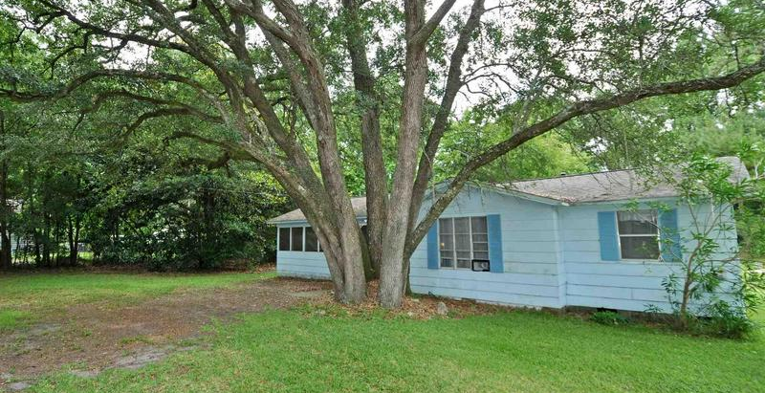
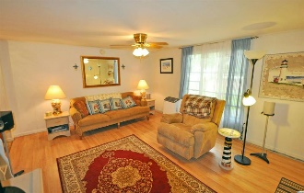
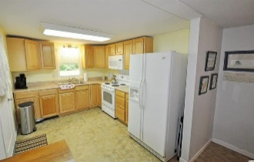
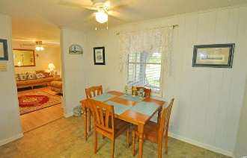
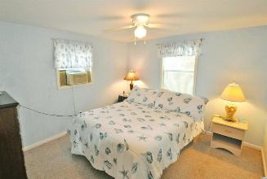
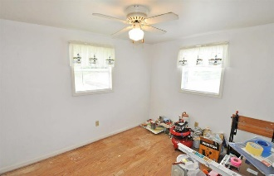
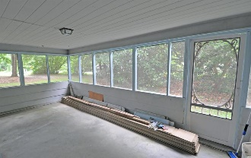
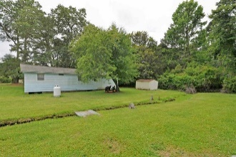
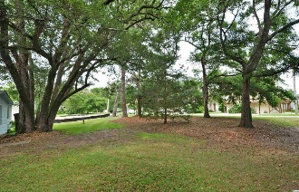
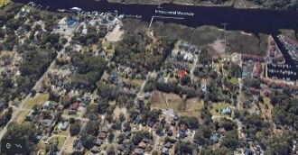


The Quintessential Southern Cottage
Instant Charm & Movie-script Landscaping
1501 Watson Ave
Little River SC 29566 | MLS# 2114010 | $174,900
This is the quintessential Southern cottage, an appealing light blue color, instant charm and movie-script landscaping with its signature live oak and impressive mature magnolia trees and set back on a wonderful, over-sized lot for privacy and innumerable-use-options. This attractive 3 bedroom/1 bath residential home on a large, half-acre-plus property is secluded but is conveniently located near many businesses and is in the desirable Hamlet of Little River, Horry County's second oldest town, which is renown for its proximity to the Atlantic Ocean via the ICW and rich nautical history including being a notorious, popular pirate port. For boaters, there are several marinas nearby to buy or to rent boat slips. For golfers, there are numerous signature golf courses, plus restaurants, antique and thrift trails, recreation, shopping, access to major highways and medical services, and good schools and parks. It adjoins North Myrtle Beach, which was recently named one of the safest cities in the nation and with one of the best beaches in the U.S., the nearby Cherry Grove Beach, minutes away. However, taxes are levied at low, low Horry County rates. View this inviting, well-priced rustic charmer with magnificent indigenous landscaping for a personal residence, rental or with potential for investment. As it is located near the casino boats, great restaurants, the historic district with its own legendary live oaks and the riverfront/Intracoastal Waterway where development is expected and may include a fishing-village-inspired concept with marshwalk and a marina. This is a spacious lot, and the cottage itself immediately beckons with a coveted wrap-around screened porch and lots of room to comfortably park cars in the designated tandem front-yard entry. The yard itself, of course, is equally appreciated, for its grand square footage and possibilities. Bedrooms are unexpectedly spacious, too, and have notable closets; and there is a larger jack 'n jill bath which is modernized with a tub/shower and vanity -- a nice surprise and easily accessible from all three bedrooms and for guests from the living area. Entrance is from the rear or the front of the screened porch, nice, covered entrances to the living room or to the kitchen of the home. The main living area is open and the dining area adjoins the open, roomy kitchen. All appliances convey. The floor plan is workable and is homey. The whole interior boasts a country/retro fun and very livable atmosphere... Some renovation has been done, and more was planned. So you can see peaks at hard-wood flooring and materials conserved in the rooms the owners intended to install them, along with some exterior materials to embellish the quaint outside...The home is being sold furnished with a does not convey list. The kitchen overlooks the back yard and is cheery and has room for family dining, good cabinet space and is nicely workable. The window air conditioning unit in the living area is new and cools the rooms well, along with other bedroom units.. This small home has BIG potential! Properties in this highly desirable Little River location and with numerous options at such a compelling price are rare! Be retrospective, or even build or build on for a future in Little River, along the waterway, in this singular community of diverse, treasured homes. Welcome!
Video Tour: https://www.youtube.com/embed/6QkK6FAVe-4
Deborah Collins
843-424-9013
dctidewater@yahoo.com
Connie Ross-Karl
702-306-2643
conniesross@aol.com
NEW WAY PROPERTIES MYRTLE BEACH

