Slide 1
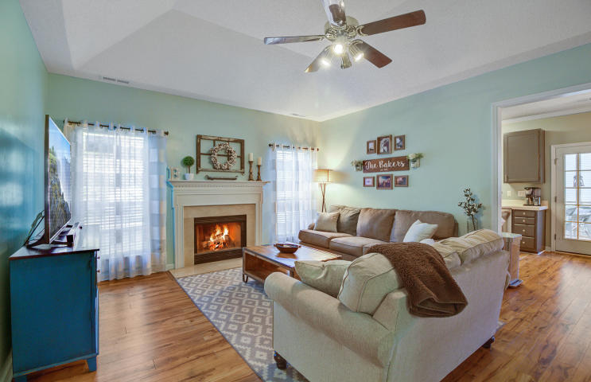
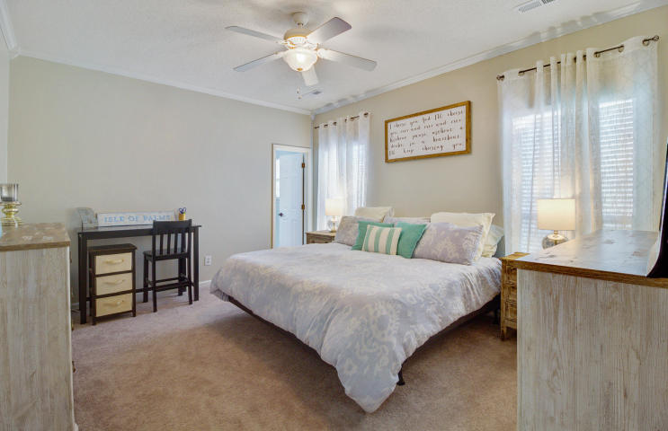
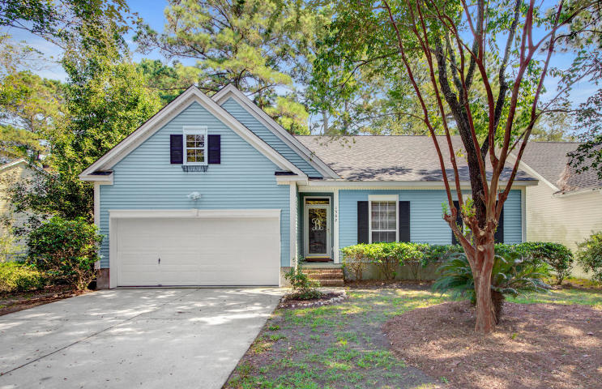
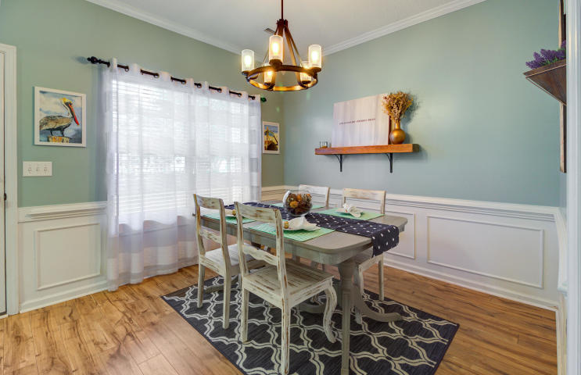
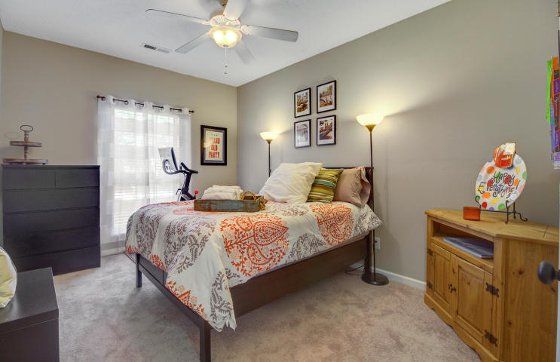
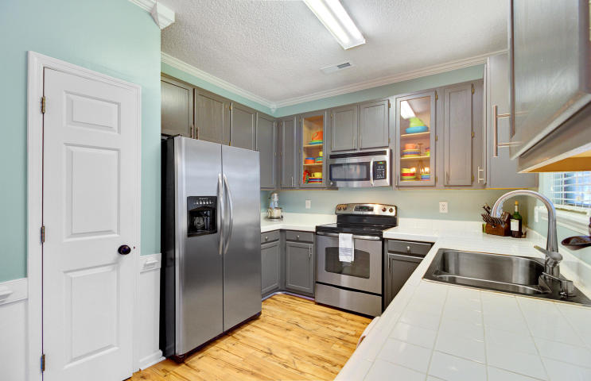
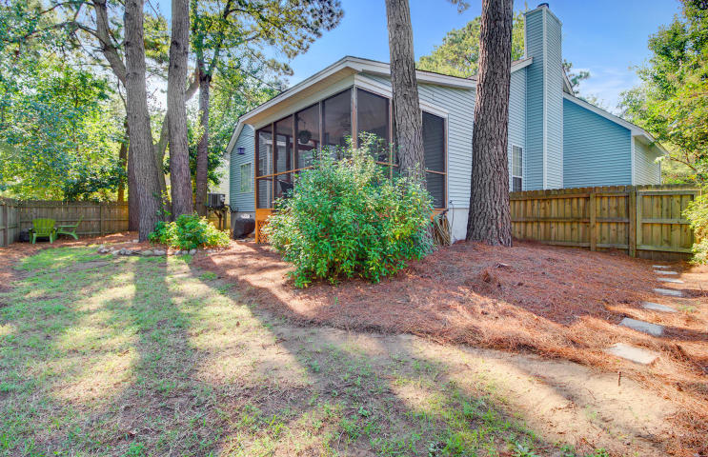
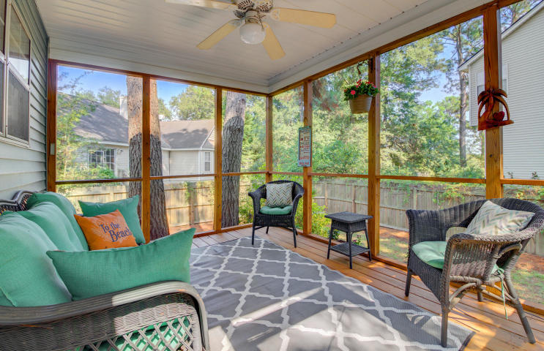
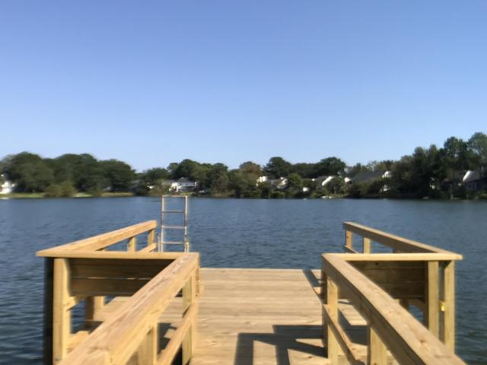


Beautiful "New Listing" on James Island
1502 Harborsun Drive
Wexford Sound
Charleston, SC 29412
MLS# 18026163 ~ $320,000
When you enter Wexford Sound you immediately know you are in a special community. With sidewalk lined streets and beautiful mature trees including moss covered oaks, you approach your destination with a welcomed feeling. Enter 1502 Harborsun Drive and you realize you have found a truly move in ready home. This is one story living with all the features and benefits one could want! The home has lovely wood floors in all main living areas. Tasteful colors are throughout and it is evident that this home has been lovingly maintained by its current owners. The kitchen has freshly painted cabinets (and plenty of them) and stainless steel appliances for a fresh updated appeal. The dining area is the perfect size and overlooks the back yard. A wood burning fireplace is the focal point of the large family room with vaulted ceilings. The heart of the home is comfortable and has a great flow. Additionally, there is a large screened porch offering an another living space outdoors and it overlooks the private, fenced in yard.
This lovely home has three bedrooms, each with brand new carpeting, and two full baths. The master bedroom has a walk in closet and is large enough to accommodate a full bedroom suite with ease. The new owners will love their master bath complete with dual vanities and a separate soaking tub and shower. The two additional bedrooms down the hall are generous in size and also have brand new carpeting. The laundry closet is conveniently located in the hall between the bedrooms. When choosing 1502 Harborsun Drive as your new home you can be assured that all you need to do is unpack your boxes and immediately start enjoying all that James Island and Charleston have to offer! Why? The roof was replaced in 2015 and the HVAC system in 2017. The hot water heater and carpets are all brand new having been installed in August, 2018. Wexford Sound is not only perfectly situated 10 minutes from Historic downtown Charleston and 10 minutes to Folly Beach, but offers its residents a lovely walkable community with gorgeous sights to take in! Nestled along Clark Sound, you can take in the marsh and water views. In addition, there is a massive lake and "The Commons" is the gathering spot for homeowners. This is a park like setting with bench seating and a lovely dock from which you can enjoy the stunning view of the lake. The setting could not be more serene. This stunning home in such a wonderful community is the perfect Charleston residence on ever popular James Island. Check out the 3-D Virtual tour and property video then schedule your appointment while you can!
3D Walk thru tour on MLS: https://my.matterport.com/show/?m=EKVzc4hRvGV
Ellen O'Neil
Broker/Owner, ABR, e-PRO, CNE
Charleston Realtor of Distinction
(843) 300-8530
www.EllenONeilProperties.com

