Slide 1
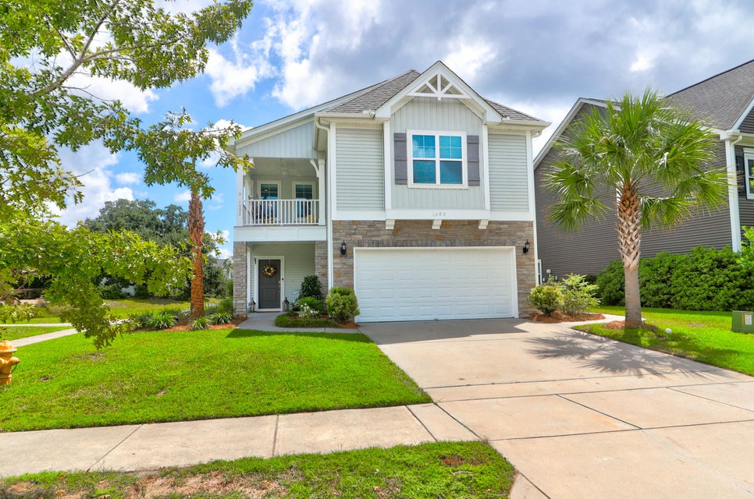
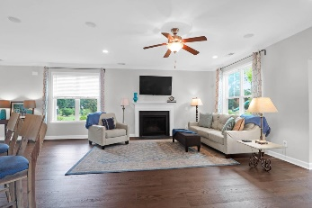
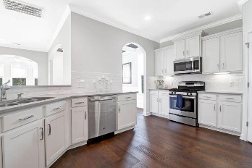
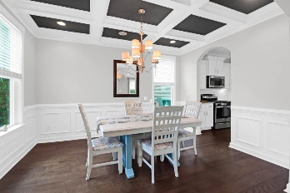
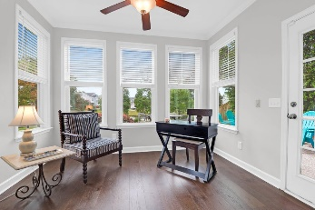
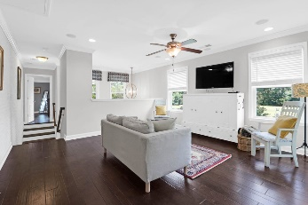
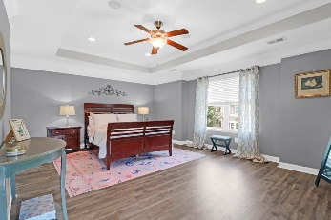
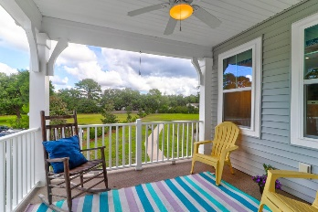
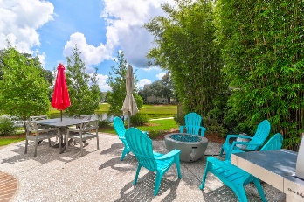
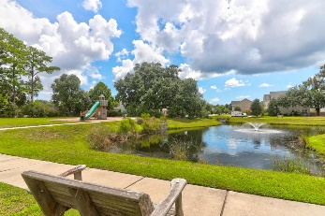
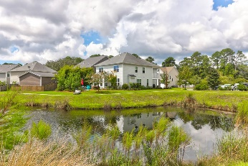



FRESHLY PAINTED | MOVE-IN READY | FORMER MODEL HOME
1502 Innkeeper Lane
Brownswood Village
Johns Island, SC 29455
MLS# 24022143
$595,000
3 Bed | 2½ Bath | 2,650sf
This stunning, former model home features many expected upgrades in a showcase home. From the extensive moldings, the open concept and lovely lighting this home is ready for your furniture! The elegant dining room has a lovely coffered ceiling and the expansive windows give a perfect view of the water. In fact, this entire home is bathed in natural light, showcasing new LVP floors downstairs. The great room, with its cozy fireplace and gas logs, is ideal for both relaxing and entertaining. Enjoy serene views of the lagoon from the sunroom, a perfect retreat for any time of day. This home also offers a convenient office space adjacent to the kitchen, a practical drop zone for book bags in the hallway, and an air conditioned two-car garage. Step outside to the private patio that overlooks the lagoon and the fountain, providing an excellent spot for outdoor gatherings. Go upstairs and enter the full loft with a custom brick wall accent. The large owner's suite is a true sanctuary, featuring a comfortable sitting area and an ensuite master bath with a luxurious soaking tub and a standalone shower. Off the Owner's suite is a lovely porch to enjoy morning coffee. The two additional generous bedrooms offer scenic water views and are serviced by another full bath. The interior of the lovely home has been freshly painted. This home is steps away from HOA managed space with a full playground and walking paths around the neighborhood. A $2,400 Lender Credit is available and will be applied towards the buyer's closing costs and pre-paids if the buyer chooses to use the seller's preferred lender. This credit is in addition to any negotiated seller concessions.
Leesa Northrup
M: 843.442.0987
O: 843.884.1622
lnorthrup@carolinaone.com
lovingthelowcountry.com
Pam Bishop
M 843-814-1622
O 843-856-3958
pbishop@carolinaone.com
www.pambishop.com
Carolina One Real Estate
628 Long Point Road
Mount Pleasant SC 29464

