Slide 1
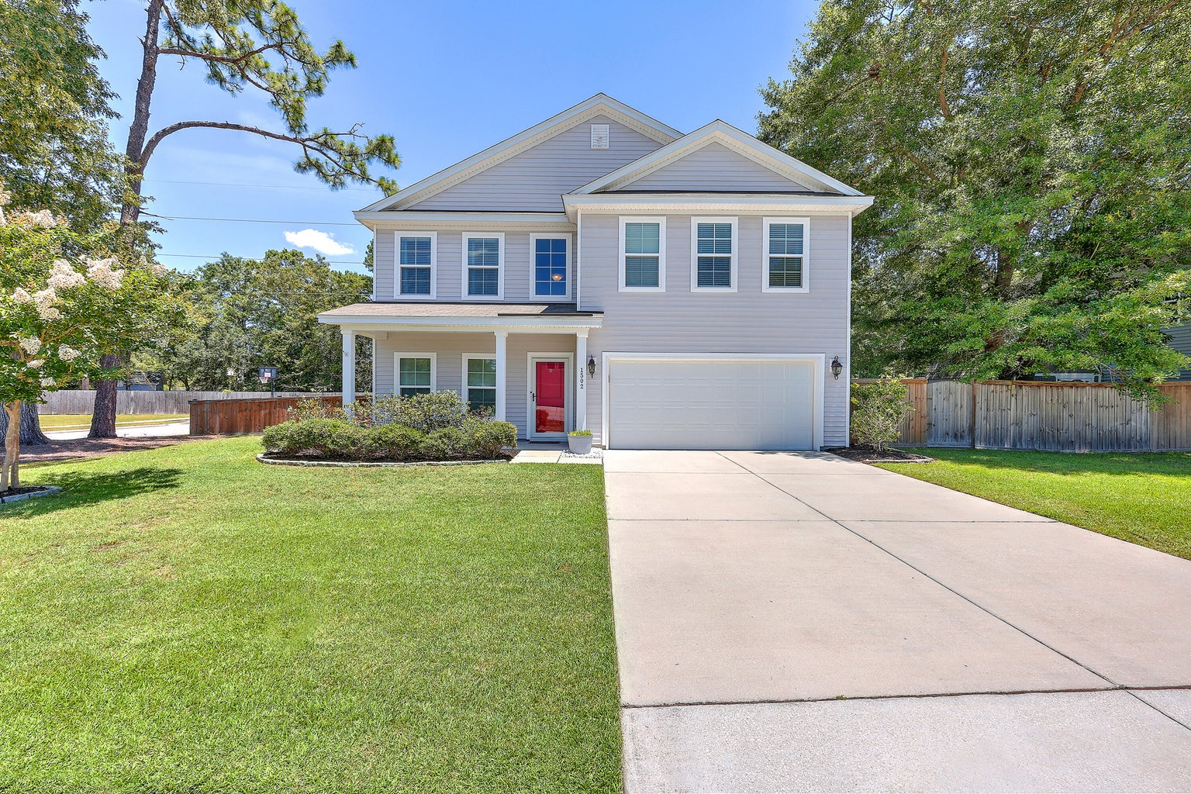
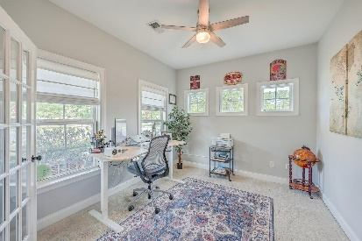
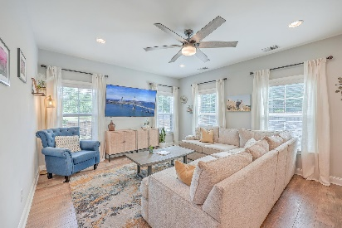
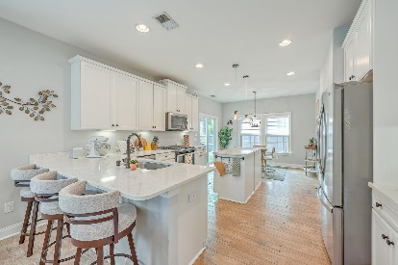
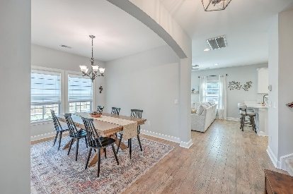
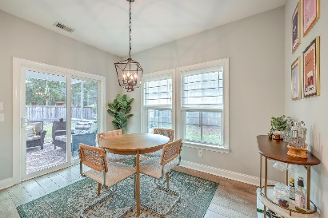
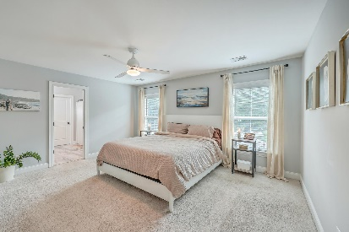
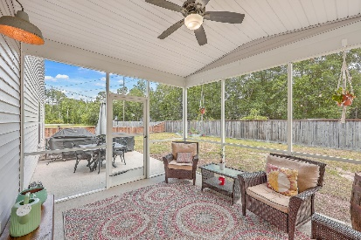


1502 Mcintosh Road
Lakeside | Johns Island, SC 29455 | MLS# 24012937 | NEW PRICE $599,900
OPEN HOUSE SUNDAY 1-3
$10,000 RATE BUY-DOWN!
Seller is generously offering $10,000 towards your closing costs or rate buy-down, saving you more money at closing! This beautifully designed home offers effortless living with contemporary flair, nestled on a private corner lot with no through-traffic. The open-concept living space, with airy 9'' ceilings , is bathed in natural light and boasts a seamless flow, perfect for both entertaining and daily family life. You'll love the tucked away office with beautiful french doors situated at the front of the home just off of the two-story foyer, especially for those working remotely. Bring your family and friends together for delicious meals served in your naturally lit dining room, perfect for large gatherings. You will absolutely love the well- appointed kitchen complete with a breakfast bar, separate eat-in area, an island, gorgeous quartz counter-tops, SS appliances that includes a newer oven(2023), under cabinet lighting, a coffee station, modern fixtures and a large pantry. Upstairs, the spacious Owner's En-Suite provides a private retreat from the stresses of the day with a newly designed walk-in closet, garden tub/shower and a private water closet. 3 additional spacious bedrooms with roomy closet space, 1 full bathroom and laundry room round out the second floor. Step outside to your backyard oasis, featuring a huge screened porch with added privacy pull-down shades, a bonfire nook and streaming lights that will enhance your summer evenings. An additional large uncovered patio space is perfect for grilling and dining. There is a gas line so no propane tanks required. Situated on a generous corner lot, the expansive backyard includes a double gate entry which can accommodate access for a boat. The recently finished garage offers an EV charging capability and ceiling storage. Unofficial access to Johns Island County Park through the neighborhood. Active Pickle-ball leagues, tennis, disc golf, soccer field, pavilion, and fishable pond. Embrace the charm and functionality of this exceptional property-your dream home awaits!
Take a virtual walkthrough!
Beth Mandell
M 803-463-7734 | O 843-871-2121
bmandell@century21properties.com
www.bestcarolinahomedeals.com
Century 21 Properties Plus of Summerville | 118 W Richardson Ave | Summerville, SC 29483

