Slide 1

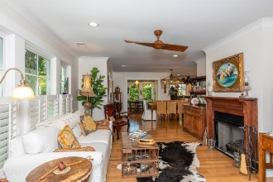
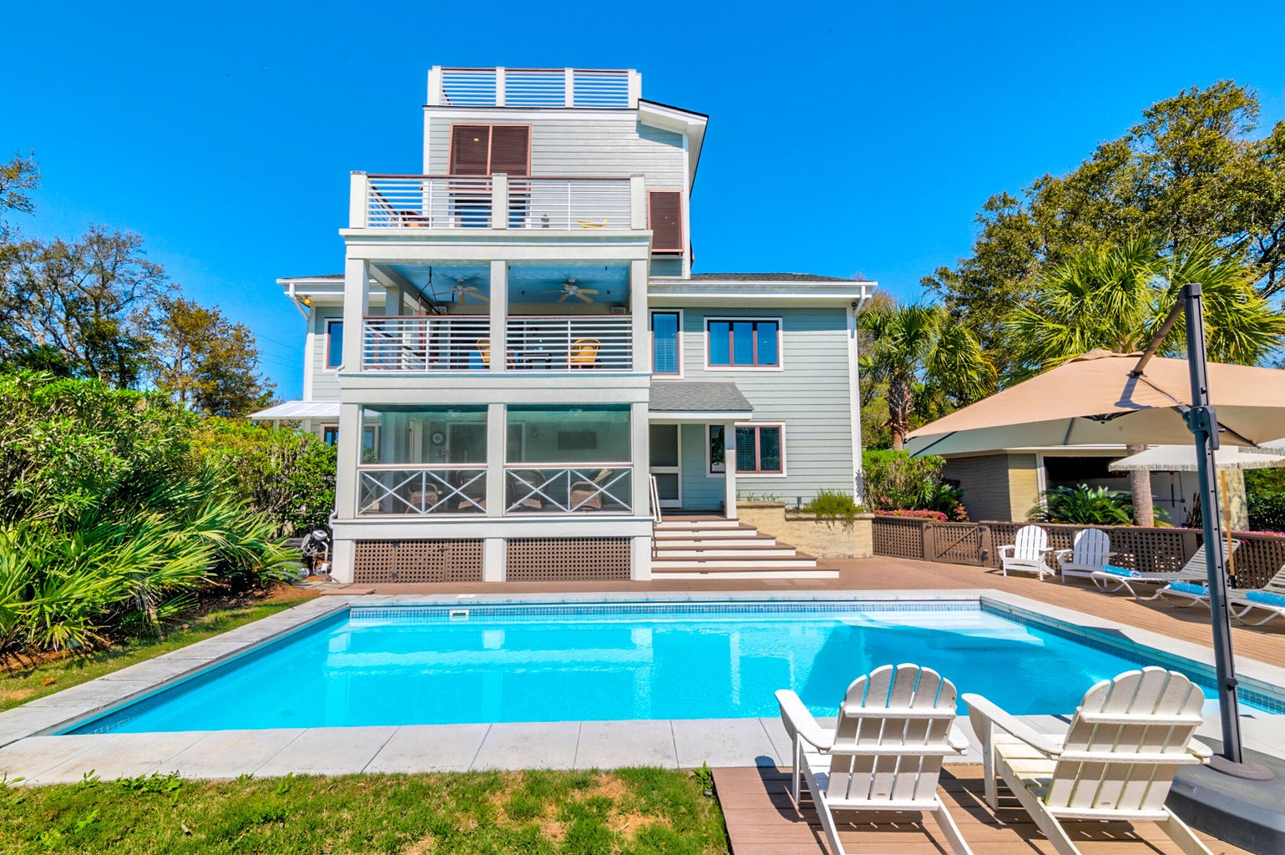
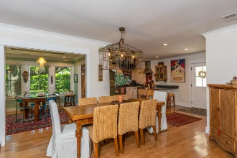
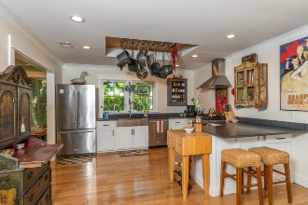
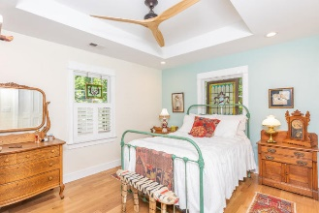
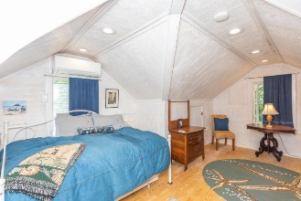
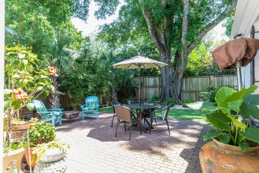
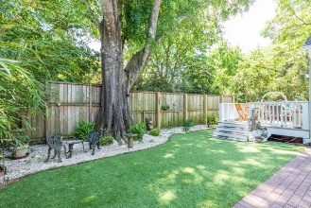

Open House Saturday 11-3
1502 Poe Avenue
Sullivans Island, SC 29482
MLS# 23005488
$3,900,000
Gorgeous, fully renovated Sullivan's Island home is perfect as a full-time residence or second home! Saltwater pool, separate oversized Hot Tub, decks on every level with views of Fort Sumter and Charleston Harbor, and only a short walk to the Beach! The most recent renovations (2022) include a new/updated Kitchen, first level Owners Suite and separate Powder Room for guests. The large Dining Room and Living Room are a warm and comfortable gathering place for family and friends, and the double glass doors lead to the spacious screened porch and pool area with ample space for sunbathing and outdoor entertaining! Back inside, the stairs take you to the open and bright second floor Family Room, two additional Bedrooms (one with ensuite bath and another full bath in the hall outside the third bedroom), plus a large Covered Porch! Perhaps the favorite room of the house is on the third floor with expansive windows, open deck and the best views of Fort Sumter and the Charleston Harbor. This room includes a Wet Bar, Beverage Fridge, Half Bath and indoor/outdoor entertaining space! Do not miss the *secret* room large enough for a twin bed! Finally, the fourth level Observation Deck has plenty of room to relax and soak in the gorgeous Island views! In 2007 this home was totally renovated, adding the third and fourth levels, all exterior decks/porches, new windows, cement plank siding, and new electrical and plumbing throughout. Along with a home Generac generator, there is an outdoor shower and oversized, detached Garage that can easily accommodate multiple cars and/or your favorite island toys! This beautiful home sits on a quiet street, is adjacent to the Ft Moultrie National Historical Park, and is a short golf cart ride to Sullivan Island's restaurants and shops.
Carolina One Real Estate
195 W Coleman Blvd
Mt Pleasant, SC 29464
Lisa O’Keefe
ABR, GRN, SFR
843-442-7968 C
lisa@theroettgerteam.com
Bill Roettger
843-224-0553
bill@theroettgerteam.com
TheRoettgerTeam.com

