Slide 1
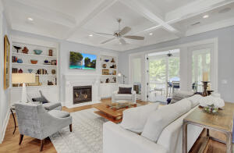
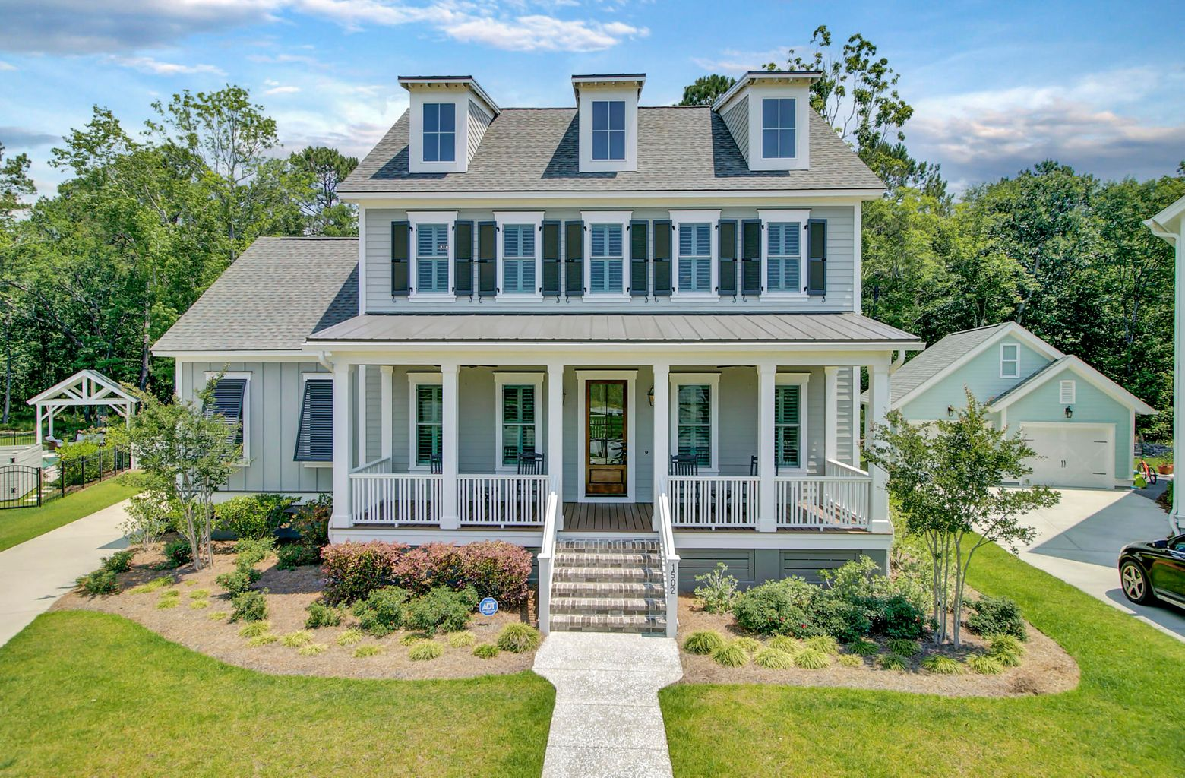
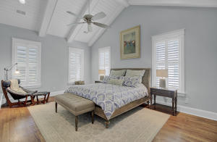
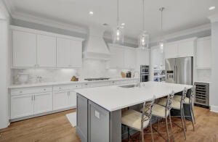
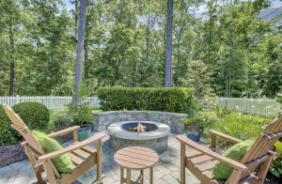
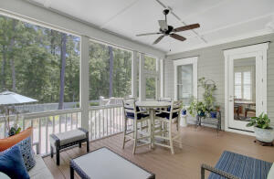
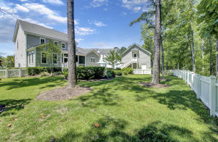


JUST LISTED
Lowcountry Beauty
1502 Windlass Way
Carolina Park
Mount Pleasant, SC 29466
MLS# 21013448 | $1,090,000
The perfect blend of sophistication, comfort, style and beauty- 1502 Windlass Way is the home you have been waiting for! From the moment you approach you will be struck by the curb appeal of this southern charmer located on a cul de sac in sought after Riverside at Carolina Park. The full front porch is the perfect place to perch yourself to greet neighbors or watch children play. Once you enter the home you'll be struck with the light filled, open and airy design of the living spaces. Attention to detail with tasteful finishes throughout make a great impression. Light floods into the home creating a warm and uplifting feeling throughout. A large family room with a gas fireplace has a wall of doors leading to the lovely screened porch. The kitchen is truly a dream come true for the chef in your home! Outfitted with a gas cooktop and wall oven with built in microwave, this kitchen leaves nothing to be desired. A wine chiller is an added bonus and an abundance of cabinets and counter space make organization and food preparation a breeze. A huge kitchen island provides ample seating for casual diners and conversation while the cook prepares the meal. The pantry is massive so feel free to stock up on all your favorites at Costco located in Carolina Park! A formal dining space overlooks the serene, wooded back yard. This open concept plan is ideal for families and entertaining. The master suite is conveniently located on the main level. Soaring vaulted ceilings have a dramatic impact on the beauty of this owners' retreat with an equally impressive spa like master bath. An elegant free standing tub is a focal point, but the massive shower is sure to impress. Double sinks and his and her closets add to the functionality of this elegant master bath. Upstairs you will find three additional bedrooms, each generous in size and with spacious closets. Two rooms share a jack and jill style bathroom while the final bedroom has its own full bath. If outdoor spaces matter, you will not be disappointed. In addition to that charming full front porch, a large screened porch overlooks a magnificent back yard. Professionally landscaped and a beautifully designed hardscape complete with fire pit, this yard is impressive! Being fully fenced it makes a fantastic yard for children and pets. Additionally, there is plenty of room for a pool if desired! Being a cul de sac location, the rear yard is huge and backs to woods- a private oasis! One true stand out feature of this home is the fully finished living quarters located over the large two car detached garage! The design of this fully habitable space includes the fifth bedroom, sitting area, a full bath, large closet and a kitchenette - a true studio apartment perfect for guests who seek supreme privacy while visiting. Other options for this hard to find space include a magnificent home office, a studio or hobby room, or even a location for home schooling. The possibilities are endless! Yes, the space can be rented if desired, so long as it is rented for a minimum of 30 days. The finishes throughout this home are tasteful and elegant. It is truly turn key! Carolina Park offers its residents a rich lifestyle with numerous amenities including swimming ( a pool in The Village section plus a new pool for the exclusive use of Riverside Residents), playground, dog park, tennis courts and an abundance of green space perfect for playing. Bolden Lake is stunning and makes for a wonderful location for walking and biking. The Carolina Park Elementary School, Wando High, and Oceanside Academy are all located in Carolina Park. Shops and businesses continue to be built enhancing the quality of life for residents. The fire station and new public library are located within the neighborhood and Roper St. Francis Mt. Pleasant Hospital borders the community next to Costco. The location is unbeatable - a short ride to the beaches at Isle of Palms or a straight shot into Downtown Charleston in less than thirty minutes. Your dream home in a magnificent community awaits!
Check out the video tour here: https://video214.com/play/sFYG5ns0bsIrvpZmO0pAyQ/s/dark
Ellen O'Neil
Broker/Owner, ABR, e-PRO, CNE
Charleston Realtor of Distinction
(843) 300-8530
www.EllenONeilProperties.com

