Slide 1
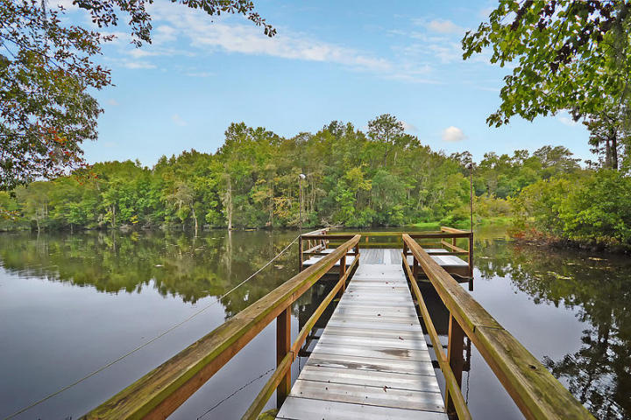
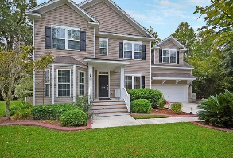
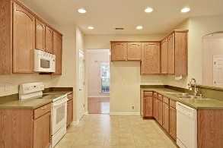
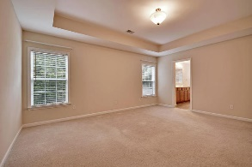
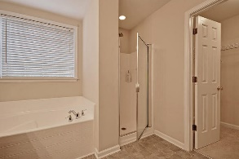
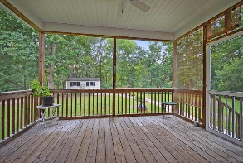
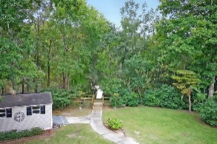
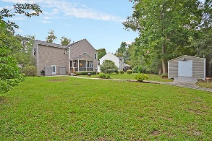
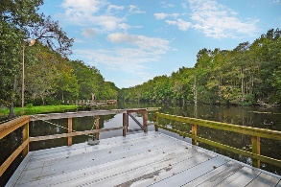
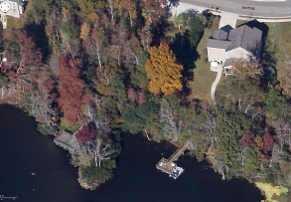

1504 Dockside Court Tanner Plantation Hanahan, SC 29410 MLS# 16026462 $425,000
Huge Private Dock! Breathtaking Views!
$20,000 Price Reduction!
Loaded with Updates
Enjoy all the natural beauty of this .42 acre wooded lot has to offer with an over-sized deck and look-out area leading down to the deep-water dock so you can sit in the cool shade of the trees and BBQ while overlooking the reservoir! Beautiful 4 bedroom 2.5 bath house has all space you could need and then some more! Walk in to a lovely foyer with hardwood floors and arched entryways. On the right is the spacious formal dining room with huge picture window overlooking the front yard. On the left is the formal living/flex room with bay window - makes for a great home office. Walk back into the house and into the spacious family room with the wall of windows. This home has it all-nature lover, boater and entertainer's dream! The family room is open to the kitchen with solid surface counters, breakfast bar, and tons of cabinet and counter space for the home chef! Eat-in breakfast area is open to the kitchen and family room, and has sliding glass doors that lead onto the big screened in porch. All bedrooms are upstairs with laundry and will not disappoint! The master bedroom is enormous and has a beautiful trey ceiling, lots of natural light and awesome views of the water. Master bathroom suite has large dual vanities, deep soaking tub and separate shower, and a HUGE walk in closet. The other bedrooms are very spacious but the 4th bedroom also makes for an amazing bonus room retreat - to use for a game room, office or media room! There is an outdoor shed that can be used for storage or turned into a "man cave" or outdoor entertaining area right next to the dock! The Reserve is a perfectly sized community where the neighbors get to know each other, has a pool, clubhouse, play park and a large community dock overlooking the Goose Creek Reservoir (but at this house you don't have to share since you have your own!). You are only 2 miles from a shopping complex and close to the Air Force Base, the Navy Base, and I26 & 526 making downtown and the beaches a short ride! This house has it all: PRIVATE DEEP-WATER DOCK, MAGNIFICENT VIEWS, WOODED YARD, LARGE HOUSE, and so much more. Call today to be first to see!
**No damage through Hurricane Matthew and the 1000- year rain!
Stan Huff
843-670-2835 stan.huff@agentowned.com
Jill Marcacci
843-297-5590 jill@agentowned.com
www.agentownedrealty.com
AgentOwned Realty Co. Preferred Group, Inc. | 824 Johnnie Dodds Blvd | Mt Pleasant, SC 29464

