Slide 1
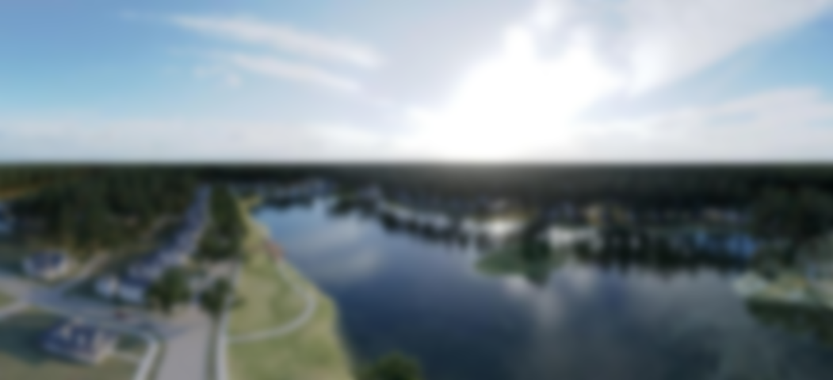
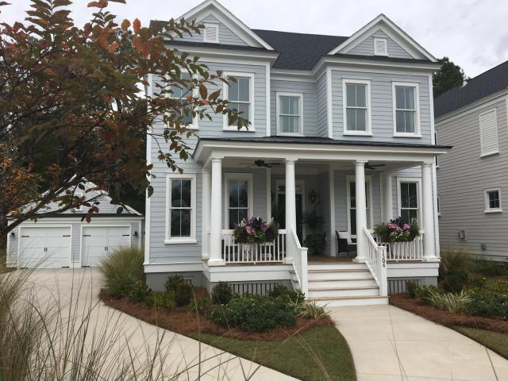
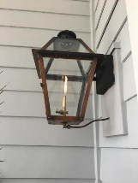
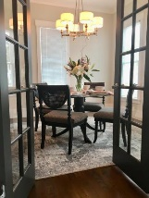
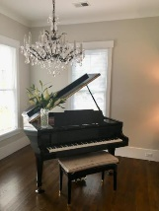
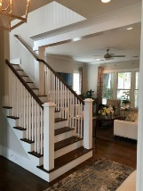
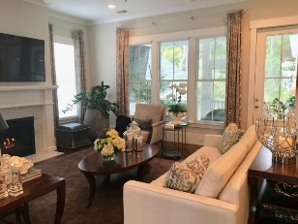
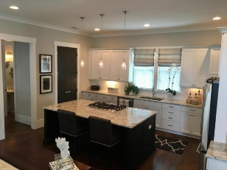
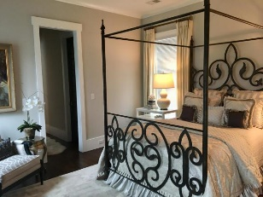
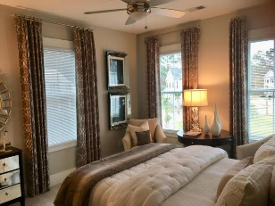
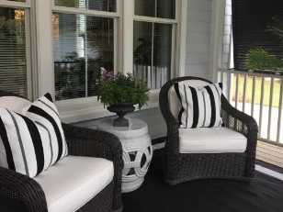
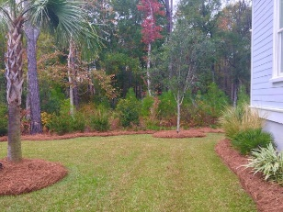

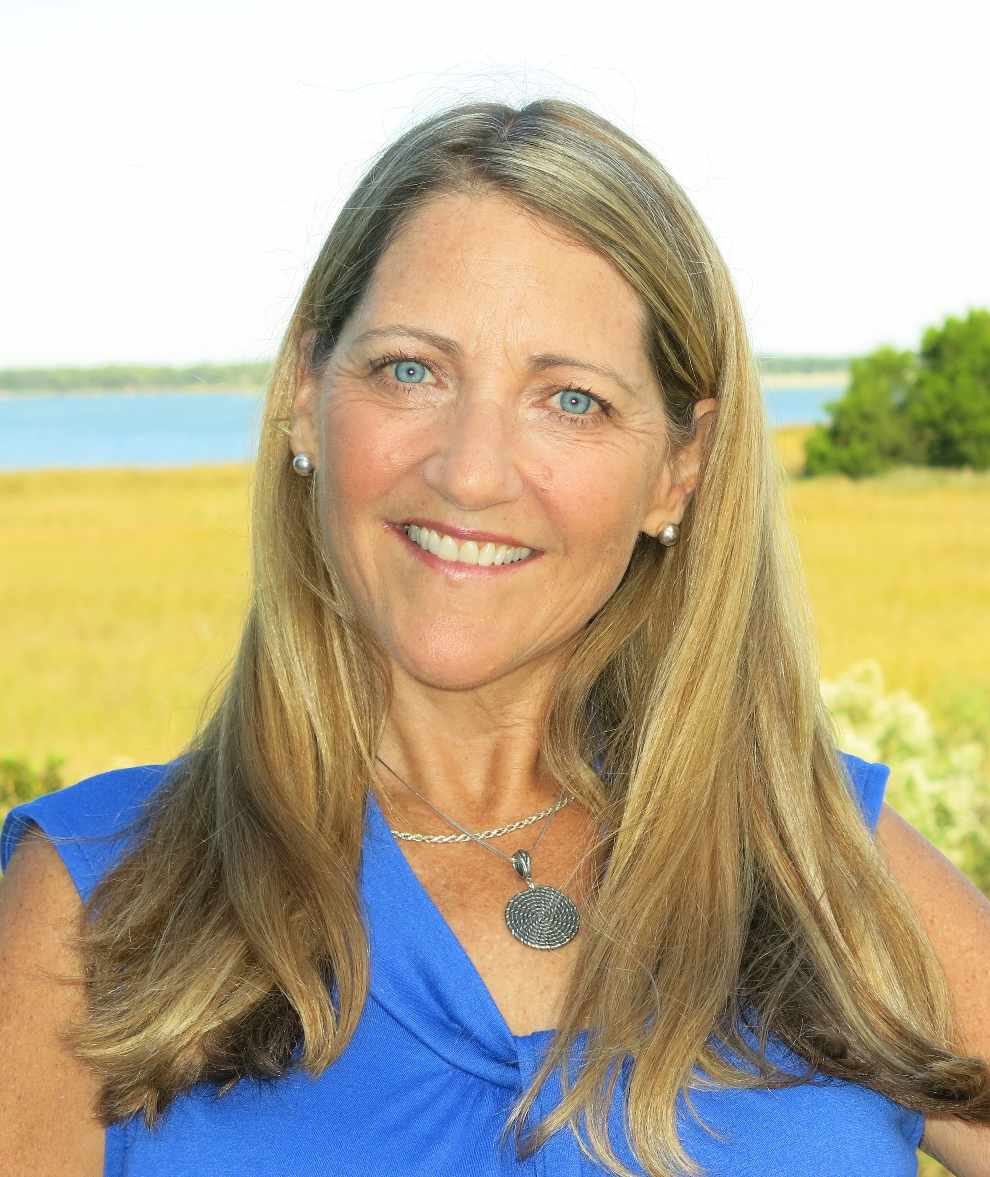
** LUNCHEON this THURSDAY, 11:30 -2 ** Hall’s Gift certificate drawing! 1504 Riverlight Lane, Carolina Park, Mt. Pleasant from Carolina Park Blvd take right on Fifle, left to Riverlight - not in GPS PLEASE RSVP pmorse@carolinaone.com 843-860-4953
Riverside Luxury Home REDUCED to $770,000
The floor plan, finishes, and signature workmanship by an award winning builder makes this home a stand-out and you'll feel it as soon as you step through the door. Set off with glass-paned French doors, the study and formal dining room grace either side of the foyer with the Great/family room ahead. The layout is both open and private with 2 extra rooms to suit your needs. And just as you want - -the Family Room and "show case" kitchen (w/Butler's Pantry and over-sized island) share half of the main floor. A private hall leads to the Master Suite overlooking the back yard. Upstairs holds 3 bedrooms, a bonus room, 2 full baths and an open area for relaxing or a study spot. Neighborhood amenities include pool, play gound, tennis, biking and walking trails. Award winning schools, childcare center, church, sports fields, professional offices and retail all within 1-2 miles of Carolina Park. Move-in ready with some furnishings for sale.
Peggy Flanagan Morse
Realtor, ABR (843) 860-4953 pmorse@carolinaone.com
www.peggymorse.com
Carolina One Real Estate | 2713 Highway 17 North | Mt Pleasant, SC 29466

