Slide 1
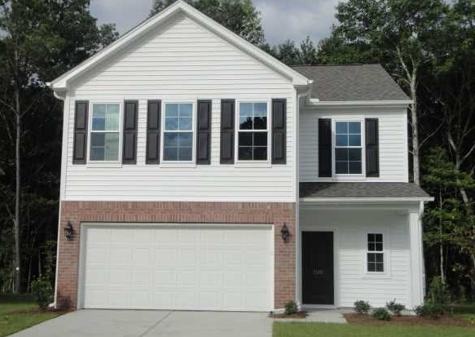
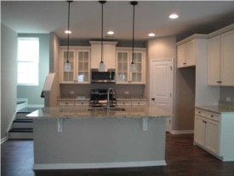
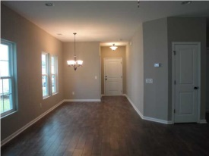
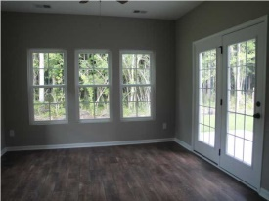
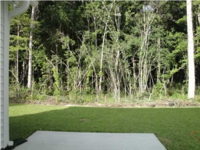
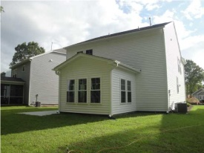

Beautiful New Home in Tupelo
This home is a Must See!!
1505 Oldenburg Dr
Tupelo - Mt Pleasant - MLS# 1423090 - $339,900
Brand new, beautiful home, never been lived in! This house is in a wonderful new development just 1 mile from Carolina Park. It's full of upgrades and backs up to protected wetlands so it's very private. Home has gorgeous upgraded, wide plank laminate wood floors throughout first floor and wood floor staircase, plus tile in all baths and laundry room. On main level is half bath, dining area, family room with gas fireplace, and beautiful open kitchen with large counter height island. Kitchen has large pantry, upgraded antique white cabinets with trim as well as some glass front, granite countertops, stainless appliances and under mount sink in the island. There is also a large sunroom with French doors leading out onto patio in wooded backyard. Upstairs you will find 3 large bedrooms plus a large loft, all with walk in closets and ceiling fans. You also have a large walk in laundry with linen closet. Master bath has double vanities as well as a luxury tile shower with dual heads and a corner seat. Master closet is huge!! 2nd Bath upstairs has double sinks and lots of room to spread out. This house is light and bright and has tons of storage; it has been beautifully done! No work to be done, move in and enjoy!
Angela Armstrong
843-224-2595
angela.armstrong2010@gmail.com

