Slide 1
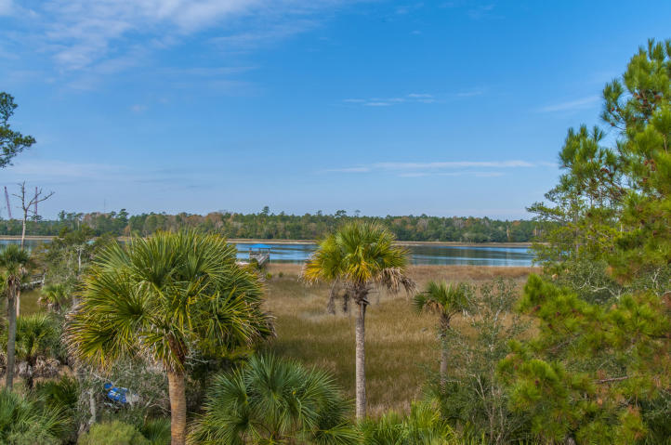
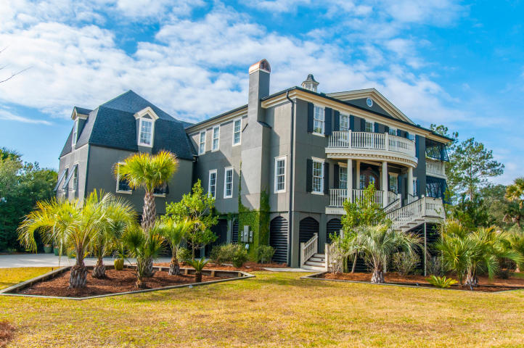
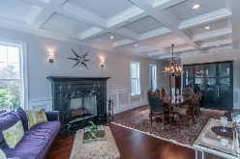
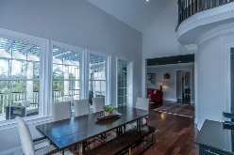
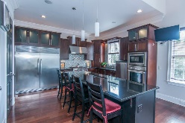
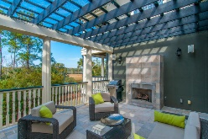
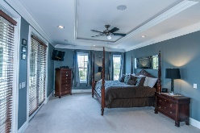
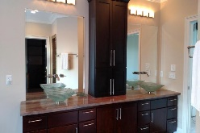
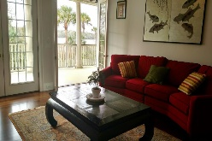
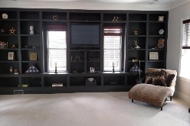
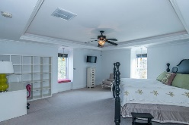
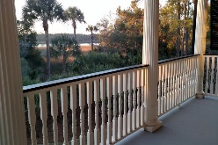
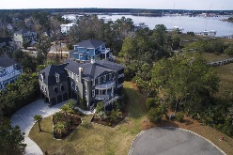
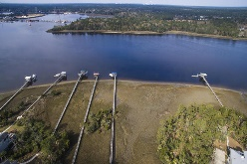


1505 Spring Line Drive Dunes West Mount Pleasant MLS# 16002620 $1,500,000
Classic antebellum architecture modeled after a mansion in historic Charleston
Unique roof elements, bowed front porches & rails, arched front door, & waterside piazzas will charm all. Continue to be impressed inside where the main floor has cathedral and 12 ft. coffered ceilings, exquisite moldings and mill-work, and cherry floors. Kitchen equipped with a Wolf 6 burner stove, Thermador oven, sub-0 fridge, wine cooler, separate ice maker, and 2 dishwashers as well as 1 in Butler's Pantry. Porch extends from the kitchen compete with a built in fireplace overlooking the water. Unwind on your own private piazza off the Master. Onyx, slate, hard woods, 5 ft. jacuzzi in MBA leads to XL dress-in closet. Surround sound, cable and dimmers throughout including outdoor areas. Deep water at all times allows unlimited access to Charleston Harbor, area beaches and beyond. Award winning schools. Premier private community featuring protected marshlands and creeks flush with beautiful views and wildlife. Miles of paved walking trails; pools, tennis, golf and club, fitness center, and private boat launch and storage. Twenty minutes to airport.
Peggy Flanagan Morse
Realtor, ABR (843) 860-4953 pmorse@carolinaone.com
www.peggymorse.com
Carolina One Real Estate | 2713 Highway 17 North | Mt Pleasant, SC 29466

