Slide 1
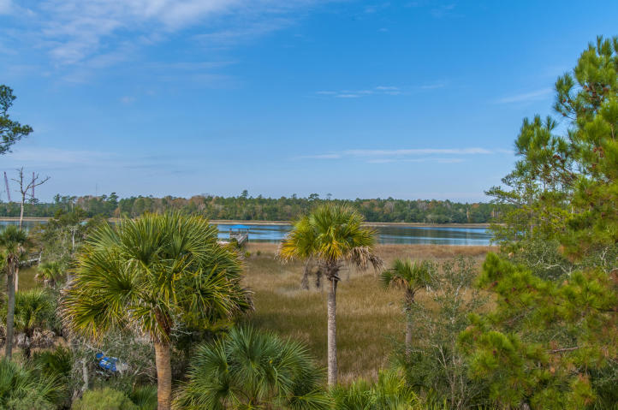
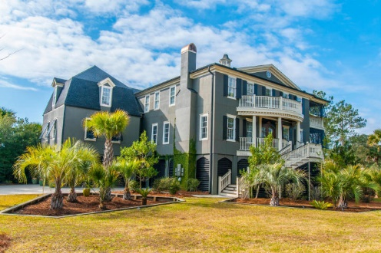
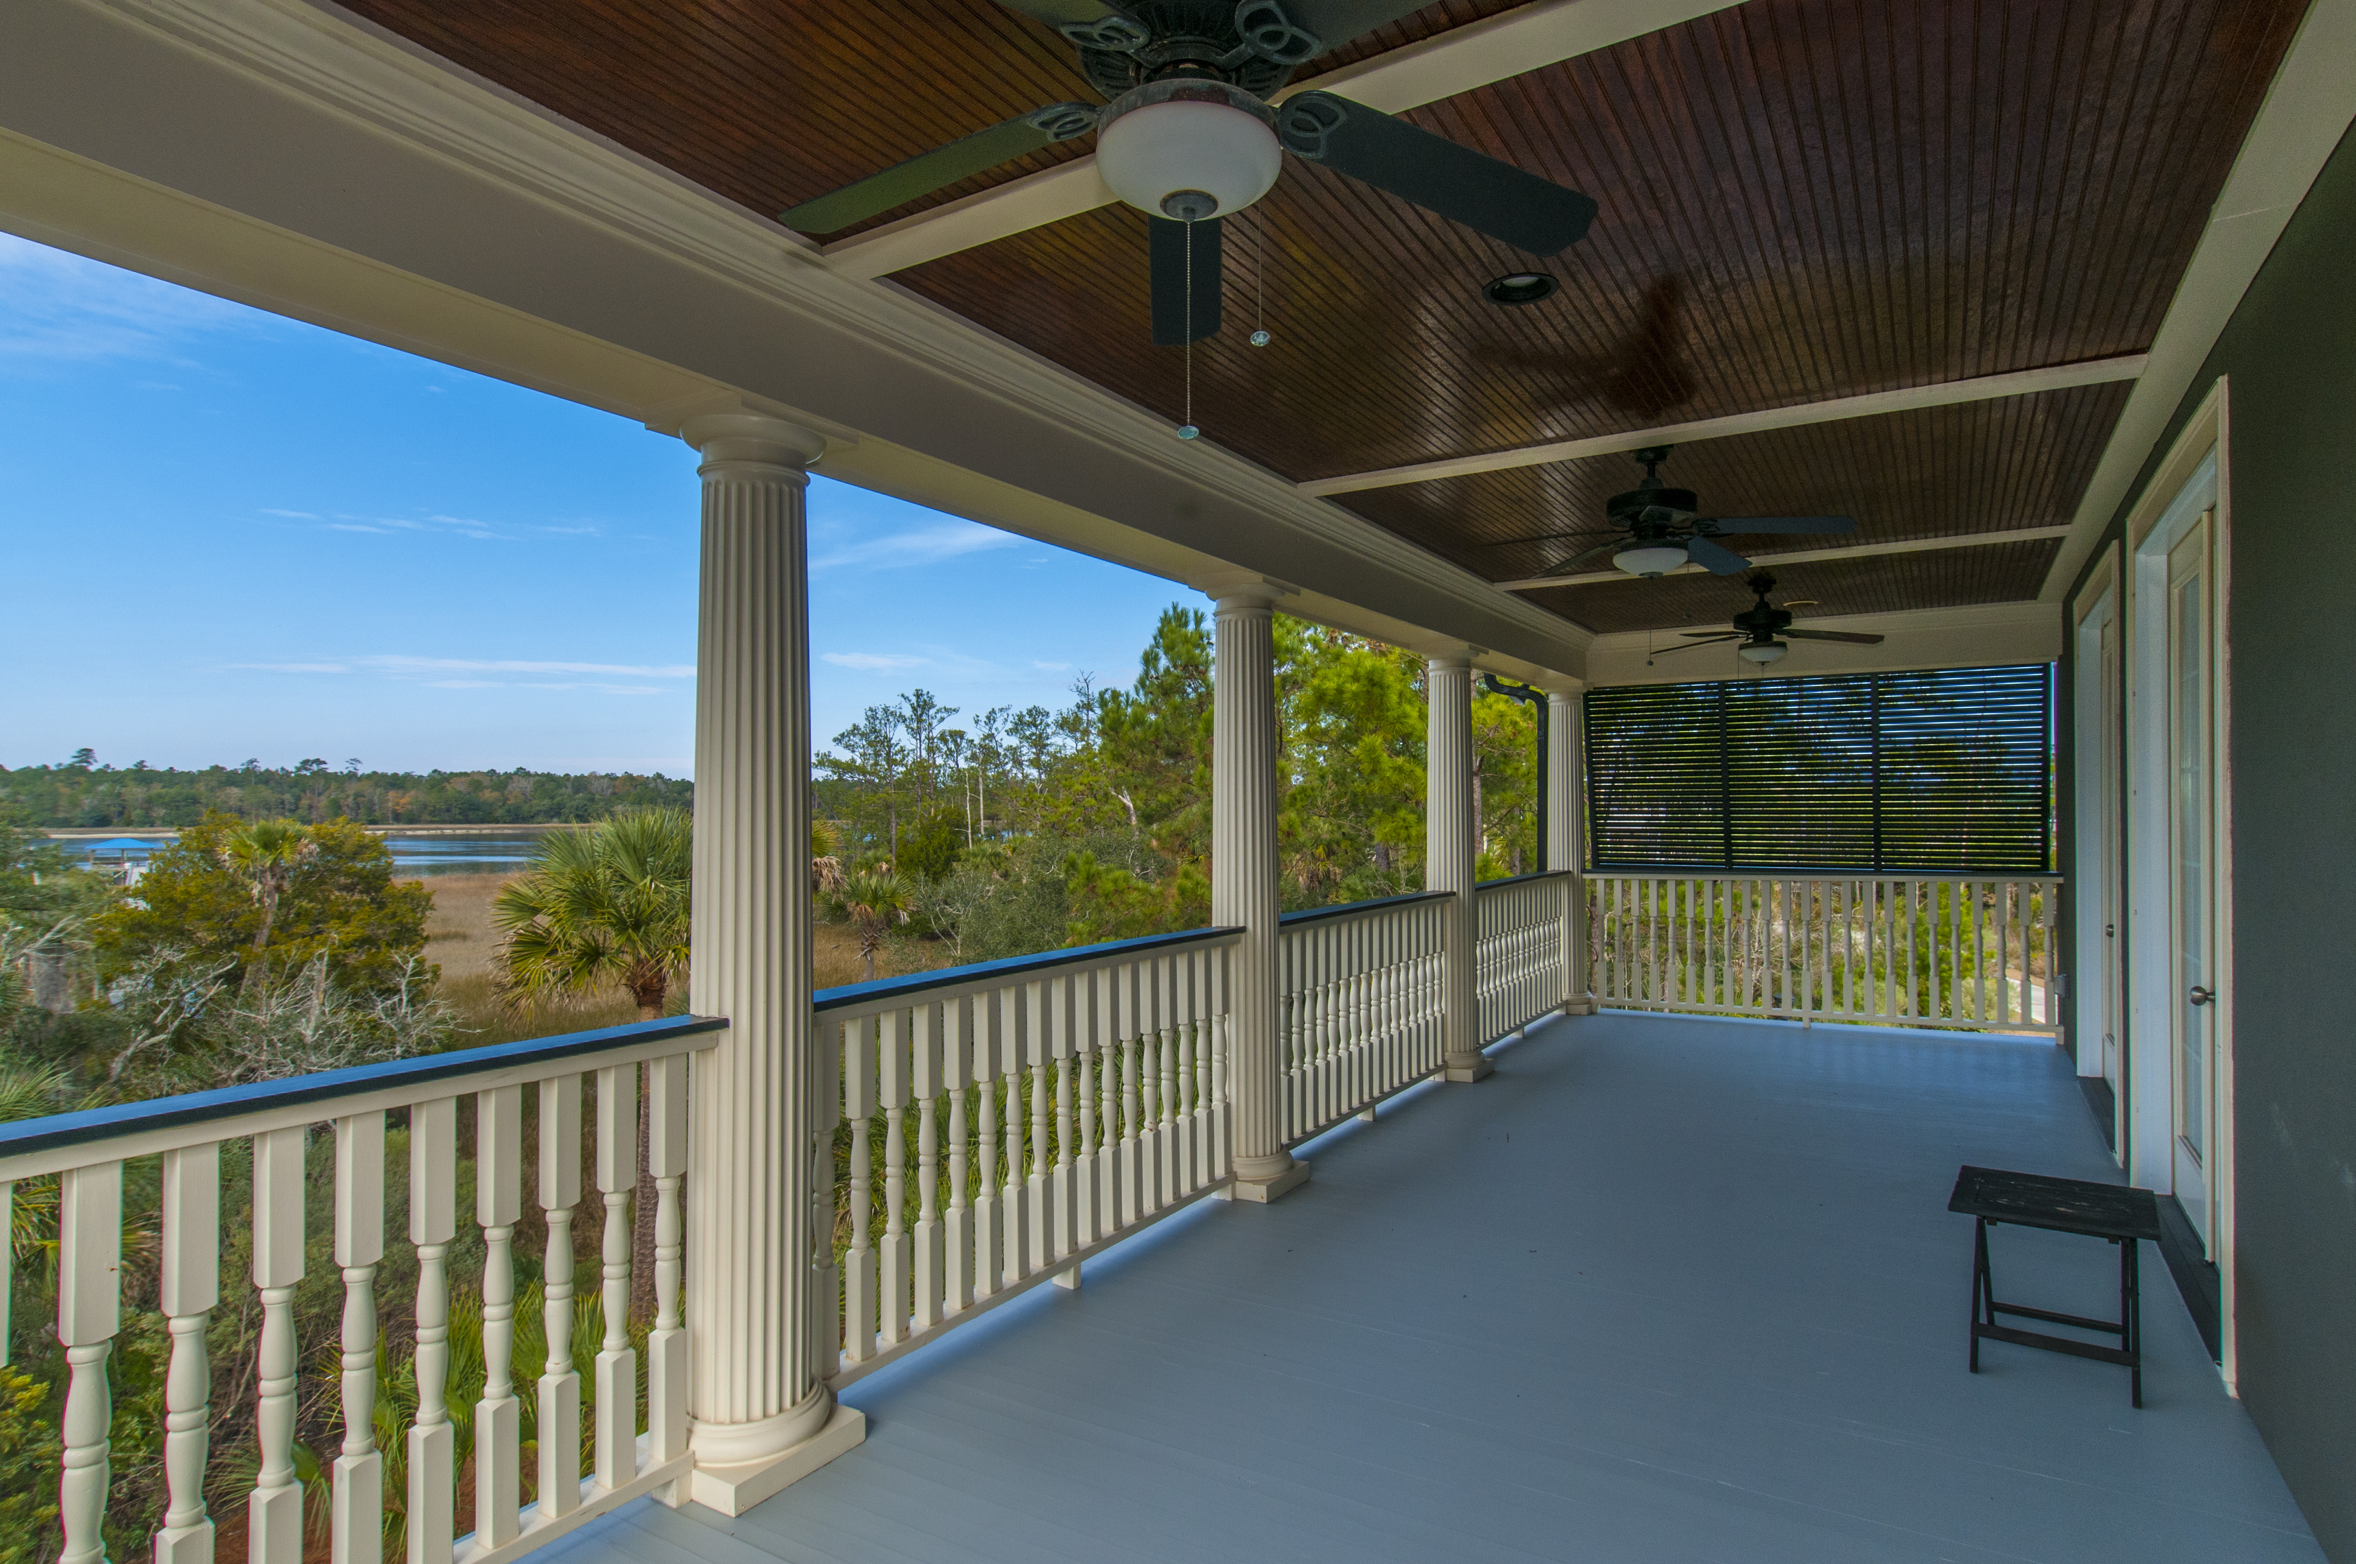
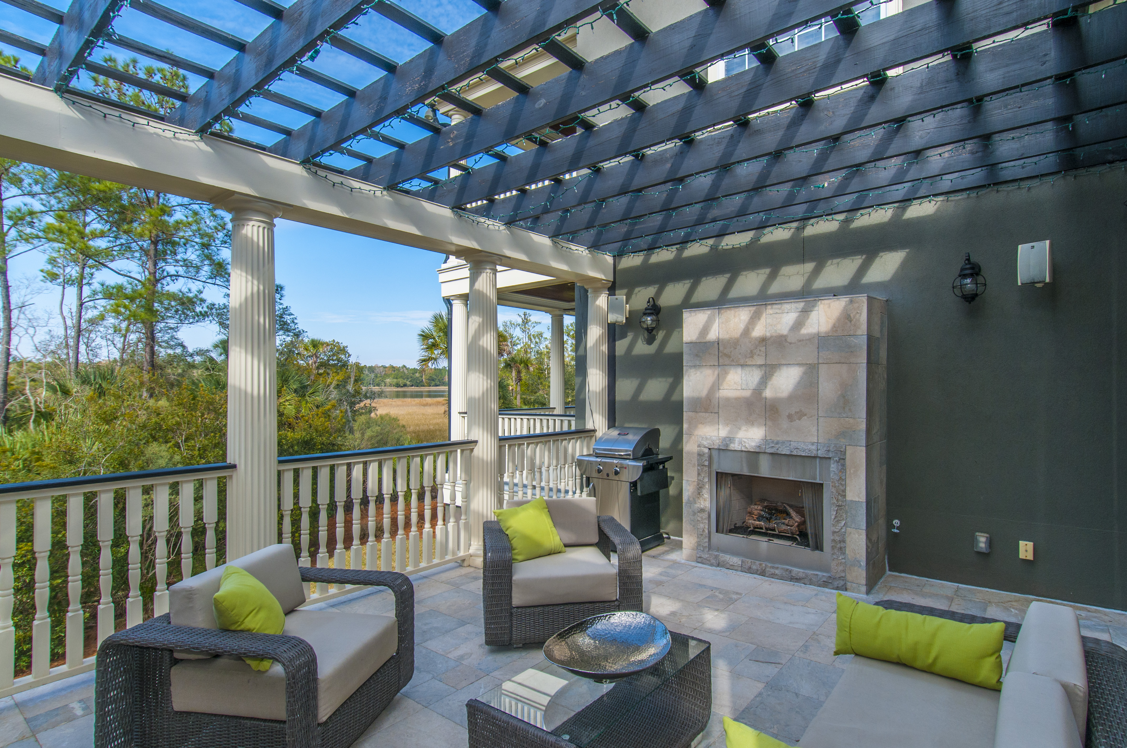
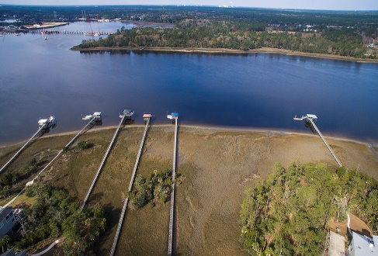


1505 Spring Line Drive
Dunes West
Mount Pleasant
MLS# 16002620
$1,250,000
NOW WITHIN REACH!!
If you haven't already seen this STATELY and MODERN home on DEEP WATER WANDO, you and your clients have another reason to FALL IN LOVE:
Seller motivated at $ 1,250,000
Schedule your visit TODAY through Showing Time.
Unique roof elements, bowed front porches & rails, arched front door, & waterside piazzas will charm all. Continue to be impressed inside where the main floor has cathedral and 12 ft. coffered ceilings, exquisite moldings and mill-work, and cherry floors. Kitchen equipped with a Wolf 6 burner stove, Thermador oven, sub-0 fridge, wine cooler, separate ice maker, and 2 dishwashers as well as 1 in Butler's Pantry. Porch extends from the kitchen compete with a built in fireplace overlooking the water. Unwind on your own private piazza off the Master. Onyx, slate, hard woods, 5 ft. jacuzzi in MBA leads to XL dress-in closet. Surround sound, cable and dimmers throughout including outdoor areas. Deep water at all times allows unlimited access to Charleston Harbor, area beaches and beyond. Award winning schools. Premier private community featuring protected marshlands and creeks flush with beautiful views and wildlife. Miles of paved walking trails; pools, tennis, golf and club, fitness center, and private boat launch and storage. Twenty minutes to airport.
Peggy Flanagan Morse
Realtor, ABR
(843) 860-4953
pmorse@carolinaone.com
www.peggymorse.com
Carolina One Real Estate | 2713 Highway 17 North | Mt Pleasant, SC 29466

