Slide 1
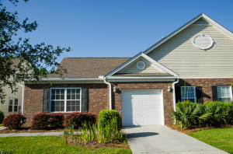
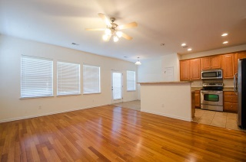
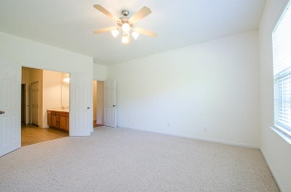
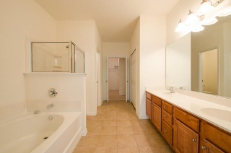
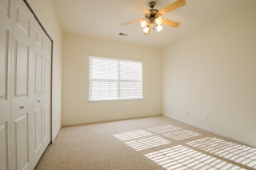
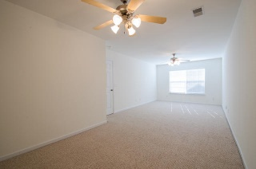
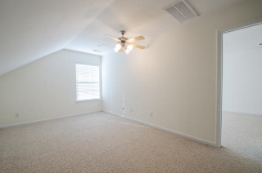
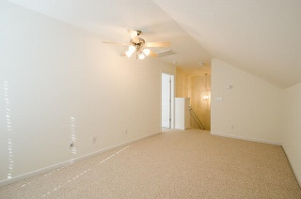
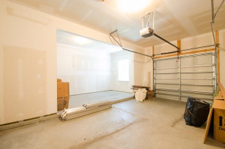
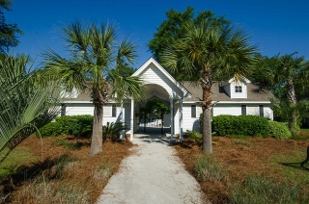
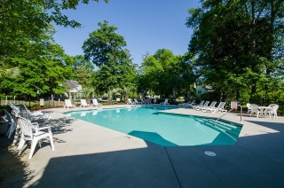


1507 Royal Colony Road The Gates of Fenwick Plantation - Johns Island - MLS# 15012918 - $287,500
Great Value in Great Location
Beautiful, spacious Fenwick townhouse is conveniently located near downtown, Folly Beach, Kiawah and Seabrook. This floor plan is fantastic and so versatile for any family situation. Enter into the open foyer which spills into the large dining room. Open to the living area is the well appointed eat in kitchen with more than ample space for preparing your meals. You will be amazed at the living area this unit offers with the very private dual master suites with multiple closets and open, spacious attached bathrooms. Two additional large bedrooms are on the first floor as well as a huge laundry room and full bathroom. Continue upstairs to another room that is ideal for an office, playroom, or a sitting room. Adjoining this room is the upstairs master suite which extends the length of the unit. The space lends itself to not only a bedroom but a sitting area or small office as well! This open, bright townhouse also includes hardwood flooring throughout the dining room, great room, and kitchen, smooth ceilings, and tremendous amount of storage space. This home has so much living space inside, but it also offers the opportunity to enjoy the outdoors as well. Enjoy relaxing at the end of the day on the back deck which backs up to a wooded buffer and watch for wildlife. Walk to the neighborhood pool or take a bike ride and enjoy the marsh views. This unit is a wonderful opportunity to enjoy living at its best in the Low country...
Peggy Leete Office - (843) 884-1622
Cell - (843) 532-7923
pleete@carolinaone.com
www.peggyleetehomes.com
Carolina One Real Estate
628 Long Point Rd
Mt Pleasant, SC 29464

