Slide 1
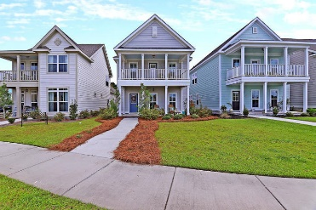
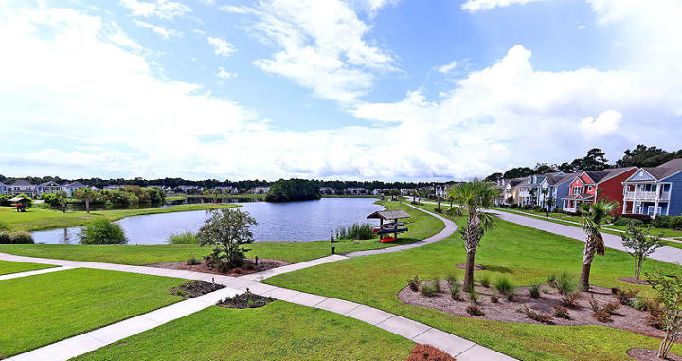
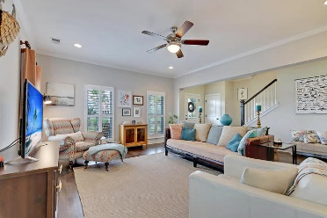
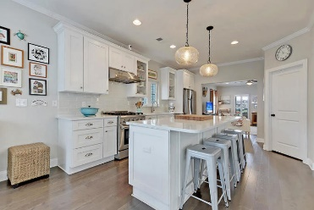
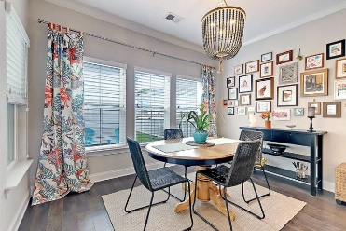
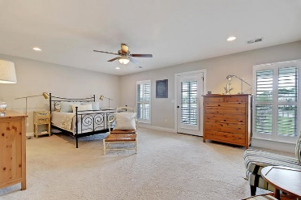
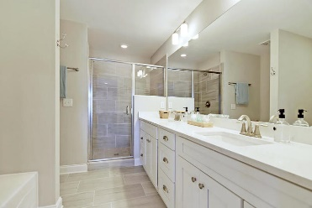
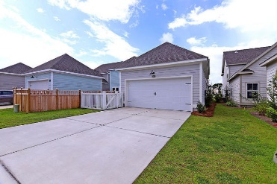
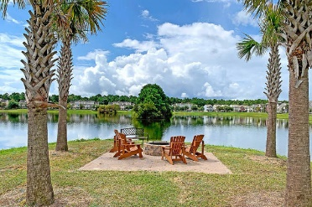

1507 Star Flower Alley
Whitney Lake · Johns Island, SC 29455
MLS# 19025171 · $385,000
Gorgeous Listing
Amazing Views! Amazing Price!
GORGEOUS LAKE FRONT VIEWS, COZY and SPACIOUS Charleston-style 3 bed, 2.5 ba, "shows like new" 2017 built home with wonderful curb appeal, professional landscaping and stacked front porches that are perfect for rocking chairs to relax and enjoy the water views! Entering you are greeted with 5" dark hardwood floors throughout the entire first floor, 5 1/4 base boards, crown molding, plantation shutters, and an abundance of natural light. The living room is beautiful and leads into the CHEF INSPIRED GOURMET kitchen with a professional grade Thor ss gas range, Thor ss hood, HUGE quartz island, quartz countertops, 42'' cabinets, Bosch ss dishwasher, custom lighting, oiled bronze hardware and breakfast nook. The flex room is open to the kitchen and could be a formal dining room, or office. Walk upstairs to the master bedroom retreat that has a private deck perfect for enjoying a morning cup of coffee with beautiful unobstructed lake views, ensuite SPA-LIKE master bath featuring a relaxing soaking tub, tiled shower w/ tiled shower floor, dual sink vanity with quartz counters, Moen nickel fixtures and two walk-in closets-a must see to fully appreciate! There are two additional nicely sized bedrooms that share a full bath. Finishing off the second floor is a large laundry room. There is a private fenced backyard with covered breezeway, patio, grilling area that is wonderful for entertaining family and friends, and 2 car detached garage. Whitney Lakes in Johns Island is a wonderfully landscaped community with community lake! The neighborhood is close to local shopping and grocery stores and is a short drive to downtown Charleston with 5-star restaurants, world class shopping and iconic history as well as a short drive to the beaches, the airport, Boeing and Daniel Island. Come take a look because you will not find another home that offers as much as this one: a chef's delight, unobstructed lake views, and entertainer's dream!
Stan Huff
843-670-2835
stan.huff@agentowned.com
Jill Marcacci
843-297-5590
jill@agentowned.com
www.agentownedrealty.com
AgentOwned Realty Co. Preferred Group, Inc. | 824 Johnnie Dodds Blvd | Mt Pleasant, SC 29464

