Slide 1
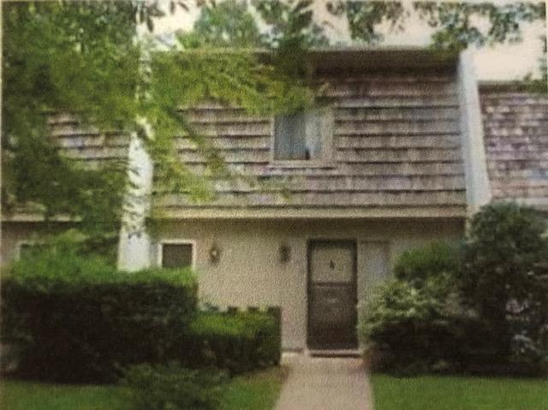
Snee Farm Rental
1507 Ventura Place
Mount Pleasant, SC 29464
MLS# 19017115 ~ $1,295
Spacious 3 bedroom 2.5 bath condo with views of the golf course. Available NOW! TENANTS TO VERIFY SCHOOLS. As is at the current rental price.
Bonnie Miller
843.884.3901 O ~ 843.693.2647 M
bcm.olddom@gmail.com
Old Dominion, REALTORS · 890 Johnnie Dodds Blvd · Mt Pleasant, SC 29464

