Slide 1
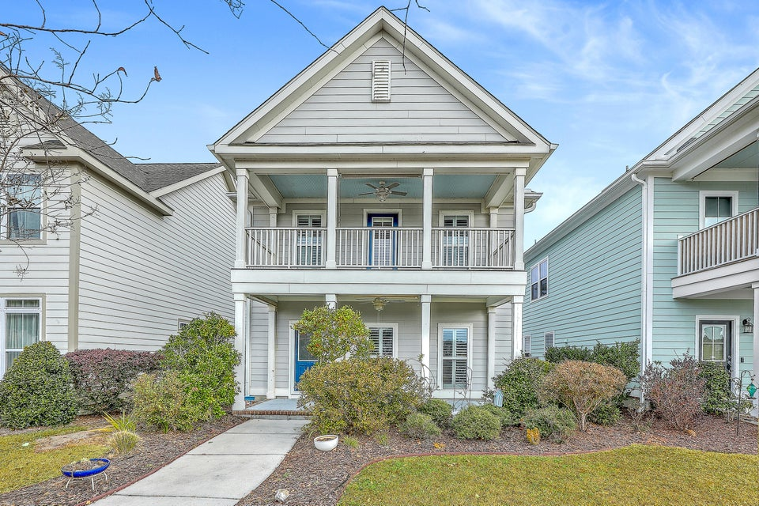
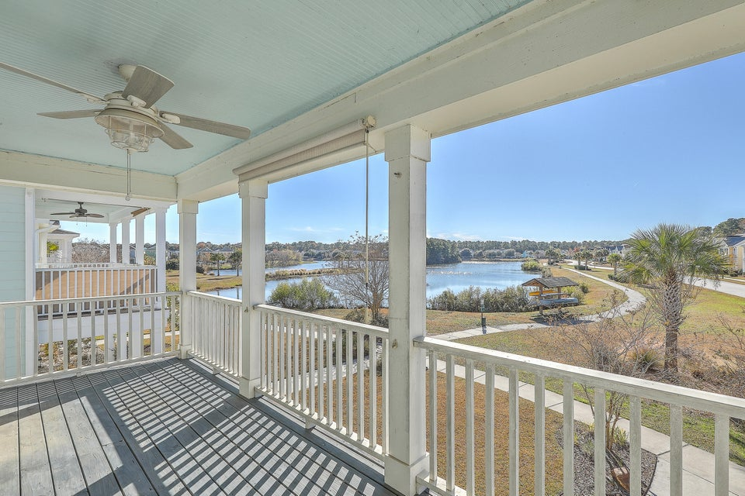
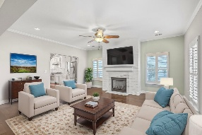
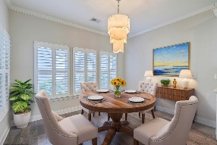
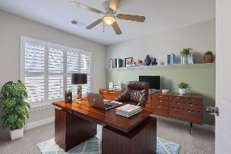
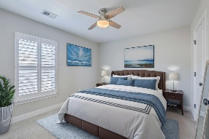
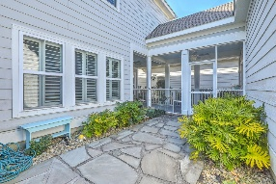
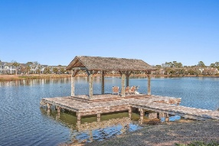


Open House
Saturday from 12-2
Michael Moseley
843-442-0959
michaelsmoseley@gmail.com
charlestonrealestateandgolf.com
1507 Star Flower Alley
Brand New Flooring!
Whitney Lake | Johns Island, SC 29455 | MLS# 24030297
$639,900 $629,000
Offering 3% BA
Built in 2017 by Southeastern Homes, so quality is second to none
Enjoy Waterfront Living Right Out Your Front Door
Generac Generator, So You Never Lose Power
TAKE A VIDEO TOUR
Carolina Elite Real Estate | 1081 East Montague Ave | N Charleston, SC 29405

