Slide 1
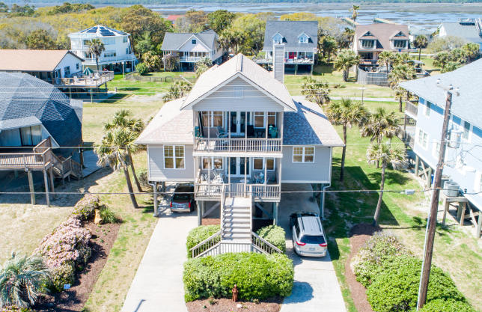
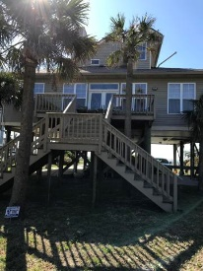
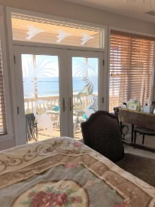
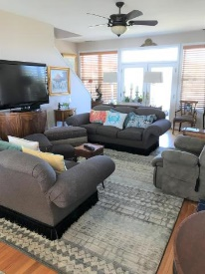
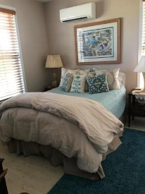
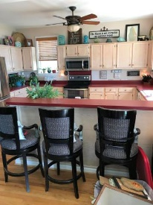
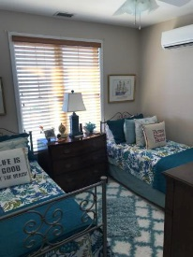
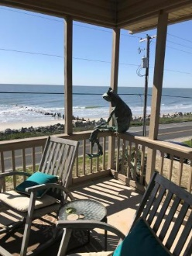
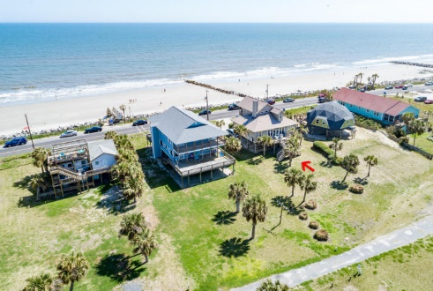
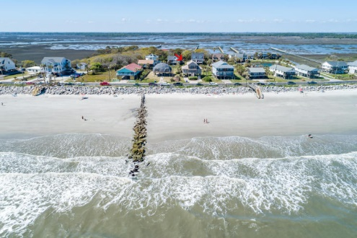
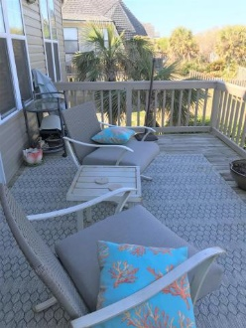

1508 E Ashley Avenue Folly Beach, SC 29439 ~ MLS# 18009017 Major Price Reduction! $1,200,000
Open House Friday 9/21 From 1-3pm
Rare opportunity to own across from the WASHOUT with UNOBSTRUCTED VIEWS.
Enjoy the beach life, with spectacular sun rises and sun sets. The house is built on pilings with covered ground level parking, outside shower and ready room. 1st floor has an open floor plan featuring a large deck overlooking the ocean. Gas fireplace in living room. Beautiful hardwood floors throughout. The 2nd floor OCEAN VIEW Master suite, has spectacular views from the balcony overlooking the Atlantic Ocean. Recent upgrades include, new roof, new siding and ductless A/C installed.
Fred McCutcheon
(843) 608-8490
fred.mccutcheon@agentownedrealty.com
Steven Olson
(843) 412-9848 – M (843) 769-5100 – O
solson1071@aol.com
AgentOwned Charleston Group
902 Savannah Hwy
Charleston, SC 29407
www.agentowned.com

