Slide 1
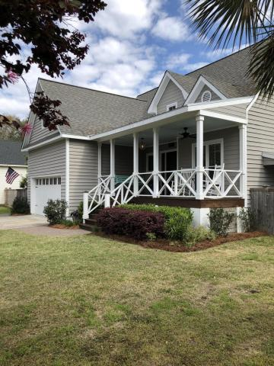
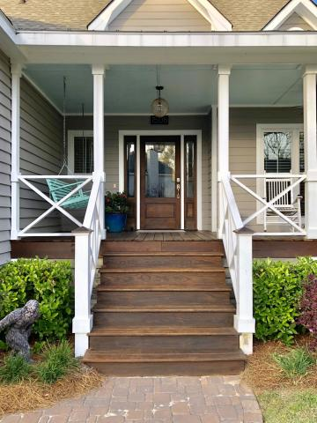
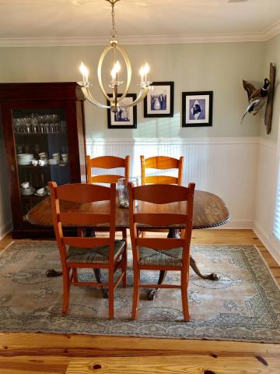
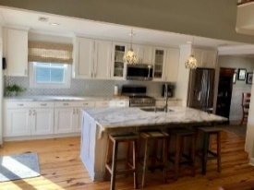
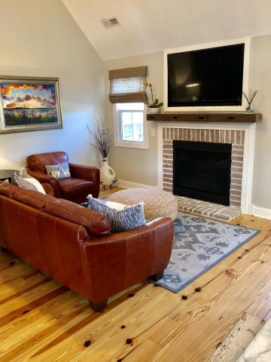
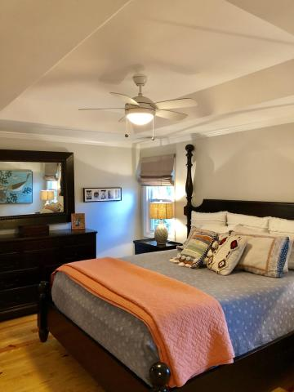
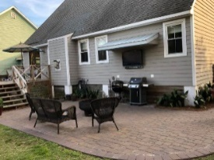


1508 Old Village Dr
Old Village Landing
Mt Pleasant
MLS# 19008699
$699,000
Price Reduced To $1,075,000!
Plus Sellers Offering A $25,000
Allowance To Buyer
W/ Acceptable Offer!
Open House
Saturday, April 13th
11:00-1:00
Don't miss this one! Fully renovated 4 Br/2.5 bath home in Old Village Landing. Short walk to award winning Mt. Pleasant Academy, Pitt Street Bridge and restaurants. The house lives large and is set up for entertaining and easy living! As you enter the formal dining room notice the bead board and hardwood floors throughout. The kitchen is a chefs dream! Stainless appliances, double oven, designer back splash and cabinets. The living room has a gas fireplace with Charleston brick surround and tall ceilings. The master suite is downstairs with a walk in shower, double vanity and a large closet. Upstairs-three bedrooms, full bathroom and plenty of storage. Outside paved walkway, grilling patio, covered TV, shower, boat storage, above ground pool. Updated/replaced HVAC, electric, plumbing.
Bring your buyers!!!
Mac Jenkinson
M (843) 224-0210
mac@carolinaone.com
Beth Moore
M (843) 532-4892
bmoore@carolinaone.com
www.jenkinsonandmoore.com
Jenkinson & Moore, LLC | Carolina One Real Estate | 1503 Palm Blvd | Isle of Palms, SC 29451-2280

