Slide 1
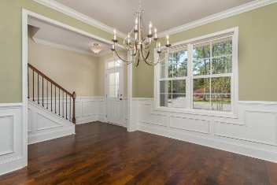
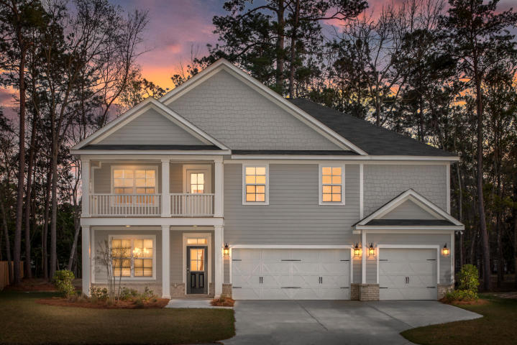
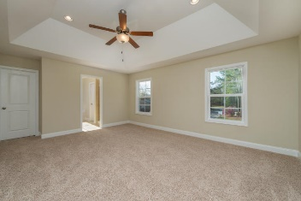
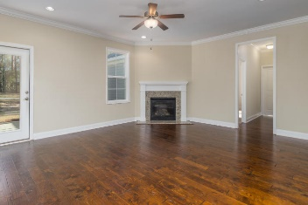
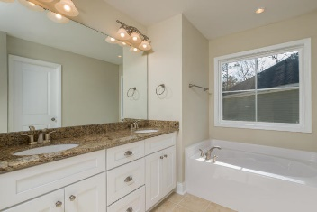
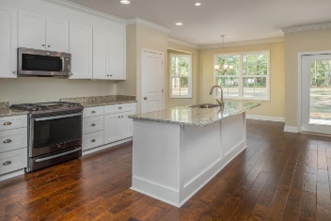
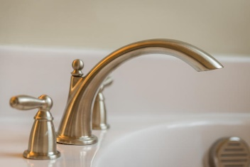
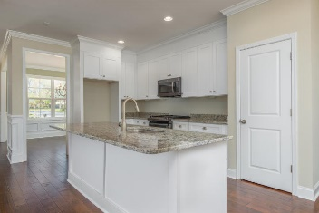
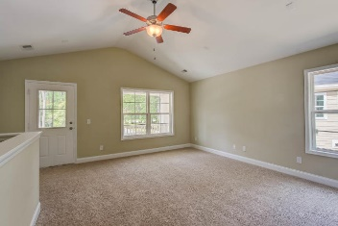
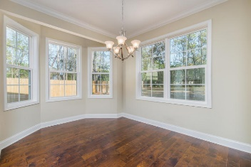
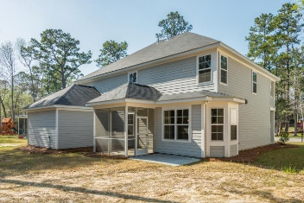

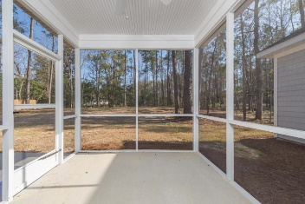
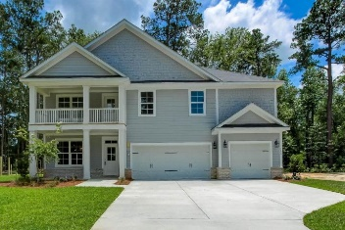
1509 Jahnz Court
Salisbury Acres :: Summerville, SC 29485 :: MLS# 18000900 :: $400,000
New
Construction
Ready Now (New Home) – Welcome to 1509 Jahnz Ave. This 5 Bedroom, 3.5 Bathrooms, with a 3 Car Garage home has all the upgrades. Lowcountry living at its best! The homesite is on Over a Half Acre which is extremely hard to find on New Construction Homes in Summerville. The features include 5” Hardwood Floor in the Foyer, Dining Room, Kitchen, Family Room and Hardwood Stair Treads leading up to the second level. Granite Countertops in the Kitchen and Bathrooms, a Screened Porch off of the Family Room, Gas Fire Place in the Family Room has a Granite Surround with a Custom Mantle. The Kitchen features Upgraded Gas Stove, Dishwasher and Microwave in the Black Stainless Steel finish giving a clean crisp high-end feel. Dual Owner’s Suite so a Full Owner’s Suites on the Main Level & a Full Owner's Suites on the Main Level and a Full Owner's Suite on the Second Level as well. Both Master Bedroom features Huge Walk-in Closets. Upstairs you'll find a Loft / Office / Study Area with Vaulted Ceilings, a 5.1 Pre-wired Surround Sound and a Structural wiring package that is Smart TV ready. There is a Balcony off the loft that overlooks the private Cul-de-sac. This is clearly the Best Value in Summerville and is located minutes from Historic Downtown Summerville, Shopping, Restaurants, Parks, and I-26. This home Is in the Dorchester II School District. Book your Showing today!
Chris Eller
EPRO, GRN, SFR, REALTOR, CRS
(843) 343-3359
iconicdevelopments@gmail.com
GFH Realty, LLC
498 Wando Park Blvd Suite 1125
Mt. Pleasant, SC 29464
www.gallowayfamilyhomes.com

