Slide 1
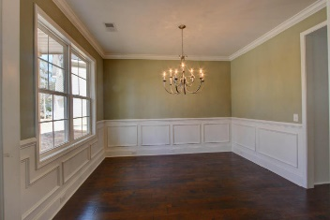
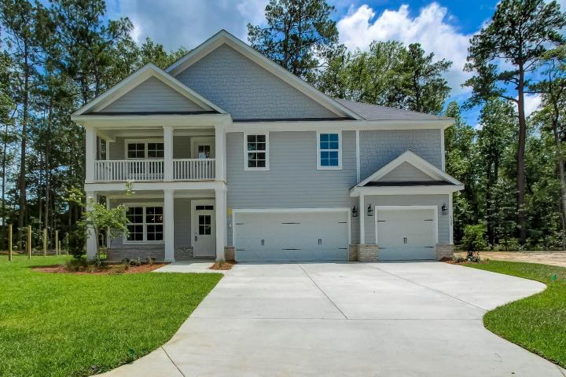
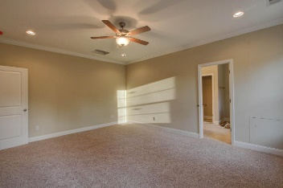
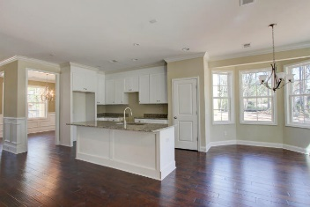
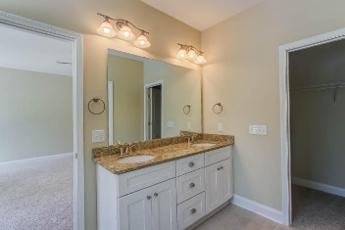
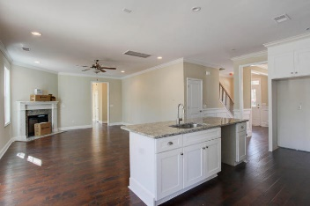
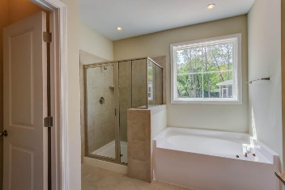
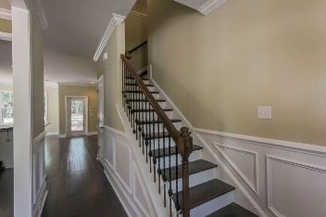
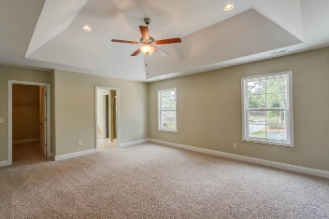
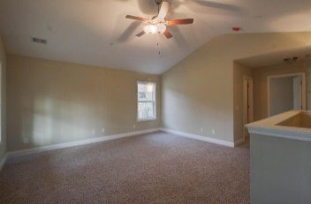
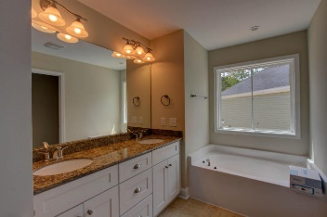

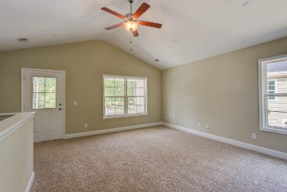
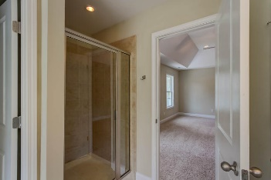
1509 Jahnz Court Salisbury Acres :: Summerville, SC 29485 :: MLS# 16031095 :: $399,990
Back on the Market!
OVER A HALF ACRE New Construction (Ready Now) Three Car Garage
No shortage of WOW in this gorgeous Salisbury Acres home! Brand New Construction 5 Bedrooms an office / study or Loft. Huge Backyard, 9' smooth ceilings on 1st floor with upgraded crown molding! Beautiful hardwoods in dining, kitchen, foyer, and staircase! 42" Maple cabinets in the kitchen! Granite! Granite! Granite! in the kitchen and all bathrooms! Dual Master Bedrooms with One Downstairs and One Upstairs with plenty of room for a sitting area. Large walk in closets! The MBR bathroom has upgraded features including his and her sinks, walk in shower and private toilet. The huge 2nd floor loft area is the perfect entertainment that leads out to the upstairs Balcony. Best Value you in Summerville and is located 5mins from Historic Summerville, Shopping, Restaurant, and Parks.
Chris Eller
EPRO, GRN, SFR, REALTOR, CRS
(843) 343-3359
iconicdevelopments@gmail.com
GFH Realty, LLC
498 Wando Park Blvd Suite 1125
Mt. Pleasant, SC 29464
www.gallowayfamilyhomes.com

